Slide 1
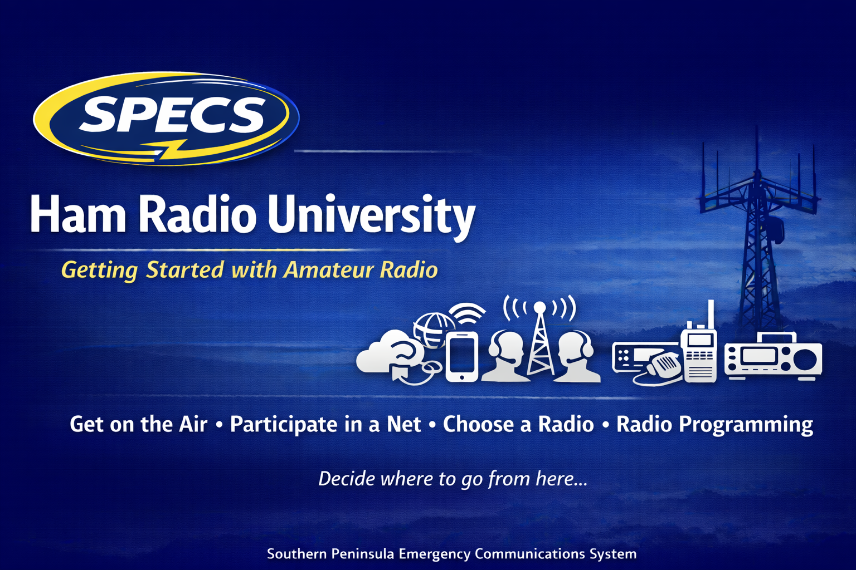
Elmering for Ham Radio University

Slide 2
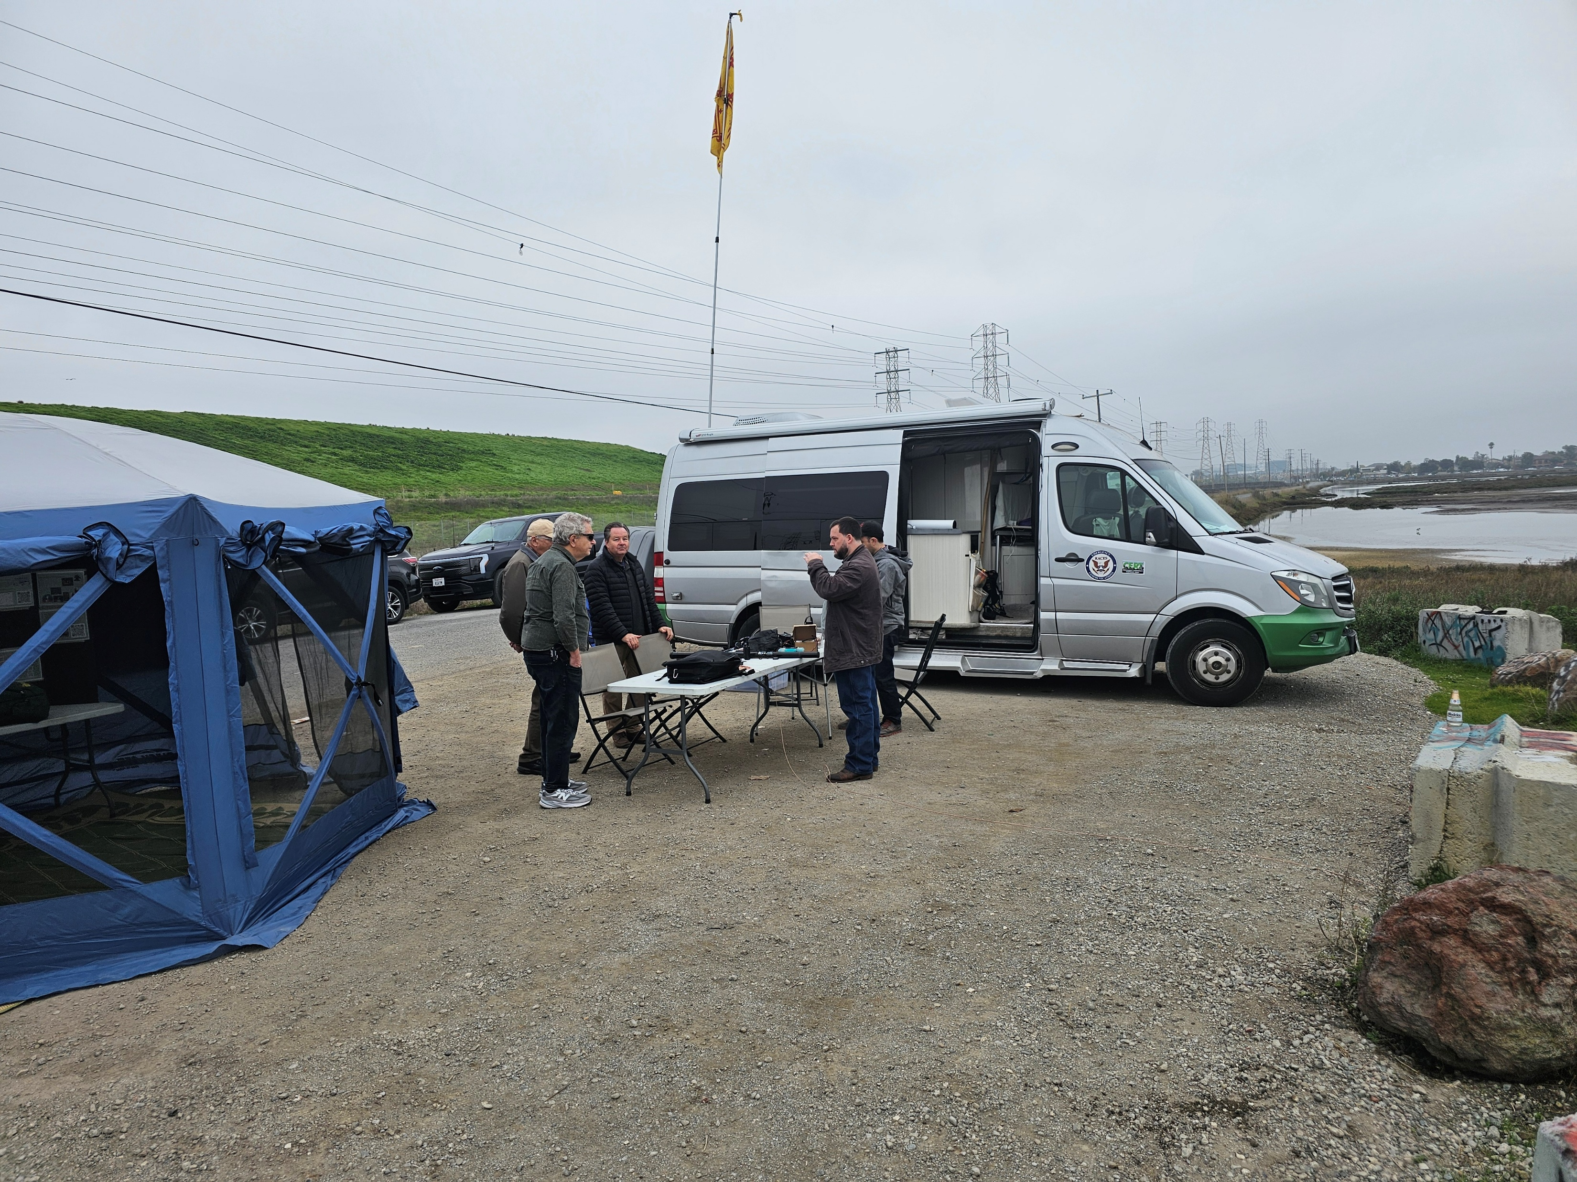
Overview
Why do we need Ham Radio University?
What is an Elmer?
Preparing for your first Mentoring
Meeting the new Ham
Engaging Newly Licensed Hams
Building Community
Shaping the future

Slide 3
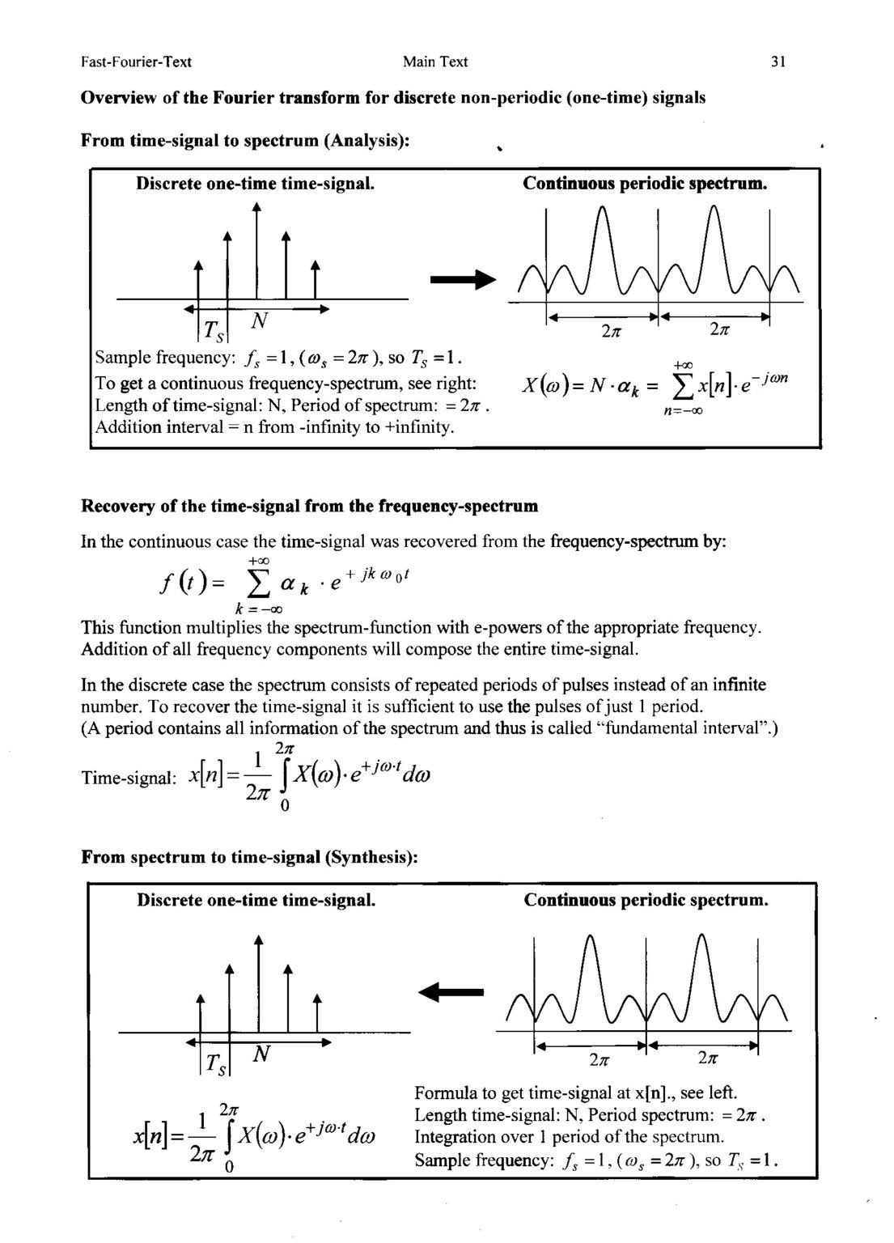
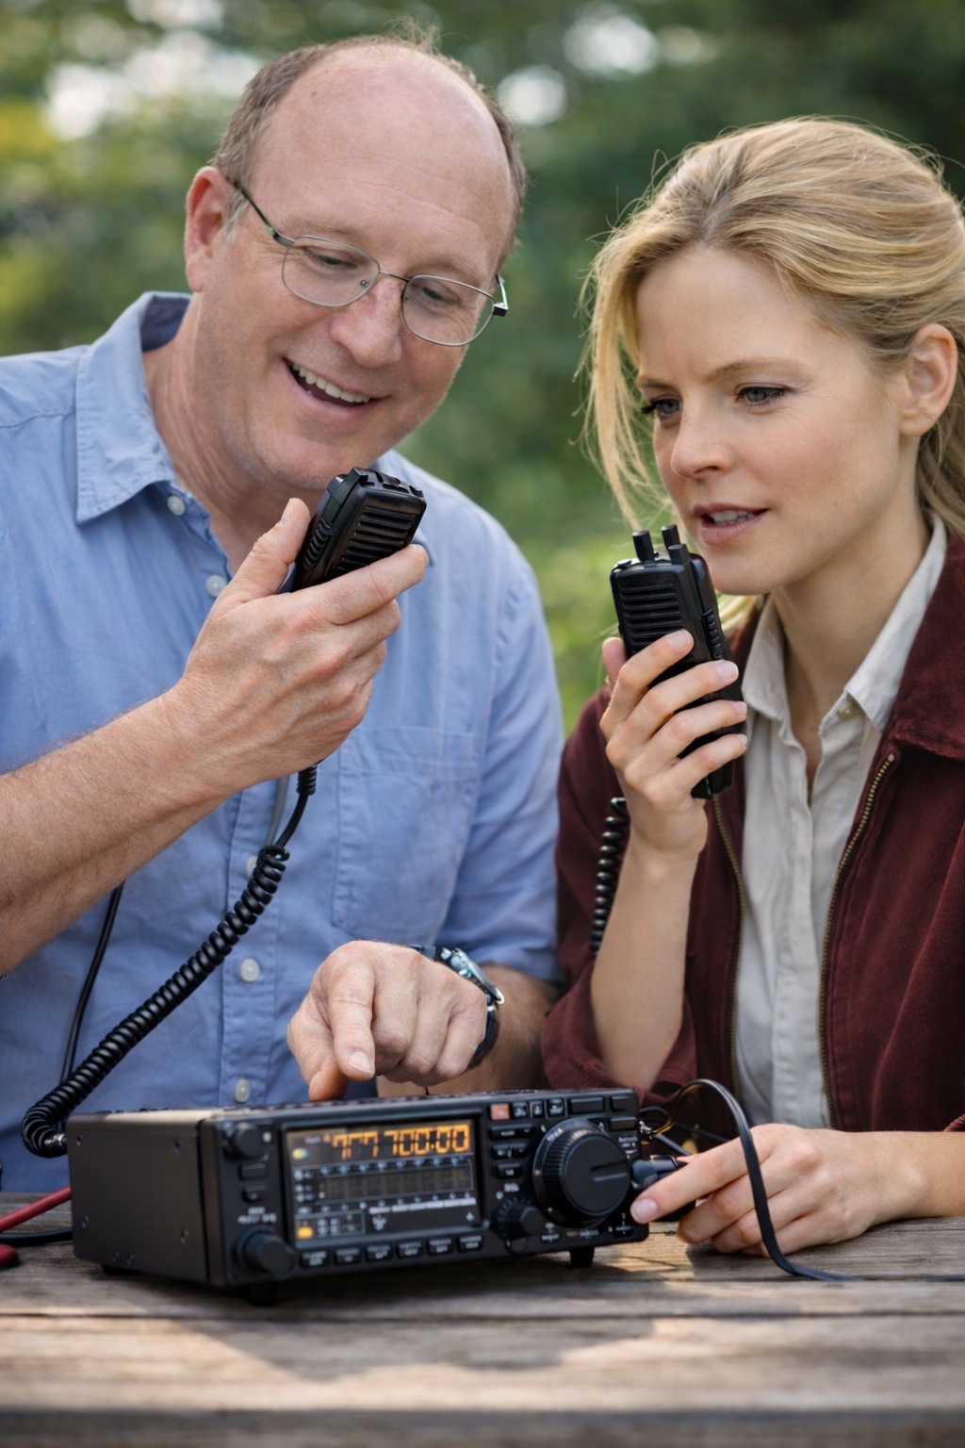
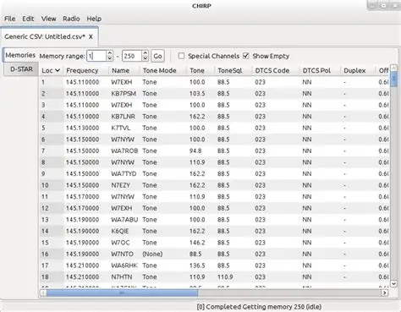
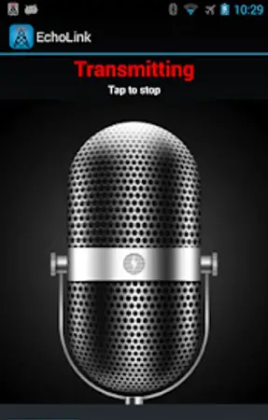
Why do we need Ham Radio University?
Ham Radio is Dying. We need a new generation of hams.
The current milieu of options for new hams are inadequate.
The basics might be obvious to you, but not to them.
We need to work together.
We need to train our Elmers too!
Notes:
1: Ham Radio is dying. We need a new generation of hams to take our place. The only way we will accomplish this is to engage new hams in the hobby, and eliminate the hurdles that have kept them for operating. Expecting new hams to learn all they need from YouTube is clearly not a viable solution. We need to get back to the basics of Amateur Radio: The Elmer. YouTube often features outdated information leading to frustration.
2: We do not have a structure specifically designed to welcome and engage new hams and connect them to Elmers. Club meetings often feature subjects of interest to very senior hams, but that are useless and scary to new hams. Contests and Field day are focused on the event, not on the new ham. Finding Elmers is intimidating and many new hams will just passively drift away. We need events tailored to their needs and interests.
3: YouTube may present some information that is generally useful, but will not help when specific information is required. Eg: Knowing how to connect to a repeater is useful, but if you are not aware of local Nets, many new hams reach only silence or static and give up. Getting new Hams connected to their local immediate resources is critical. Helping them understand the clubs in the area and connecting them to clubs that match their interests is also key. Somebody who is excited by POTA who goes to an ARES meeting is going to be frustrated.
4: Individual Clubs may lack the resources to handle an event for new hams especially if they only have one. Building a central hub for training new hams supported by all the clubs allows us to pool resources to support our new hams on a regular basis, not just during Field Day. We need to catch them while they are still excited by their new license and get them hooked.
5: It is not just new hams we need to train. Elmers need to work together to find the best ways to engage and train new hams. Ham Radio University gives us a forum to work on this. We need to provide ways to train old hams in new tricks…
((Yes. This is a creepy AI image))

Slide 4
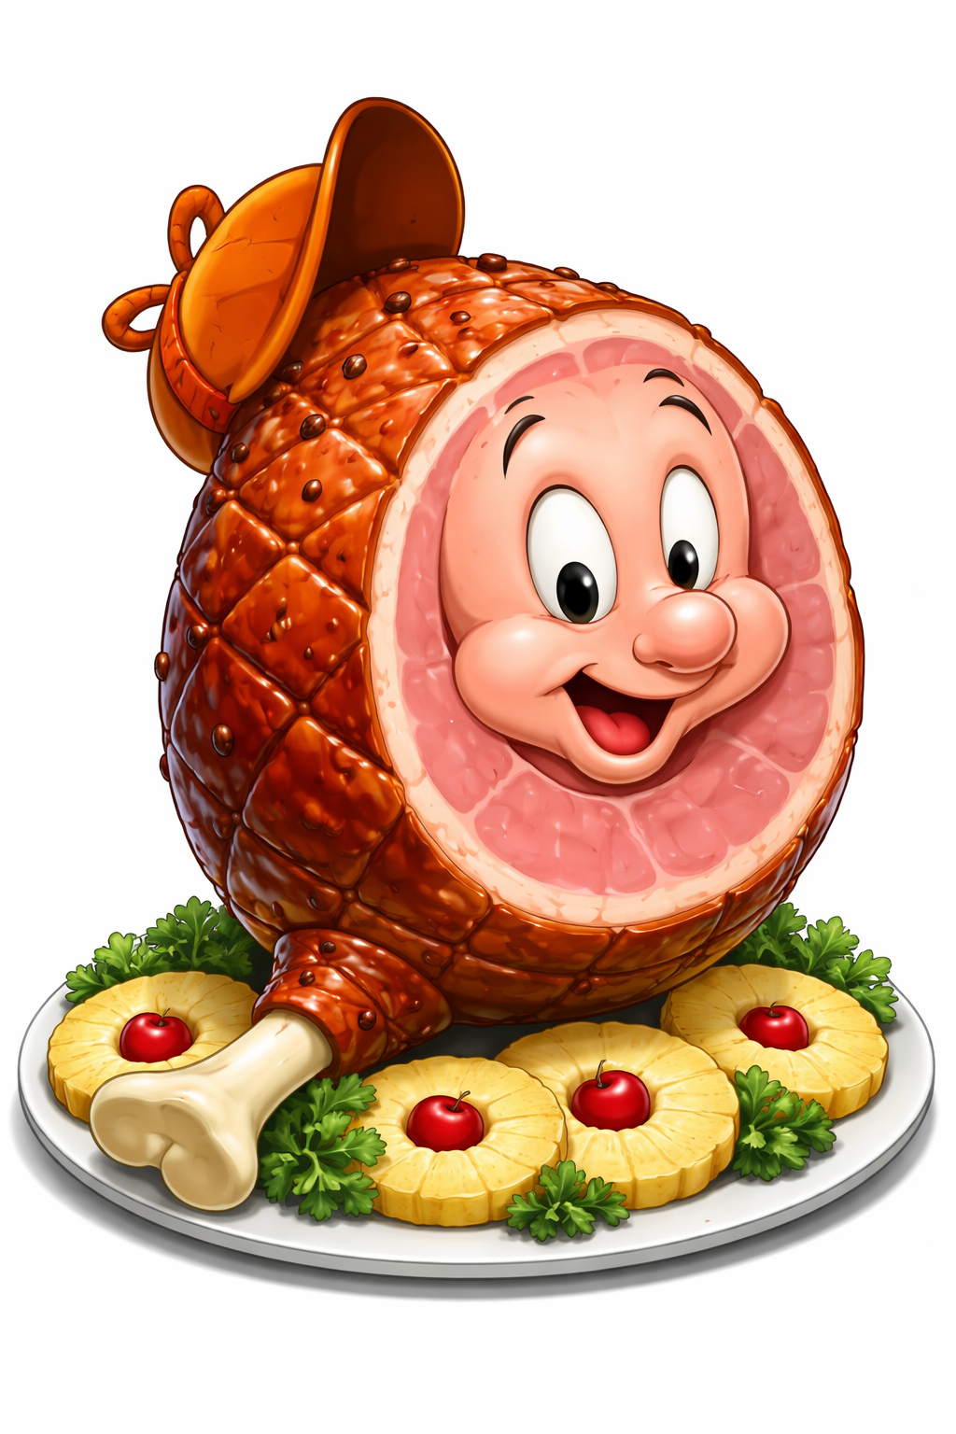
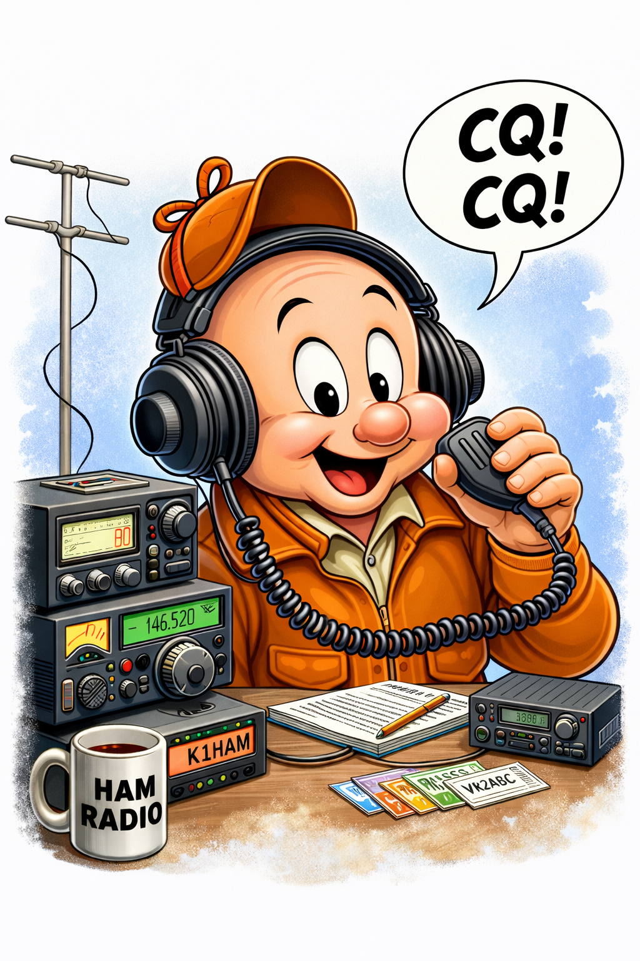
What is an Elmer?
In the world of amateur radio, an Elmer stands as a central figure, synonymous with guidance and wisdom. The term, unique to this community, refers to an experienced ham radio operator who volunteers their time to mentor newcomers.
These veterans play a vital role, passing down their knowledge and fostering the growth of the hobby.
What is an Elmer at Ham Radio University?
An Elmer is a generic term for a mentor. At Ham Radio University, we want Elmers to be prepared not just to be a generic font of wisdom, but to actually have a series of subjects they are prepared to handle, and that they offer to new students. I hope OUR Elmers will actually plan what they intend to teach, and even post what they are prepared to help with at the event. This helps us connect new hams to those who can actually help them, and to also offer ideas on subjects other experienced hams might benefit from! Eg: “What are ADIF files and how do you manage them?”. Winging it may not always be the best.
Notes:
The text above covers the basics, but we will get into more specifics about curriculum in a later slide. Don’t be afraid!

Slide 5
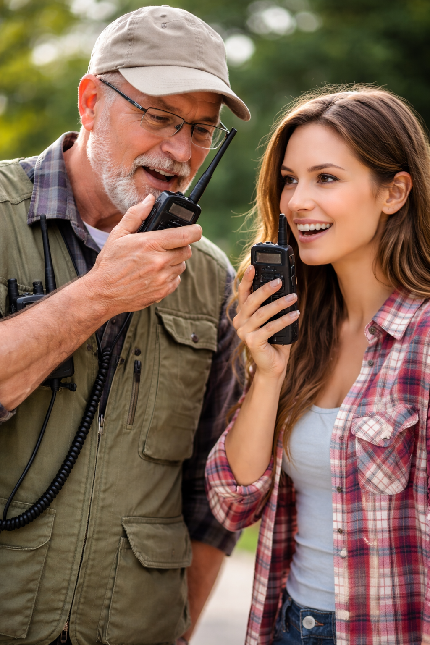
Preparing for your first Elmering….
Being an Elmer can be scary, but a little preparation can relieve your anxiety and also ensure a wonderful experience for the protégé.
Build an outline in advance.
Determine success criteria
Plan your resources
Collaborate with HRU.
Review your experience.
SAMPLE OUTLINE
Ham Radio Basics
[Goals: Understand what parts of spectrum you have access to, understand how to access a repeater, and participate in a net, be able to access N6NFI from echolink, understand how to program your radio with Chirp (or RT Systems), evaluate local clubs and resources, know what activities are available to me. Sign up for SCC Ares…]
Understanding your license (VHF/UHF/HF)
Getting on the Air
  Echolink
  NETs
  Choosing a radio
  Programming your first radio
Connect to Community
Understanding local clubs and their individual flavors, ARRL, MeetUp.
What can I do with my license?
EmComm, FoxHunt, Preparedness, NETs
Notes:
1: Building an outline helps organize your thoughts, and make sure you cover all the topics you intend to cover. It helps keep you on track and ensure nothing is missed. It is too easy to forget key points during a presentation otherwise.
2: Success Criteria. Knowing in advance what you expect the protégé to gain from the class. We should be able to check off items on this list. I have a list called [Goals] in the outline above that does this. You may want to cover this list of goals before you start to set expectations.
3: Plan your resources: Can you program a Baofeng? Can you bring a laptop and demo Chirp on your HT, and even better help them program their own radio? Do you have Echolink installed, and a radio to show you can communicate? Do you have a band plan handy? Do you have links to the www.stiv.com website and similar resources for your new ham to access? Doing POTA? Have a portable demo system? Thinking of all the things that might be needed while helping a new ham avoids frustration if we forgot something.
4: Collaborate. Come to the University events and share your work with other Elmers. As we all learn over time, lets share our experience so we all benefit. Feedback from other Elmers can help us improve.
5: At the end of the day, take the time to write down any highlights from the day. Are there things we could do better or things that went really well that we can share? Share them on the Groups.IO.

Slide 6
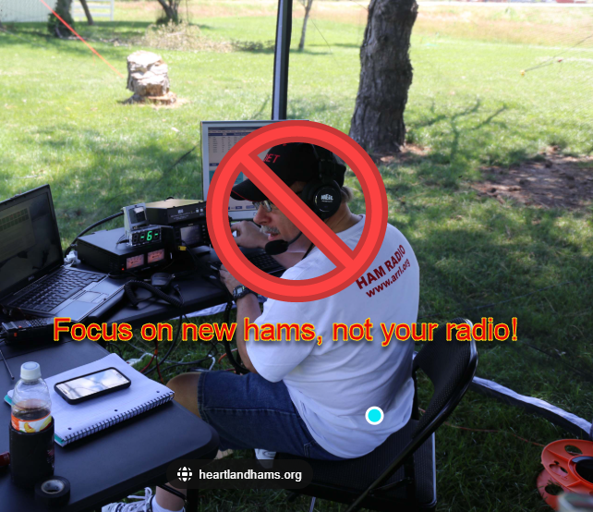
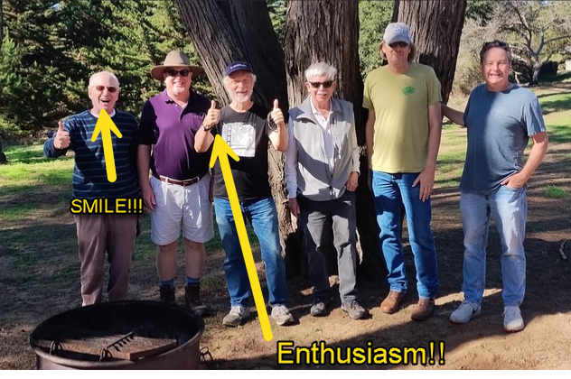
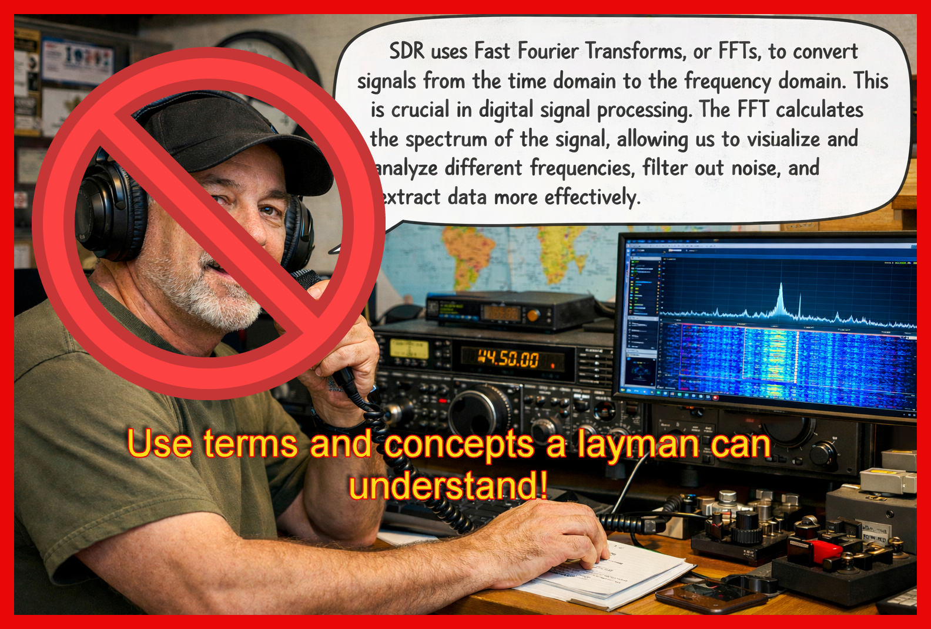
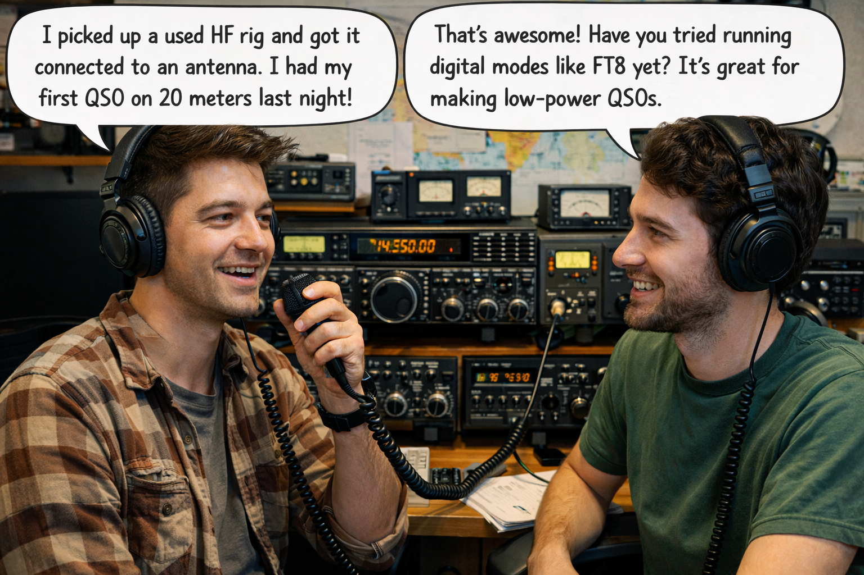
Meeting the new Ham
Introduce yourself, and learn about them.
What do they hope accomplish today?
KISS: (Keep It Simple Stupid).
Can we connect them to further resources?
Notes:
1: If somebody wanders up, smile and engage them. Explain who we are, why we are here, and ask THEM questions.. Where do they come from? Why did they get a license? Do they have ideas for where they want to go? We really want to tailor our engagement to meet their needs. Some folks got a license and have no idea what they intend to do. Those folks we want to educate about their options. Folks that came strictly for EmComm might appreciate more focus on SCC ARES/RACES and County Training. Get to know them so we can best adapt to what they are here for. Be ready for questions about POTA, Packet Radio, SOTA, Fox Hunting, EmComm, Basics of RF, basic antenna recommendations. New hams might be Technician, but may also be new Generals!
Tips:
You should be facing the new hams, not have your back to them. If you are going to operate, try to have a partner who faces them and explains what you are doing. If you can leave an open seat at your radio for the new ham, it is an opportunity to invite THEM to operate with your help.
Smile! Be happy! Let them see your enthusiasm! It is contagious.
We are a community. Recommend your club if you like, but consider if another club might be a better option. Consider what they want to do, where they live, and what they want to learn. It is more important to address their needs then our clubs.
2: What do they hope to accomplish today? If they are here for a specific purpose (programming their radio, doing a POTA activation, doing a packet check-in) do we have an elmer prepared to handle that subject? (Having Elmers sign up for the University and note what they are specifically prepared for may draw in students)
3: KISS: You may have years of experience, but they don’t. Try to keep your vocabulary consistent with terms a layman can understand. Explain items they may not be familiar with. Watch their eyes for a glazed look. People may not understand and nod just cover it up. There is no shame, but it is tough to be a rookie. Try to keep the information limited to the minimum of what they need to operate.
4: We don’t want new hams to wander off without a plan. If nothing else, we should point them to a club, NET, or resource that can further engage them. Is there a subject we should prepare for the next University? Can we get their contact information and refer them to a club?

Slide 7
Engaging the newly licensed Ham
Help them understand what they can do.
Get them on the air, with or without radio
Teach them about Nets and finding folks to talk to
Educate them about clubs and organizations that exist to support them.
Point them to vendors and websites they need
Get them excited!
SAMPLE OUTLINE
Ham Radio Basics
[Understand what parts of spectrum you have access to, understand how to access a repeater, and participate in a net, be able to access N6NFI from echolink, understand how to program your radio with Chirp (or RT Systems), evaluate local clubs and resources, know what activities are available to me. Sign up for SCC Ares…]
Understanding your license (VHF/UHF/HF)
Getting on the Air
  Echolink
  NETs (Rfinder, RepeaterDirectory)
  Choosing a radio
    Accessories
  Programming your first radio
Connect to Community
Understanding local clubs and their individual flavors, ARRL, MeetUp, SCC . Where to buy…
What can I do with my license?
EmComm, FoxHunt, Preparedness, NETs
Notes:
A newly licensed ham is probably excited about their achievement, and we have no better chance to engage them than this moment. The outline above is designed to get them connected and online, and educated about the possibilities that are open to them to explore. The University is a regular event they can come to and advance towards many different activities. I hope we have more participation, as I think our entire community will benefit from more advanced subjects being available. I hope clubs decide to participate by offering classes and activities through the MeetUp to make them more widely accessible.
1: We hopefully have talked to our new ham to find out what their interest is, but perhaps they are not aware of the breadth of options for them to enjoy. If they came in just for EmComm, let them know about other activities..
2: Getting them on the air should be our primary goal. If they have a radio, try to get it programmed for the local nets. If you can’t program their particular radio, walk them through a Chirp demo on your radio. Try to get them connected to a repeater (preferably one with a Net) and talk to them on your radio. Get their phone connected with Echolink, and connected to N6NFI. Talk to them on their phone and hear them on your radio.
3: So, they know how to connect, now explain some local nets. Let them know many repeaters are sparsely used outside Net times. Explain the difference between a TalkNet and an EmComm net (role call). Suggest they monitor a few nets until they are comfortable and ready to talk.
4: It can be lonely as a new Ham. Finding other Hams to associate with is key to keeping them active. Explain that clubs have different personalities, and may have different purposes. You are not limited to one club, and you don’t have to join the first club you visit. Find one you like. Note that an EmComm club may be focused on …umm.. EmComm! Social Clubs like PAARA and FARS may have activities and discussions you are interested in. Special purpose clubs like NCCC and the NCDX clubs (Contesting and Dxing) are focused on one particular aspect of Amateur radio.
5: Tell them where to buy gear, and explain the difference between buying from HRO or Gigaparts and buying on Amazon or AliBaba. Warn them about Chinese radios! They don’t need to avoid them, but they do need to know the tradeoffs. Let them know about local Ham suppliers if you can. It is good to support our community.
6: Radio is fun. If you love it, share your joy. People want to be part of things where other people are having fun.

Slide 8
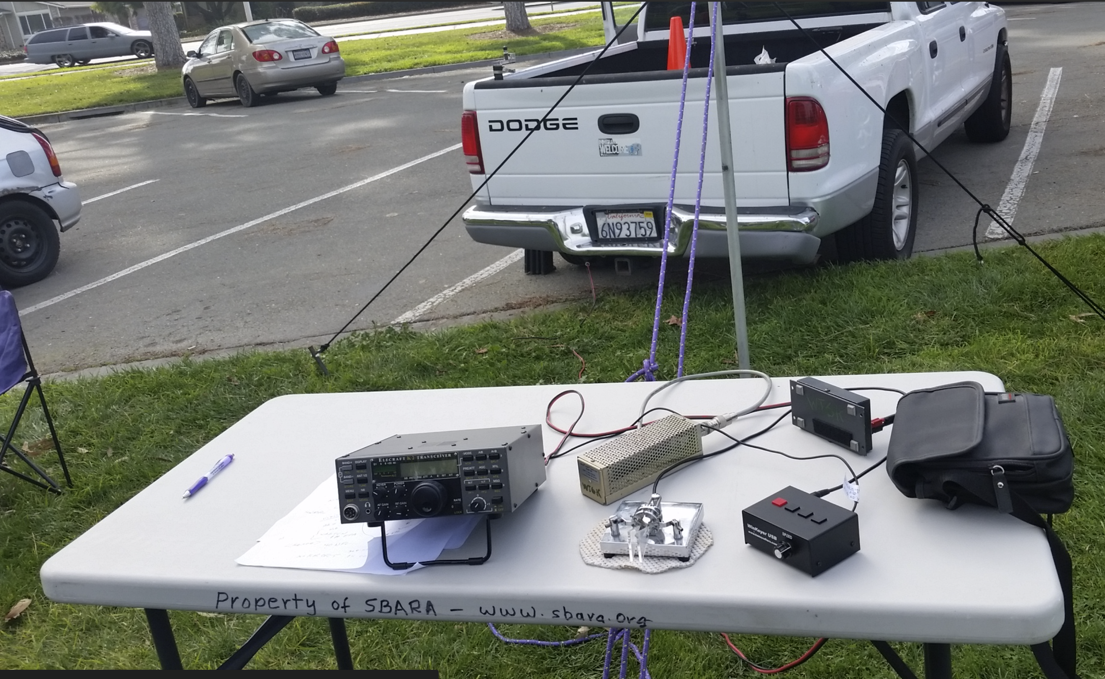
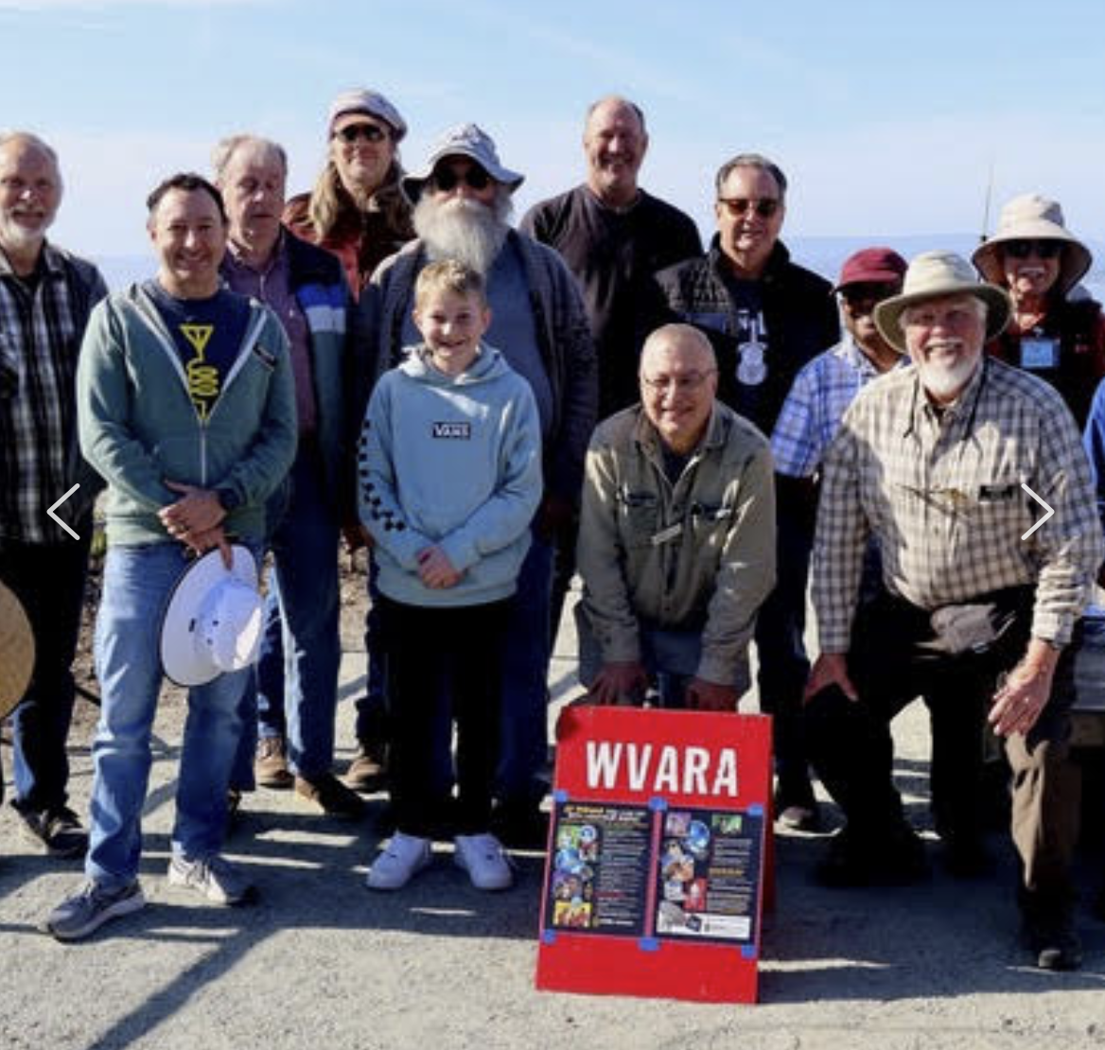
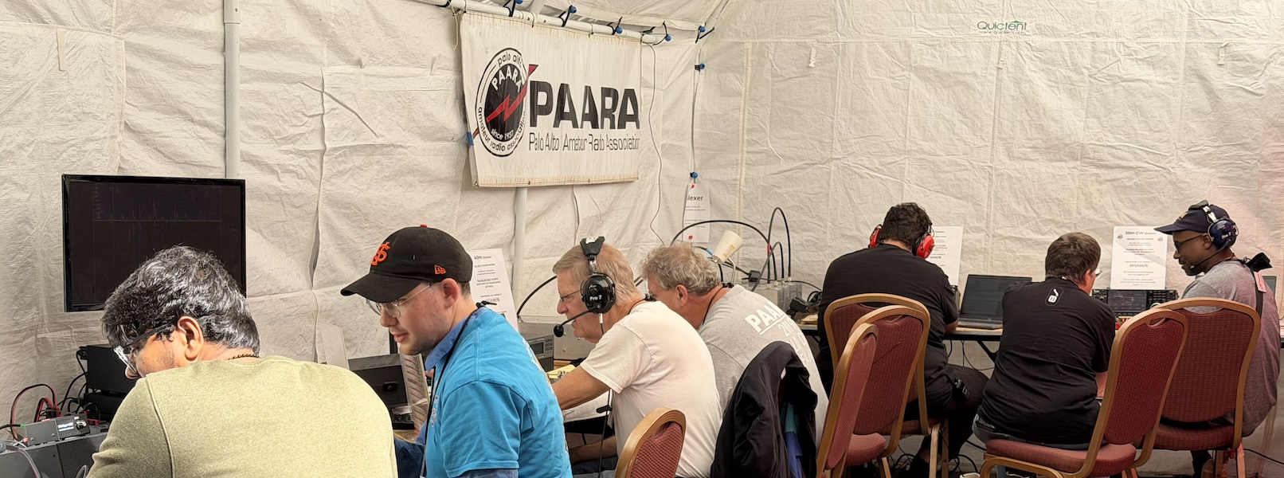
Building Community
Engage New Hams
Evangelize Radio
Work Together
Cross Pollinate Knowledge
Do things as a club, besides meetings!
Notes:
Engage New Hams: We have a short window after a new ham gets their license when their excitement and enthusiasm are at their peak. If we don’t engage them at this point, they may lose interest and we lose them.
Evangelize Radio: If we want new hams, we need to let people know we are here! Find local groups with a radio synergy and introduce them to radio. (Eg: Hiking Groups + POTA, Churches + CERT) Get your club name out there!
Work Together: Clubs should not (IMHO) keep to themselves. Share resources and hold joint events.
Cross Pollinate: Learn about new facets of Amateur Radio, and help others do the same. You may be an expert in EmComm and know nothing about DXing. Learn something new, or teach somebody else.
Do things! A club officer mentioned a comment at a meeting “When did our club stop doing anything besides watching PowerPoint decks one a month?” People join clubs to get something, be that camaraderie, training, or encouragement. Doing things helps you recruit AND retain.

Slide 9
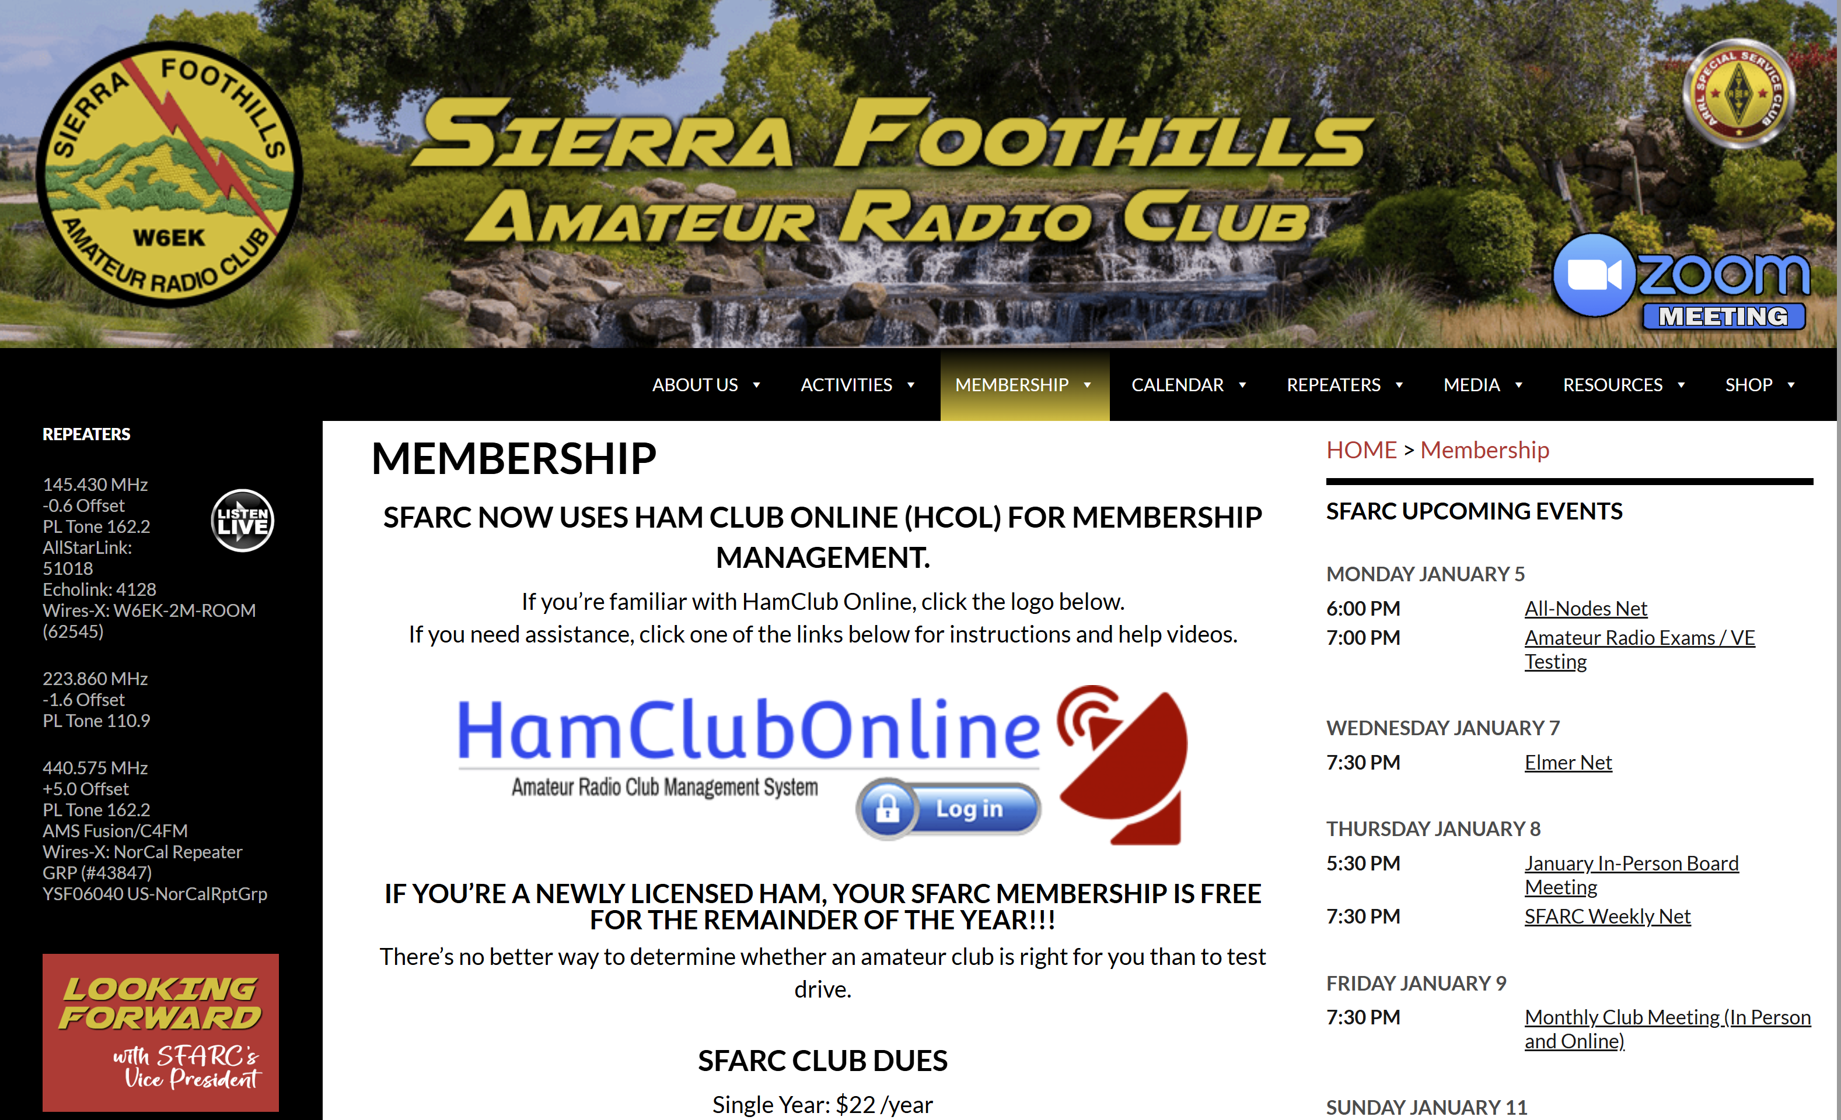
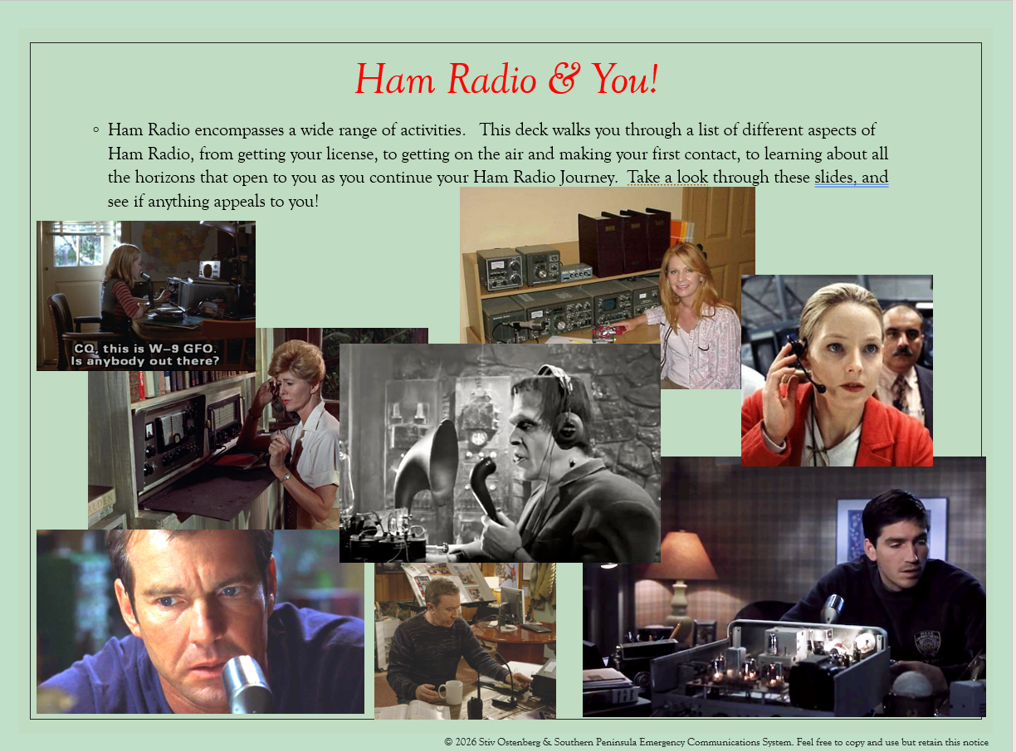
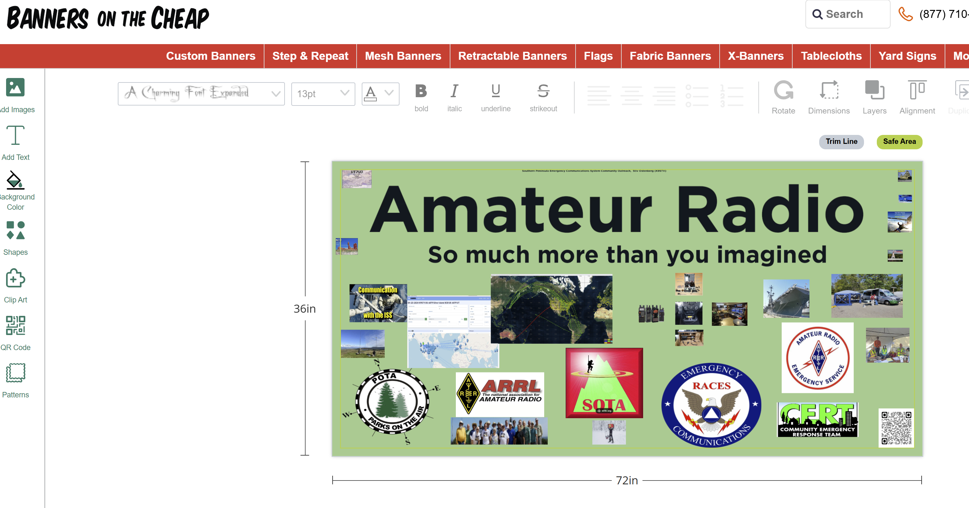
Shaping the Future
Change Perception
Update Websites
Club Promotional Materials
Share ideas
Notes:
Change Perception: Is Radio dying? Why not? Be prepared to make your case.
Stale websites indicate lack of interest and will not bring people in.
Advertise your club! Make sure people know who you are..
This presentation is my idea. Lets hear from other people! Show up at the University to crowdsource solutions to club problems with other hams. ARRL is not helping, so we need to do it.

Slide 10
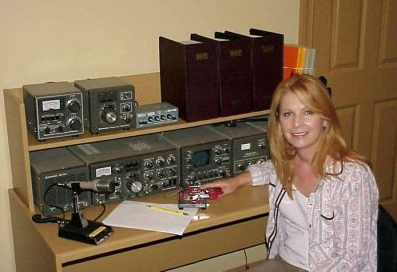
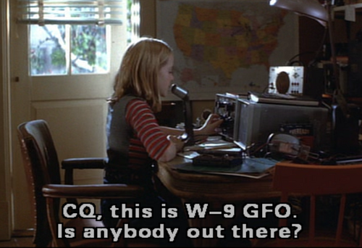

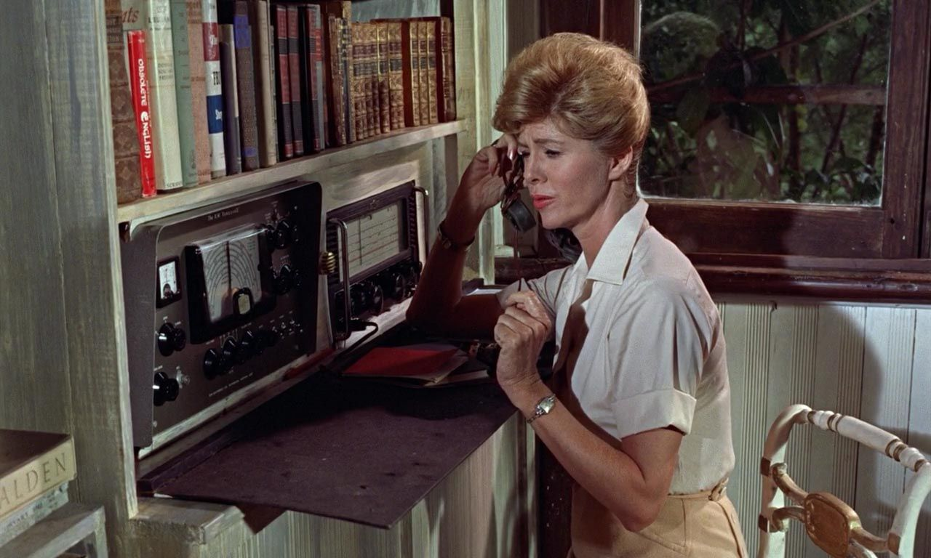
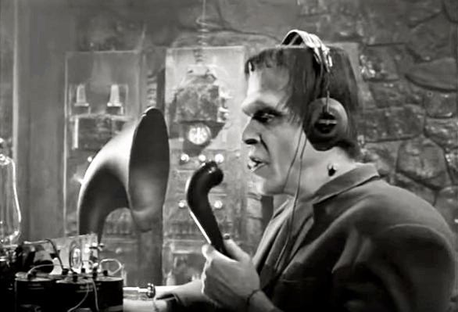
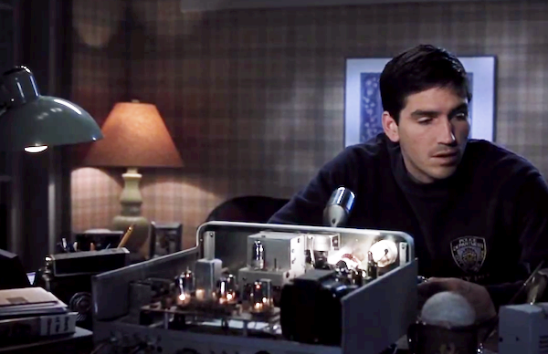
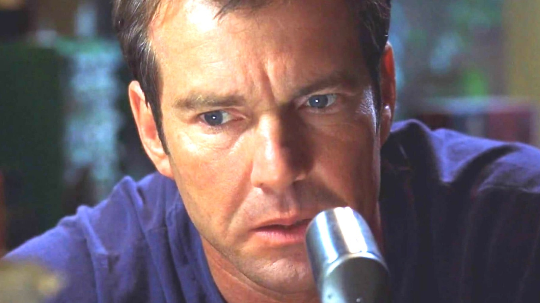
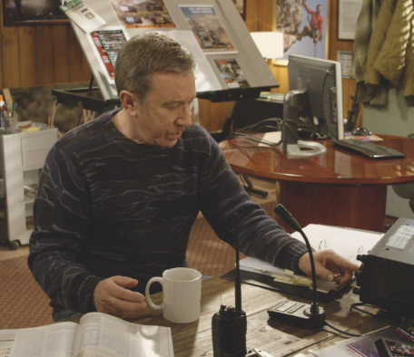
Ham Radio & You!
Ham Radio encompasses a wide range of activities. This deck walks you through a list of different aspects of Ham Radio, from getting your license, to getting on the air and making your first contact, to learning about all the horizons that open to you as you continue your Ham Radio Journey. Take a look through these slides, and see if anything appeals to you!
Notes:
Fred Gwynn (Herman Munster)
Jodie Foster (x2) in Contact
Dennis Quaid and Jim Cavazel in Frequency
Tim Allen
Patty Loveless
Dolores Keator as Mary Trueblood in “Dr No”

