Slide 1
Finding and Retaining Next Generation Hams
Stiv Ostenberg, K9STV
SPECS Community Outreach Officer

Slide 2
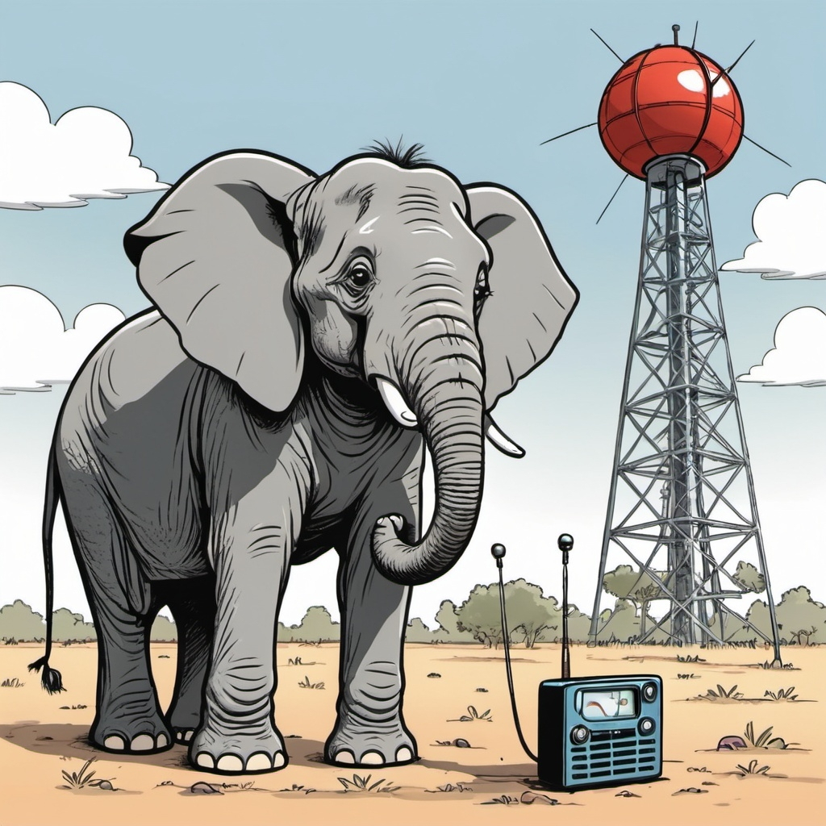


Finding and Retaining Next Generation Hams
The Elephant in the Room
Problems we face
Goals
Actions
SPECS Solution
Discussion
See more: Open the Notes below for more information.
Notes:
This slide is an overview of what we are covering.

Slide 3
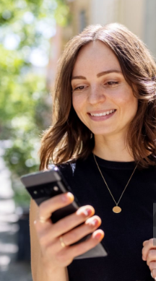
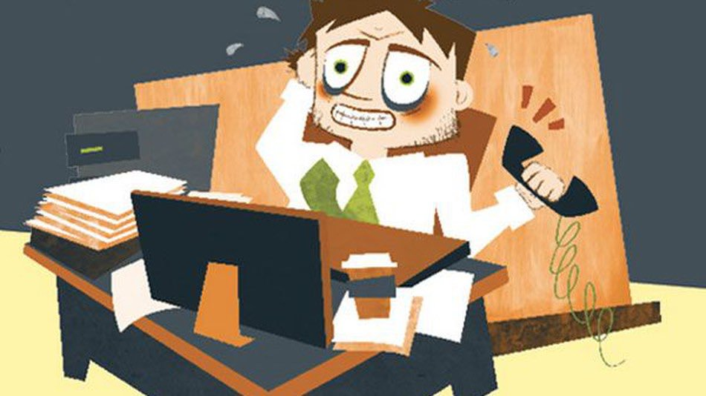


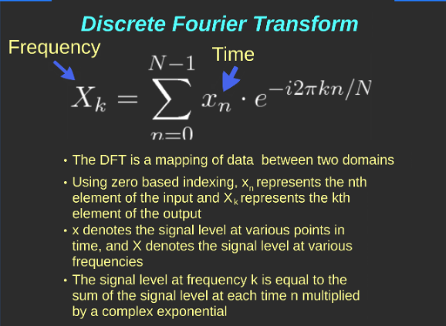
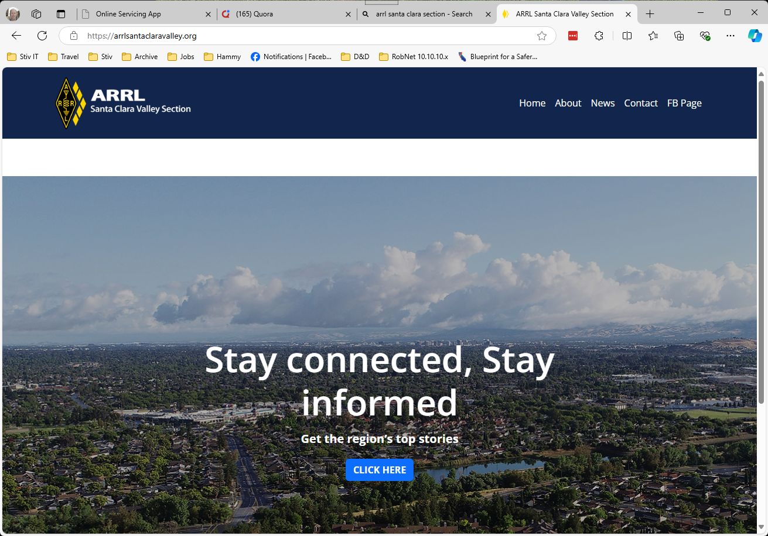
Problems
Everybody HAS a radio (cellular)
Club Officers Overloaded
People get license and vanish
“Ham Radio is Boring”
Club Meetings not focused on new hams
Many club sites are stale
Apathy and Old Dogs
Notes:
Ham Radio has always been about communication, but in the modern era, when everybody has a radio in their pocket (cell phone), and you can talk all over the world over the Internet, what relevance does Ham Radio have?
Club Officers and a small number of volunteers are carrying heavy loads, and people are reluctant to make commitments or to volunteer. There is more work to do then people to do it, so many aspects of Ham Radio, such as fresh Web Sites or public events are casualties of the manpower shortage.
People are not captured at the exams, and once they leave are often never seen again.
Ham Radio is just an old white dude who hides in a shack tapping on a key and making beeping noises.
Club meetings focus on topics relevant to the guy in the last bullet point (old white dude in shack), not a new ham.
This problem is related to point 2, but the problem with stale websites contributes to the perception that Ham Radio is boring, obsolete, and irrelevant.
People are busy and don’t want to commit. Old hams not interested in new collaboration tools.

Slide 4
Goals
Generate Interest in Radio
Keep new hams engaged
Distribute workload
Get out of the Shack
Be visible!
Notes:
We need to get out and make people aware of Ham Radio and all they can do with it. Make people WANT to get a license.
Once a ham gets a license, we need to get them active, and we need to make it fun. We need events to connect Elmers and Gomers.
We need to distribute the load. While some involves getting volunteers, we can accomplish a lot by sharing resources and cooperation between clubs. ARRL is uniquely postioned to do this.
We need to get our current Hams out of their shacks and evangelizing ham radio and sharing their experience.
Get out in public and let people know what Ham Radio an offer them.

Slide 5
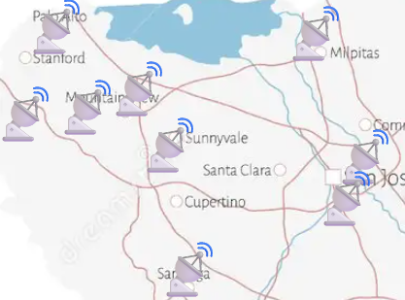
Actions
Evangelize Ham Radio
Provide opportunities to operate and learn
Keep Communications Channels Open
Break down silos
Make Ham Radio FUN!
Make it easy to find information and resources
Notes:
We need to get out there and generate interest if we want new hams.
New hams are excited and looking to cash in on the promise of coolness their license represents. We need to provide activities and education during this critical phase if we want to keep them. They are not looking for YouTube videos, or presentations at club meetings. They want to get their hands on experience with an Elmer at their side!
We need to provide communications channels that go beyond a single club. We need to work together to coordinate activities, and we need to share volunteers who are willing to do more then support a single club.
Each club operating as its own silo, results in redundant effort. Local clubs should share and contribute data (such as local Nets, How to guides, and event calendars) to build a wider and more robust community. ARRL sections seem the logical boundary for such groups, though some resources should be available at the National level.
Make Ham Radio FUN! This is really key to retaining people. Even if we are aiming to get folks involved in EmComm, we need Hams to draw from. Helping people get involved in the fun aspects of ham radio is a logical stepping stone to taking a more responsible role in the hobby.
I keep stumbling on new programs or tools I didn’t know existed. I am trying to share what I found so others don’t miss out on great resources.

Slide 6


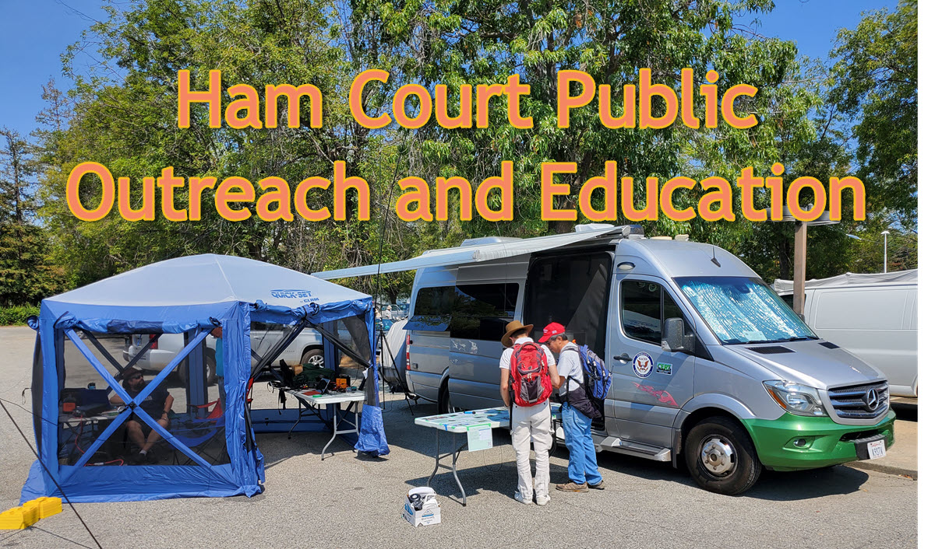
My solution

Slide 7
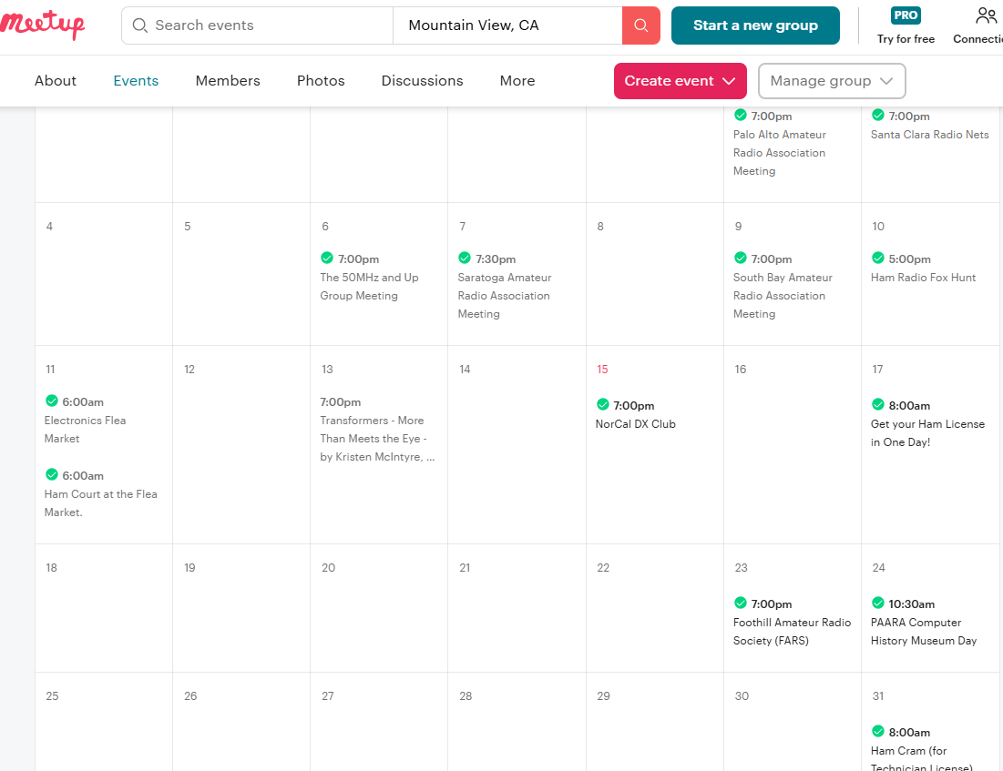
MeetUp Phase 1: Club Participation
Get clubs to add their own events.
Get members to sign up for events!
Notes:
The Phase One of the MeetUp simply involves collecting all the Ham Radio events in the area and posting them in a single place. This covers club meetings and events posted on the club sites. The key effort is getting buy in from the clubs to post their own events. This not only provides new hams as many possible activities to engage as possible, but does it in a public forum where people looking for things to do may come across events and become curious about ham radio.
Encourage clubs to get their members to sign up for meetings and events. If folks sign up, it encourages others to attend.

Slide 8
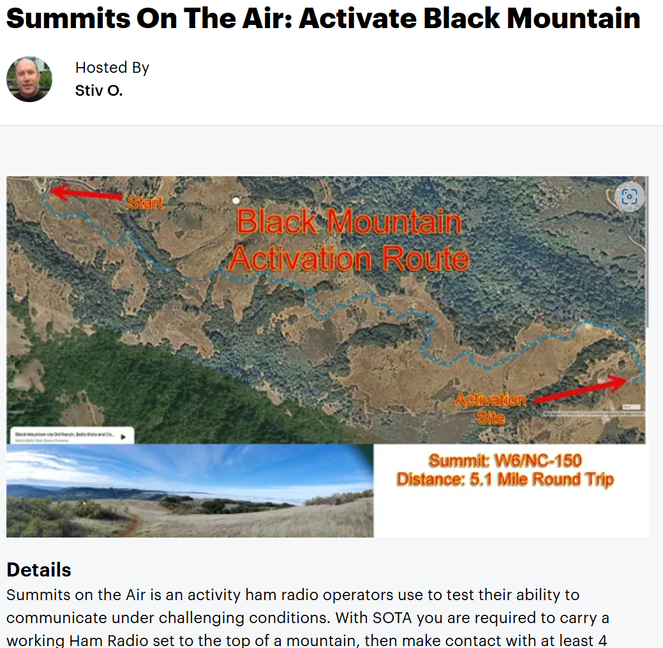
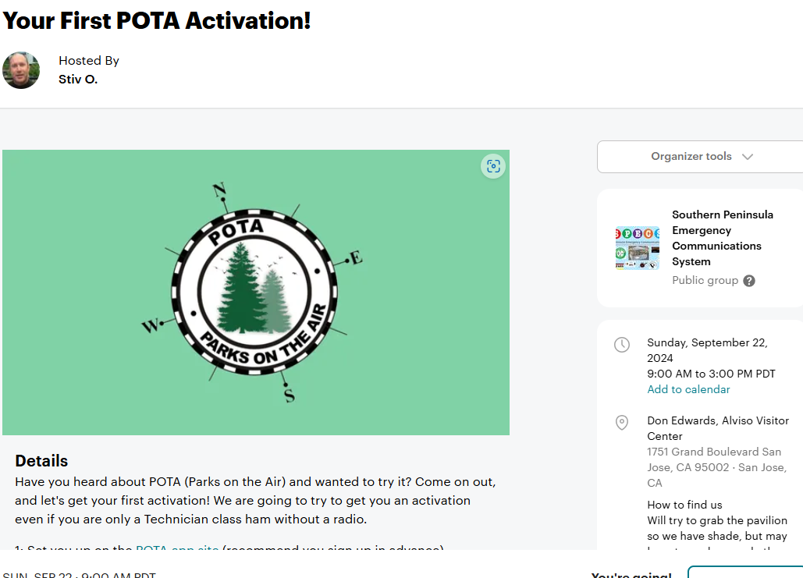
MeetUp Phase 2: Elmer Participation
You don’t have to be a “club”!
Be an Elmer.
Share activities with new hams.
Do Cross-Group events.
Notes:
You don’t have to be a club to hold an Event. You don’t have to be an expert. All you NEED is a willingness to engage in an activity and invite others to join you.
Even rookie hams may know enough to Elmer other hams. Just commit to sharing your experience with others.
Do activities like POTA, SOTA, Packet Radio Check-Ins, connect to a net with your new radio. Program an HT. They can be simple or advanced. Just be willing to explain what you are doing.
Want to get new people into Ham Radio? Find MeetUp groups that may share an common interest and do a joint event! The event above was a joint effort with the Bay Area Hiking and Anything Fun group. They have over 7000 members! SOTA combines hiking and ham radio. Doing an event together exposes people who may have a synergy with Ham Radio is a fertile recruiting ground!

Slide 9
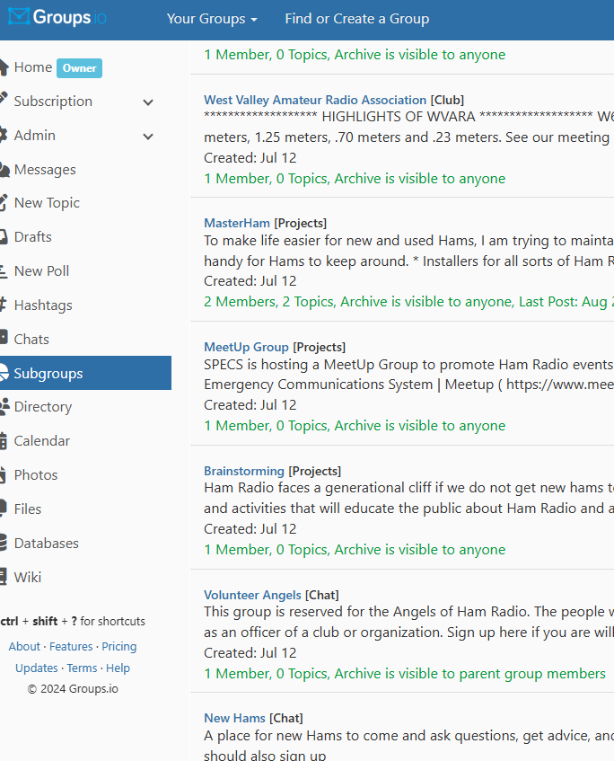
Groups.IO
A single location to discuss any local activity you are interested in.
Help new hams get connected.
Resource for cross-club communication.
Volunteer opportunities and requests.
Notes:
Gives new hams connections to any subject they might be interested in. Lets hams (like me) find collaborators for projects or events. Lets clubs seek volunteers or speakers.
Let people manage what conversations they participate in. Don’t force clubs and officers to keep track of Emails and Preferences.

Slide 10
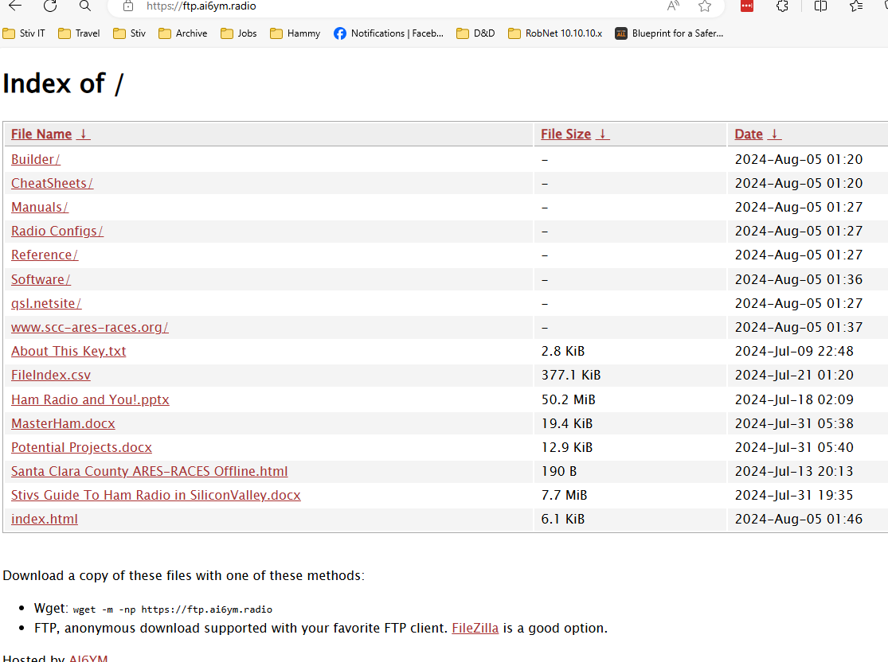
MasterHam Project: qsl.net/k9stv/
Collaborative resources
Offline Data for EmComm
Getting started guide.
Notes:
This is just based off my personal information store, but shared out. Ideally we can get clubs and Elmers to help maintain this.

Slide 11
More ideas?
New Licensee Postcards
Discord / Slack
ARRL Hosting? Web Templates?
Elmer Tools. How to host an event. How to find collaborators.
Beyond Field Day….(cpota?)

