Slide 1
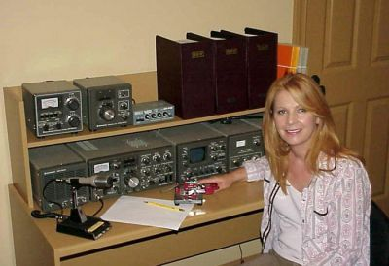
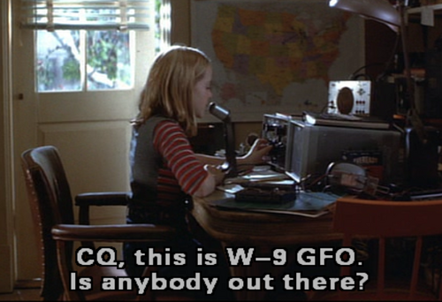
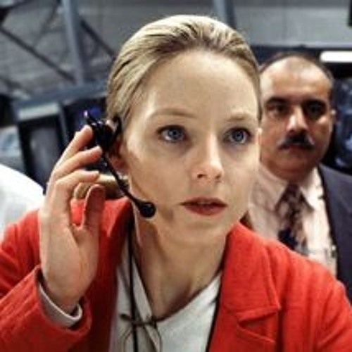
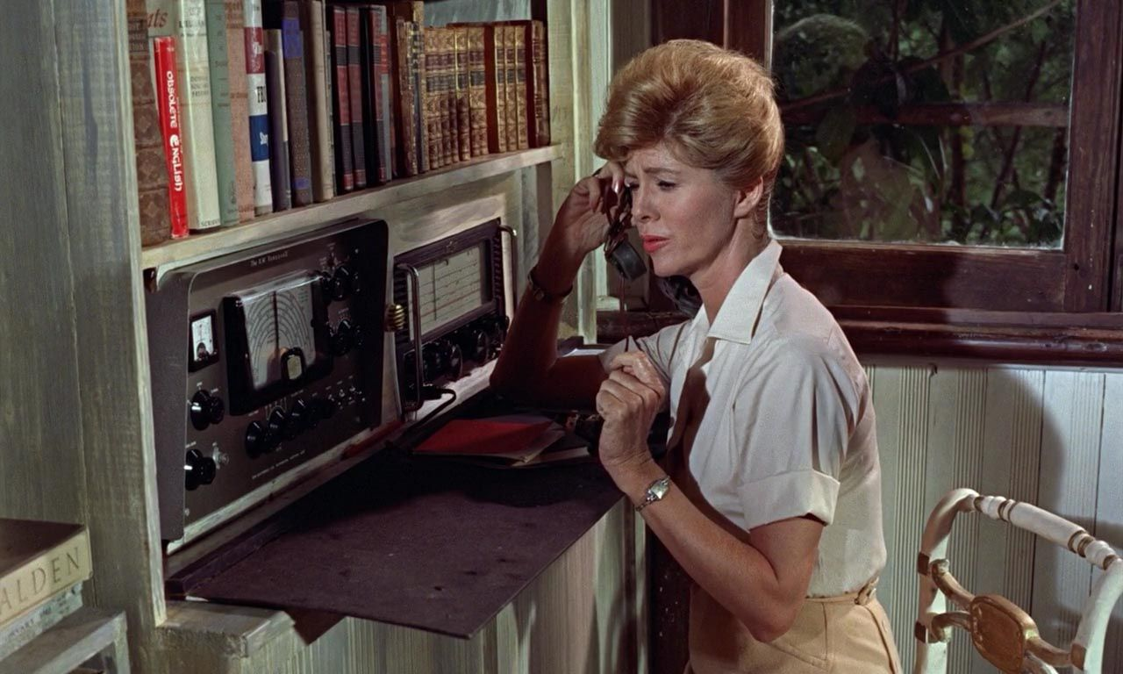
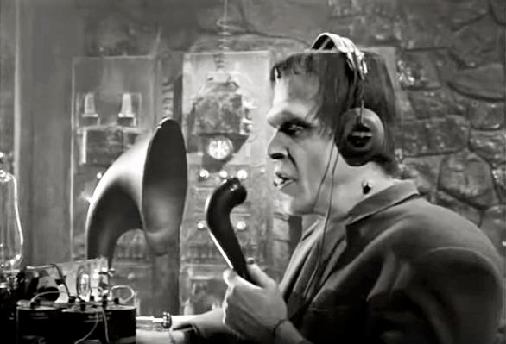
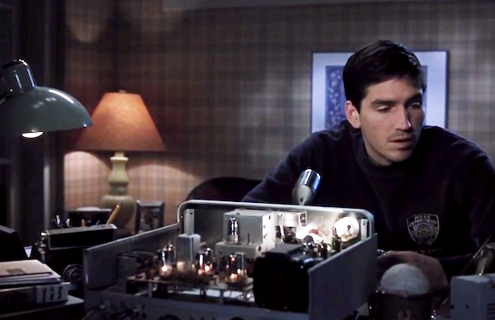
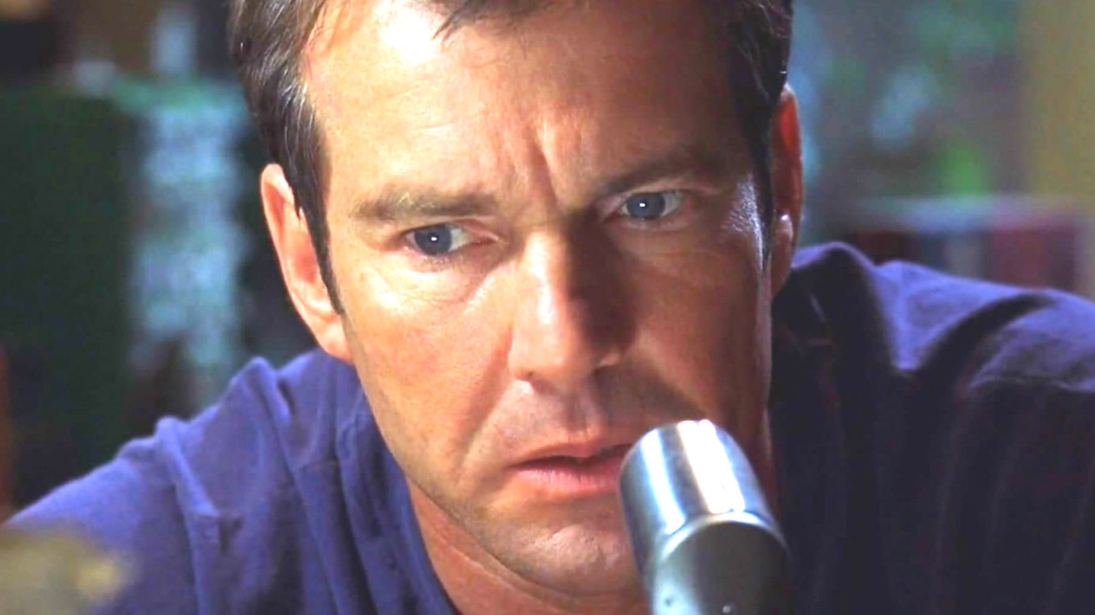
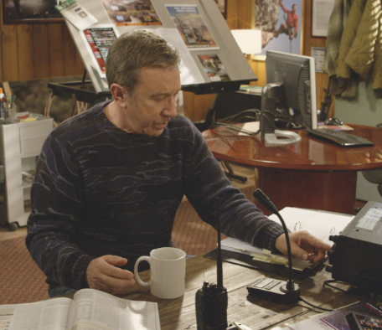
Ham Radio & You!
Ham Radio encompasses a wide range of activities. This deck walks you through a list of different aspects of Ham Radio, from getting your license, to getting on the air and making your first contact, to learning about all the horizons that open to you as you continue your Ham Radio Journey. Take a look through these slides, and see if anything appeals to you!
Notes:
Fred Gwynn (Herman Munster) Jodie Foster (x2) in Contact
Dennis Quaid and Jim Cavazel in Frequency
Tim Allen
Patty Loveless
Dolores Keator as Mary Trueblood in “Dr No”

Slide 2
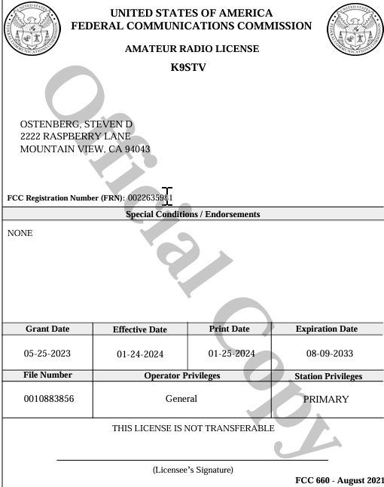
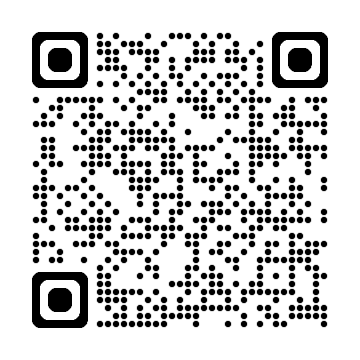
Getting your license
Getting a license is a LOT easier than it used to be. You do not need to learn Morse Code, and there a tons of folks out there to help you. Basically, if you are willing to commit one day of study and take a test you have a 90% chance of passing the exam with no prior experience. You need to pass the technician license first, then repeat the process if you want your General License. The FCC will charge you a fee, and the testing site may or may not, but just budget around $50 for your first license.
Technician License
Your first license will be a Technician and allows you to operate on VHF/UHF Frequencies, and some limited HF. This is primarily used for local communications using repeaters, and is all you need to participate in Emergency Communications.
General License
Upgrading to General Class gives you access to HF frequencies. This allows you to use higher transmit power and other frequencies that allow you to talk all over the world. More of the recreational activities (POTA, SOTA, DXing) happen on HF.

Slide 3
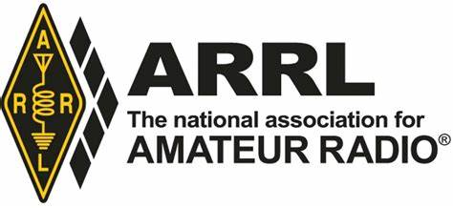
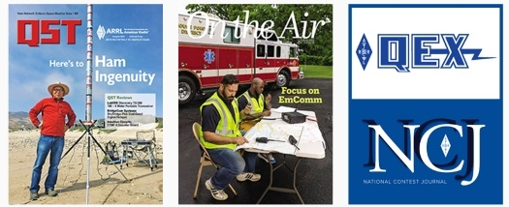
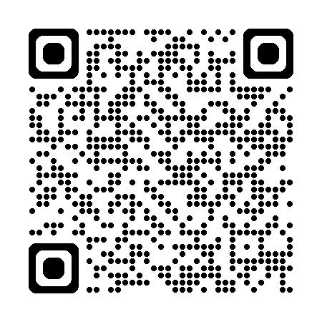
Join ARRL
When you join ARRL, you'll have access to information, learning, programs & services to help you get (and stay) active and on the air. Your membership supports ARRL’s work to promote and protect amateur radio and provides you with benefits to do more with your amateur radio license.
Join now and get immediate access to the full benefits of ARRL membership.

Slide 4
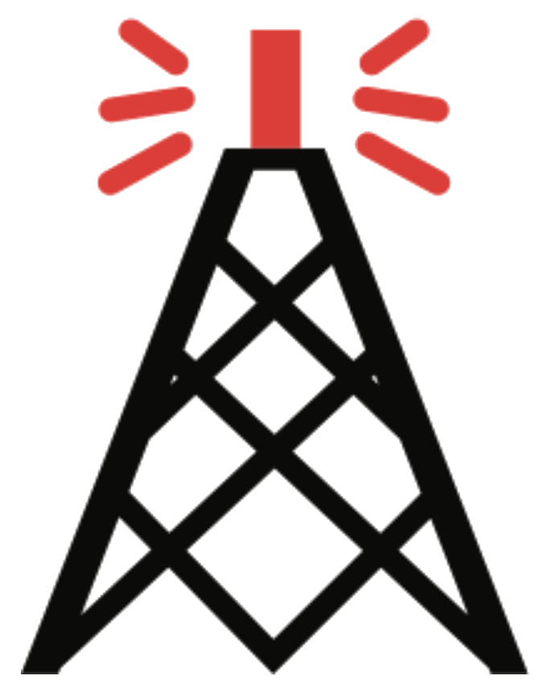
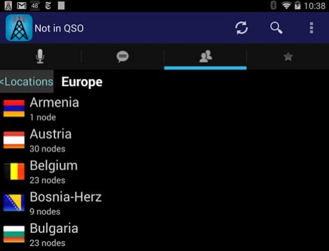
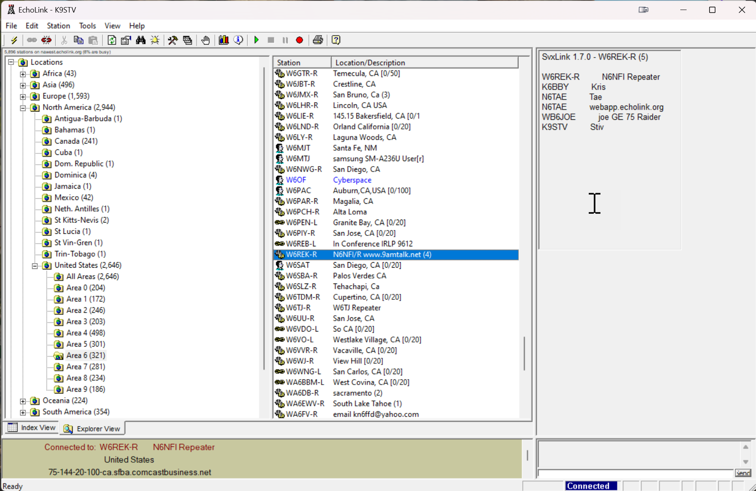
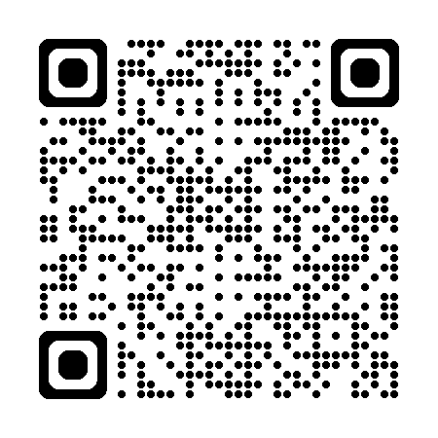
Echolink
Connect and talk with stations and repeaters around the world using your PC, Cellphone, or radio!
Software is free
*Requires ham license to use

Slide 5
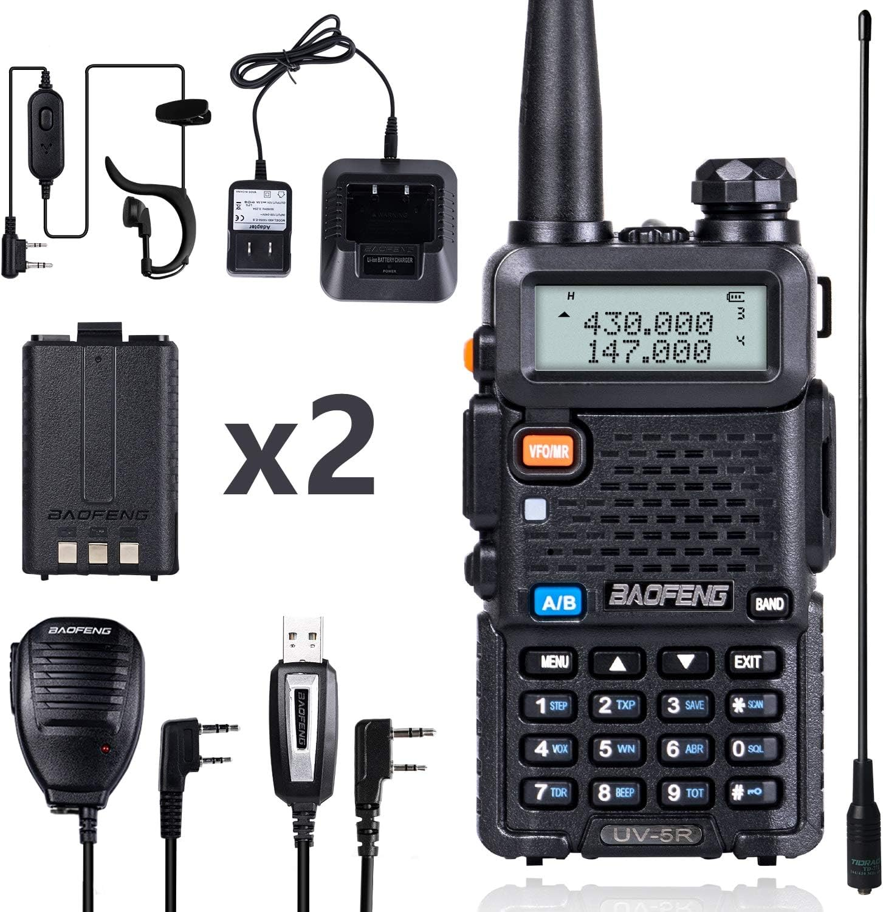
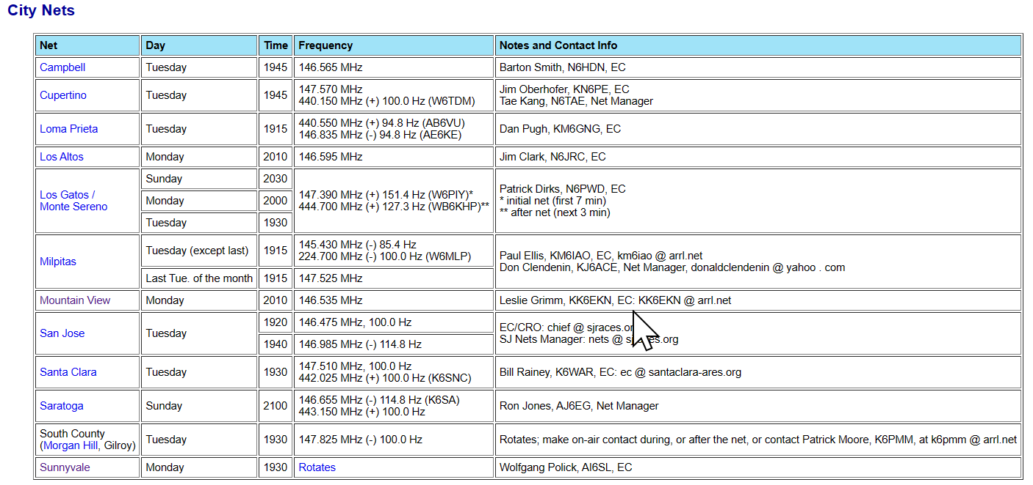
Participate in a Net
A Net is a scheduled event where groups of people get together to talk or engage in an activity. There are many Nets out there, depending on your location and frequency and power. The sites below are EmComm nets, though many clubs and organizations also have their own regular nets.
EmComm Nets exist to allow operators to practice their skills (such as acting as Net Control), and to perform regular tests of their equipment and the EmComm infrastructure gear.
You can participate in one of the local Nets with nothing more than a $30 Handheld, though a better quality radio is recommended for EmComm work. Alternatively, some Nets are accessible by EchoLink.
Local Repeaters allow low power handhelds to reach a far larger area.
This Handheld Ham radio sells on Amazon for $30. It is a good way to get started if you are undecided about your commitment level. Alternatively you could use EchoLink.

Slide 6
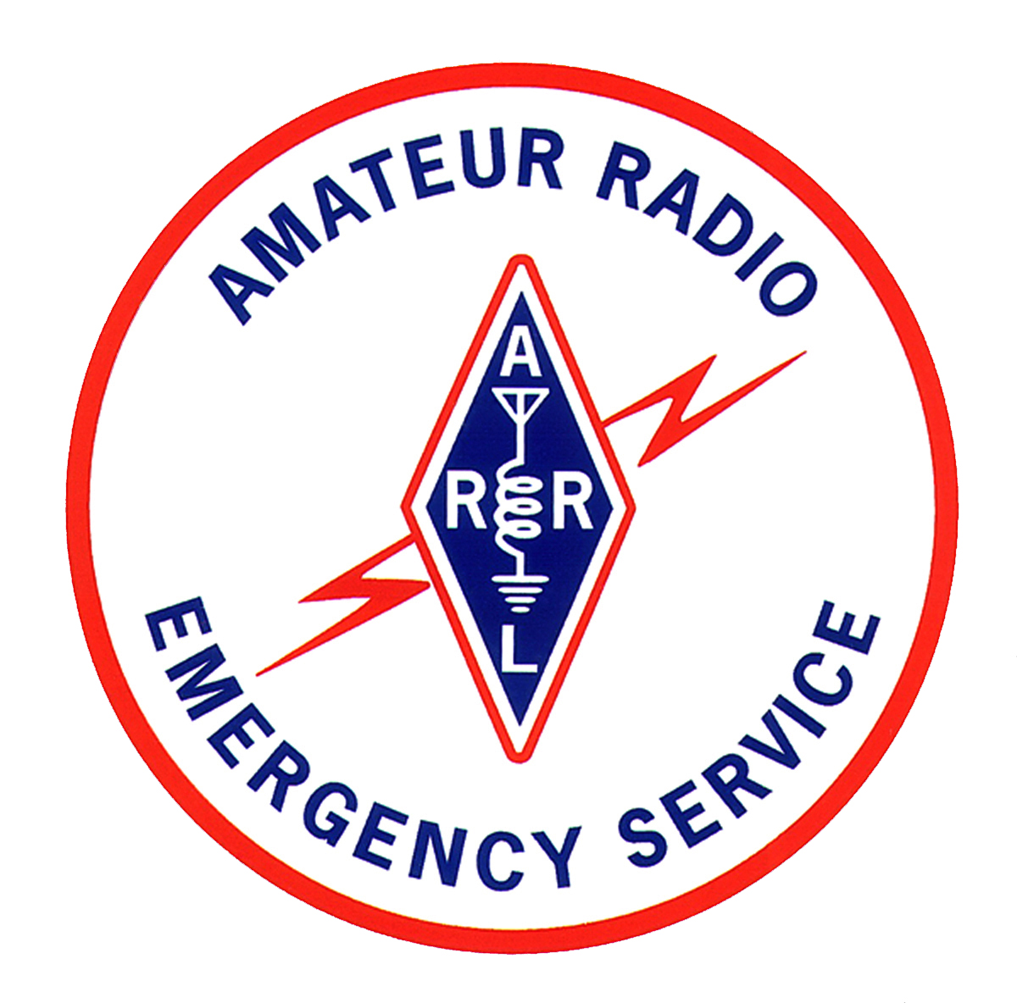
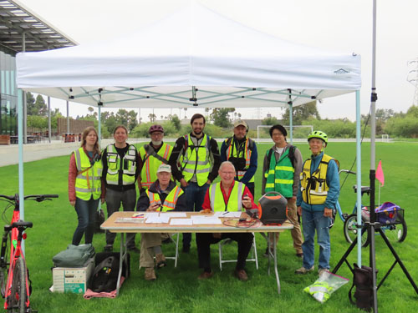
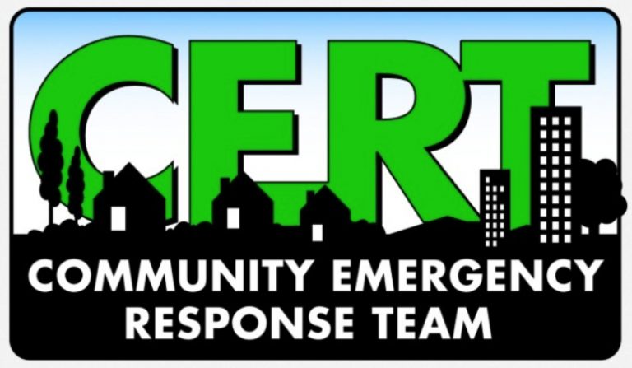
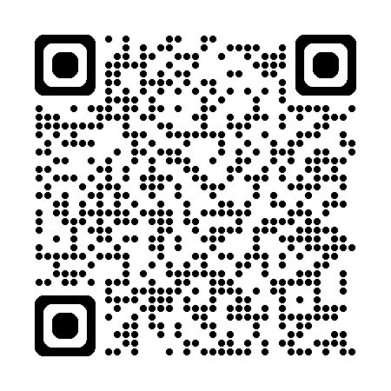
Emergency Communications
Take free training to be prepared to respond in a disaster
Support community events in your local area
Learn to use your radio effectively for various support roles
Scan to visit Santa Clara County’s Emergency Communications Site. Signup is free, as are the classes!

Slide 7
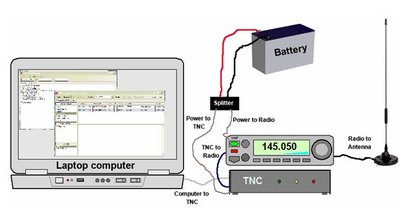
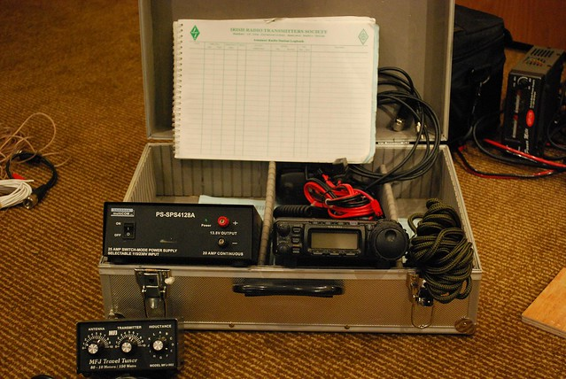
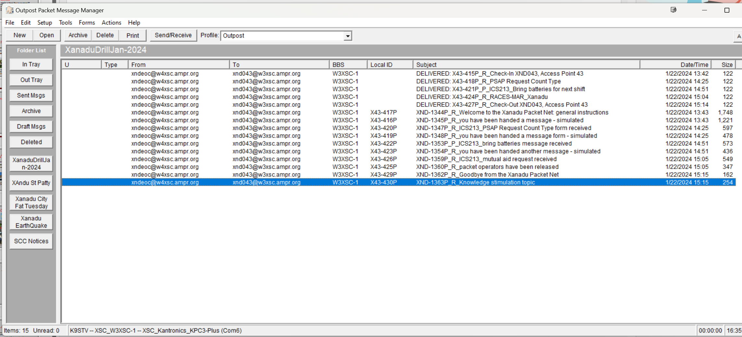
Packet Radio for EmComm
Use your computer, a “modem” and your radio during an emergency to transmit and receive data.
Free training at County website.
Connect to Ham Radio BBSs!

Slide 8
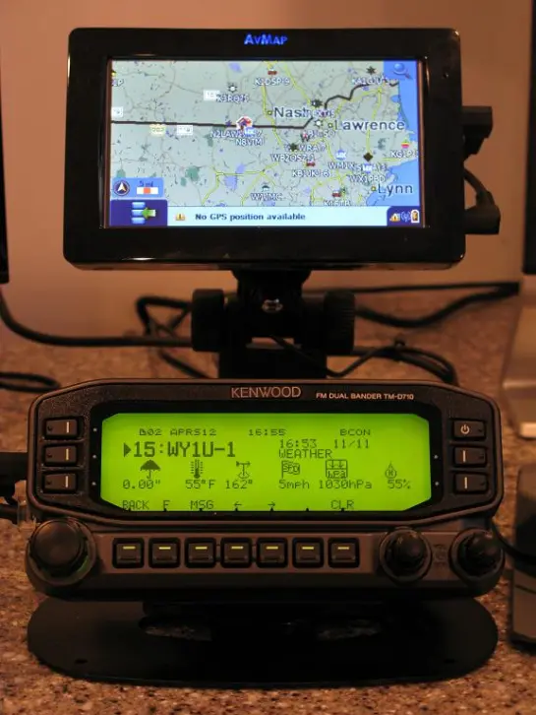
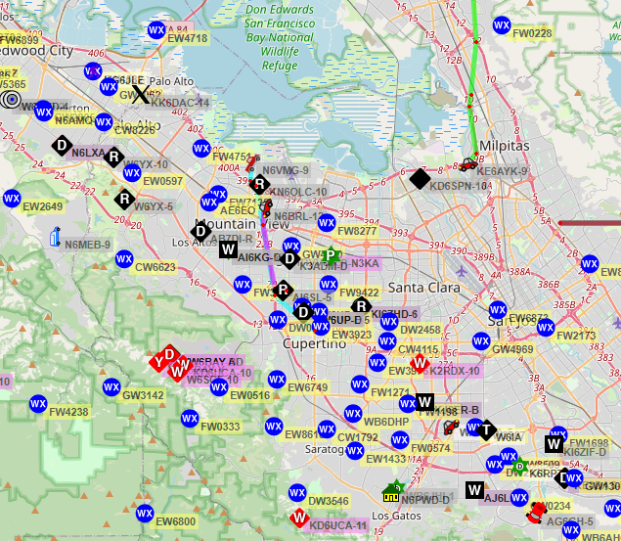
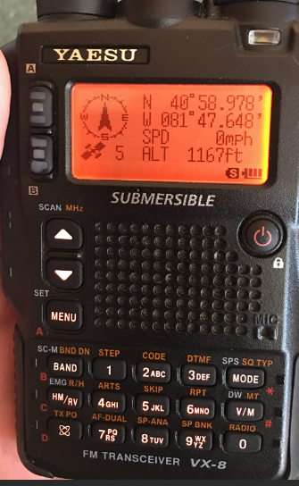
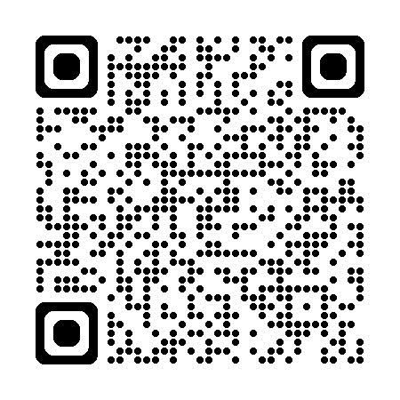
APRS
The Automated Packet Reporting Service is a digital real time communications system to share tactical information and messages. The most common activity in APRS is to plot the location of moving objects using GPS information, but APRS can also be used for short messaging, weather station telemetry, announcements, and displaying objects on a map.
Data can be tracked by radio, or online.

Slide 9
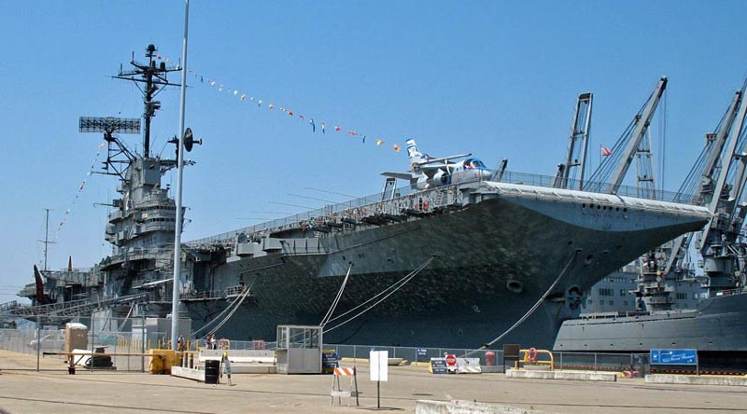
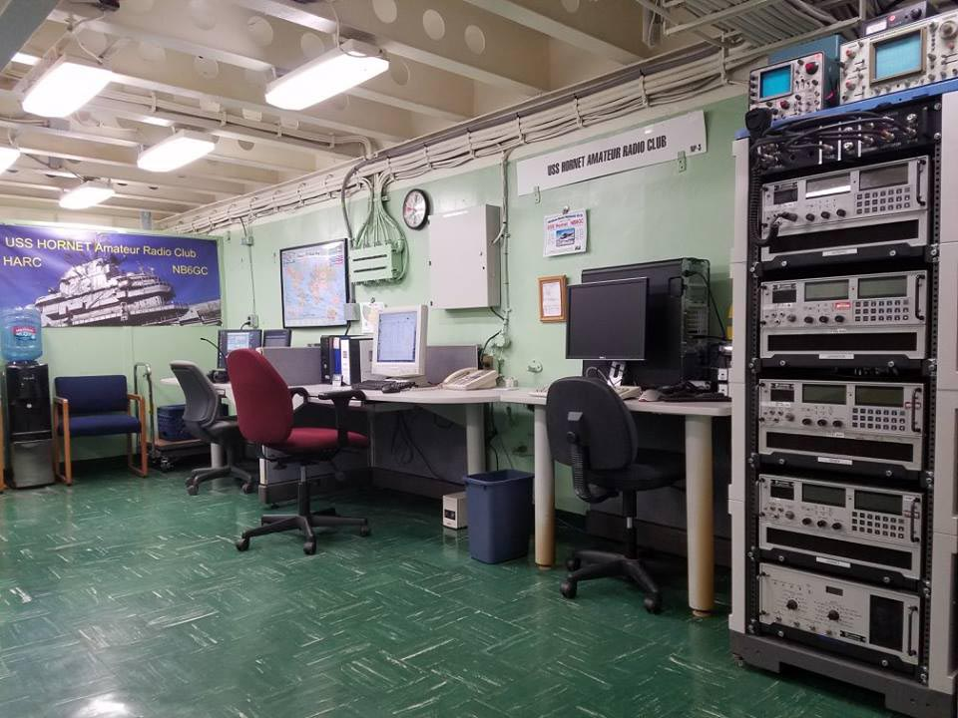
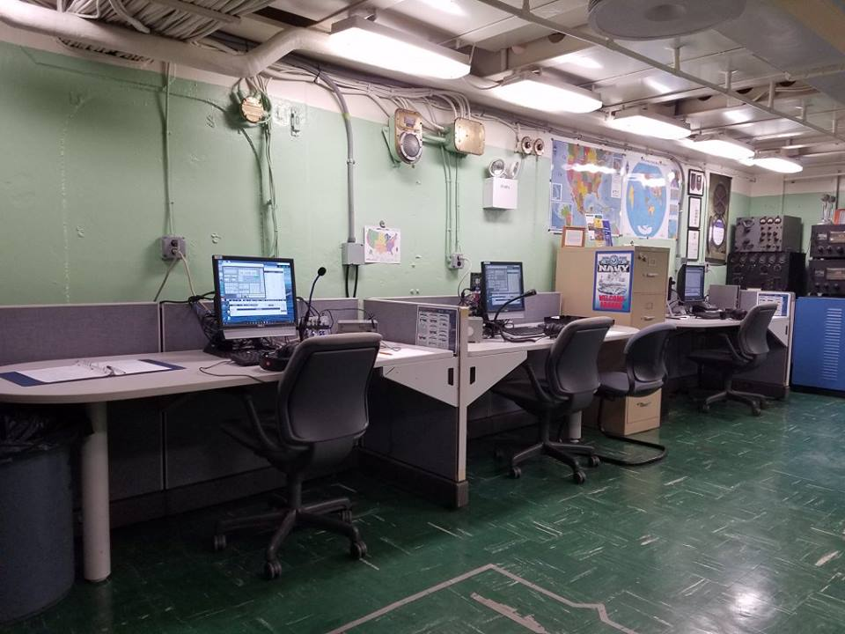
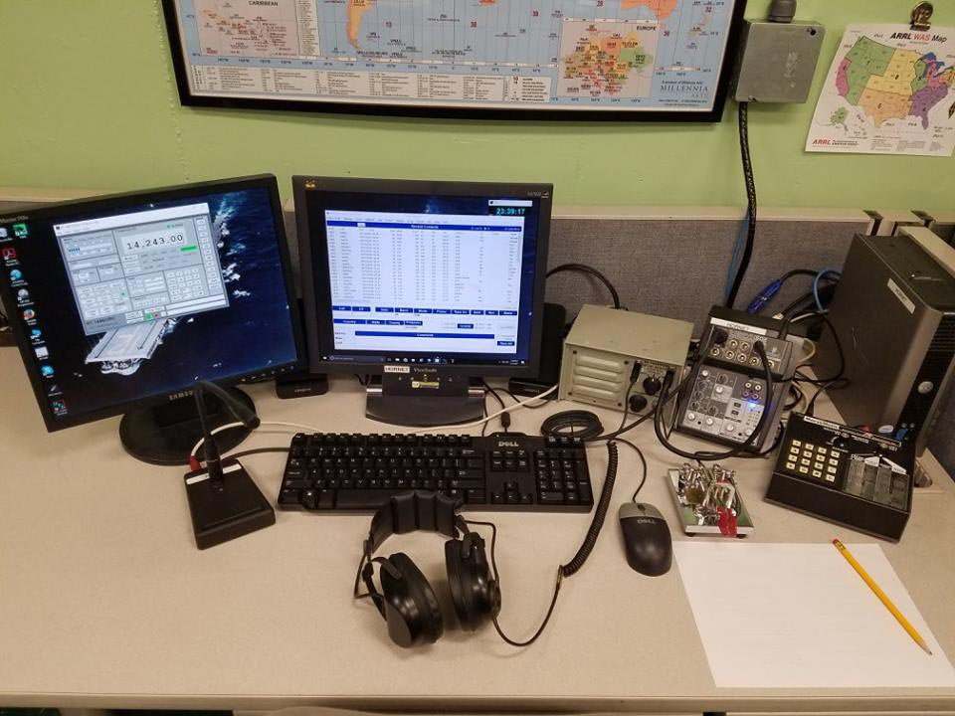
Visit the USS Hornet Radio Room
If you are planning to visit the USS Hornet Museum Ship, give us a heads up so we can meet you at the ship and show you around the station. Contact us at the email addresses listed below at least a week before your planned visit and some times that work in your schedule! We're really proud of USS Hornet and the NB6GC Radio Room and like to show them off.

Slide 10
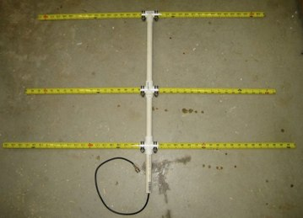
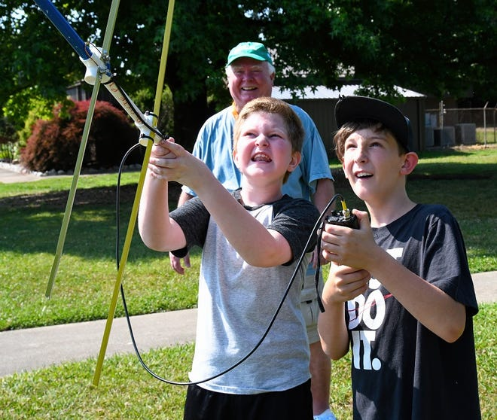
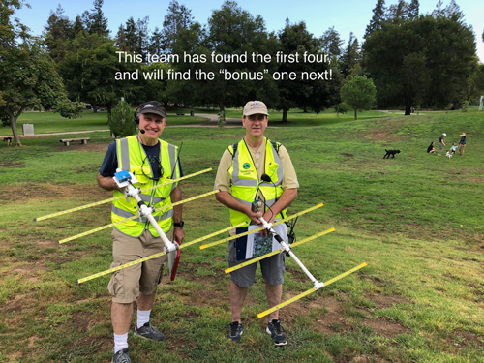
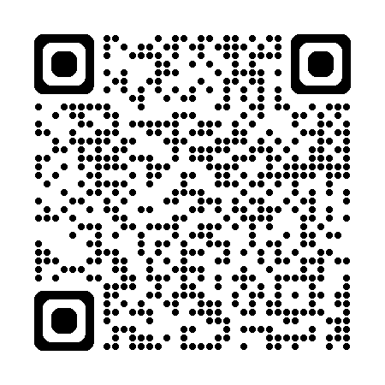
Fox Hunting
Every weekend, in cities and towns all across the country, ham radio operators gather on hilltops for a very special kind of contest--the Fox Hunt. A small, low power transmitter is hidden and the rest of the crew tries to find it. Sound simple? It can be very challenging and a whole lot of fun. The direction finding skills learned in this activity can be very valuable in locating a repeater jammer, or a lost hiker.
Use an inexpensive homebuilt antenna, or ask for a loaner. You may also join a team.
Does not require a Ham License to hunt as you do not transmit. That means kids¹ can participate!
1: Kids are not provided. Bring your own. Instructions for building a kid are also not provided.

Slide 11
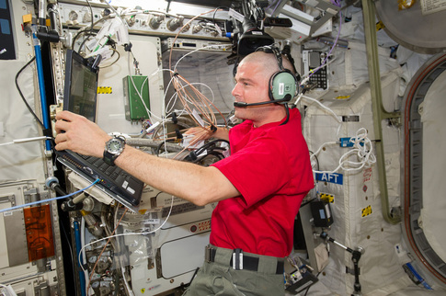
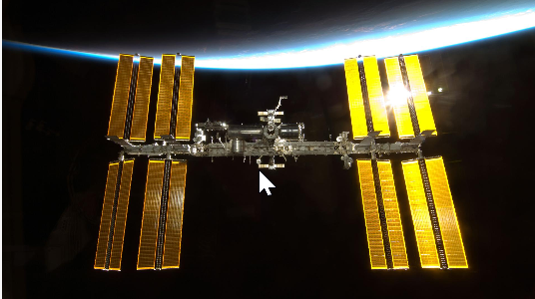
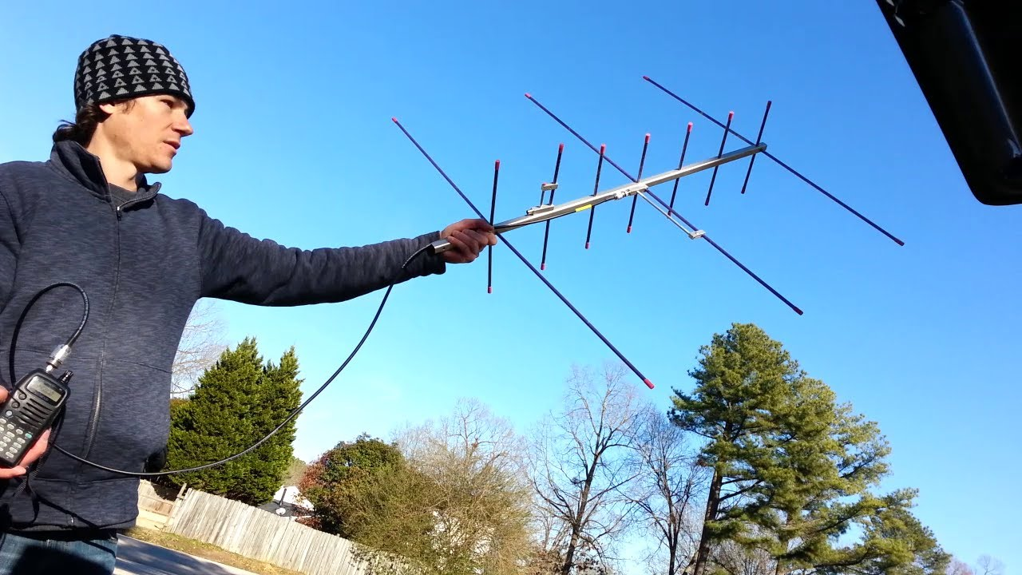
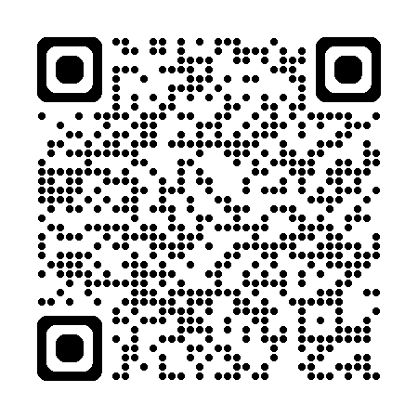
Contact the International Space Station
Some ISS crew members make random, unscheduled, amateur radio voice contacts with earth-bound radio amateurs, often called "hams". They can make radio contacts during their breaks, pre-sleep time and before and after mealtime. Astronauts have contacted thousands of hams around the world. The work schedules of the ISS crew dictate when they are able to operate the radios. The crew's usual waking period is 0730 - 1930 UTC. The most common times to find a crew member making casual periods are about one hour after waking and before sleeping, when they have personal time. They're usually free most of the weekend, as well .
APRS (Automatic Packet Reporting System) is an Internet-based network that inter-connects various APRS radio networks worldwide1. The International Space Station (ISS) has an active APRS digipeater operating on 145.825 MHz. APRS was designed for local tactical real-time human exchange of brief digital information

Slide 12
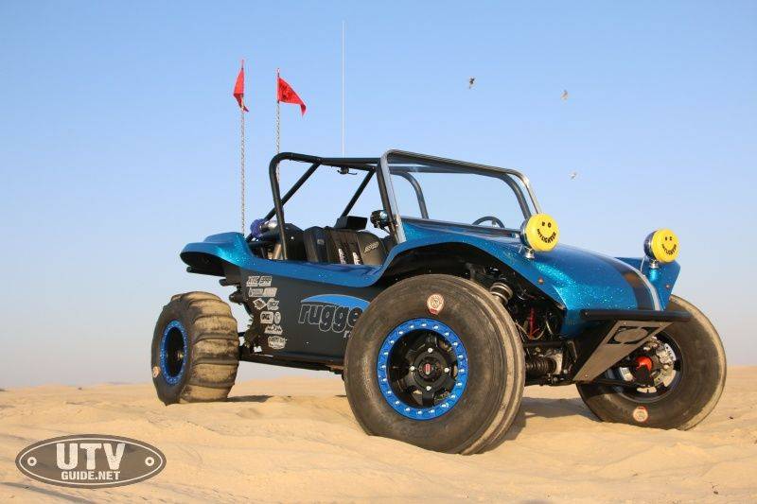
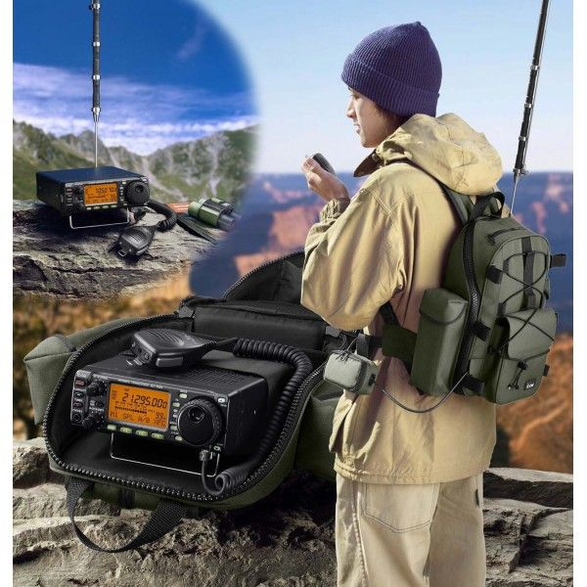
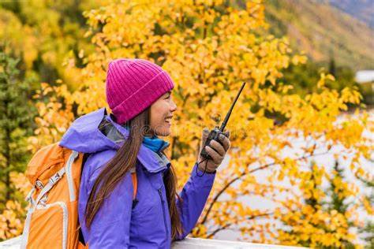
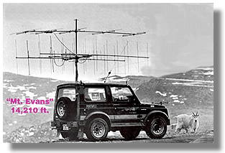
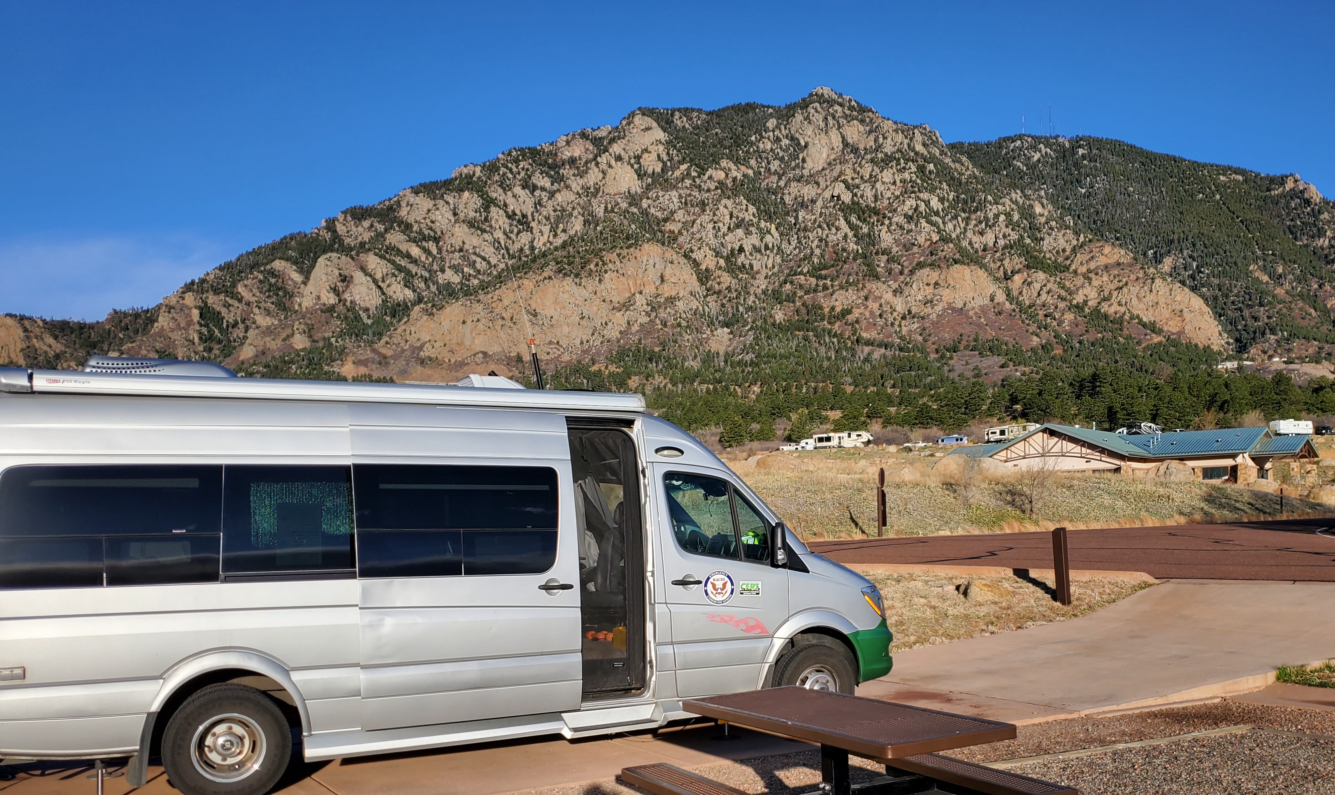
Backcountry Communication
Many people like heading out into nature, far beyond the reach a cell towers. Hikers, Offroaders, and Campers may need a form of communication that does not rely on AT&T…

Slide 13
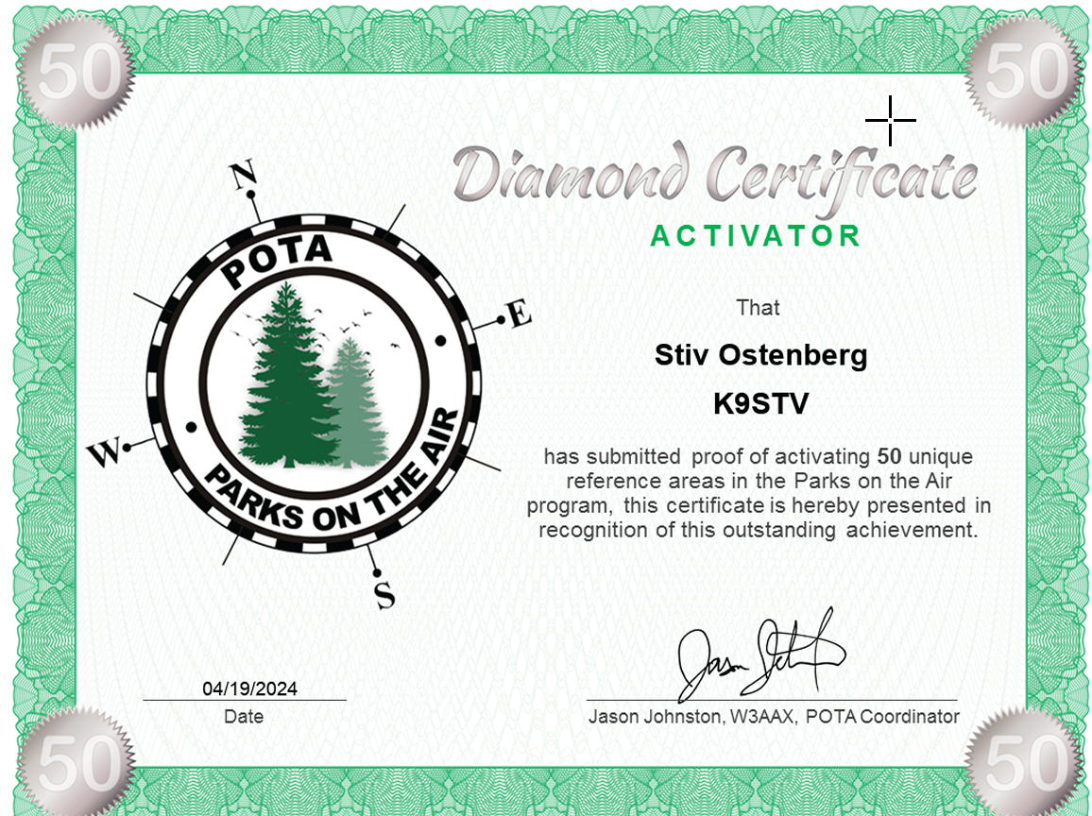
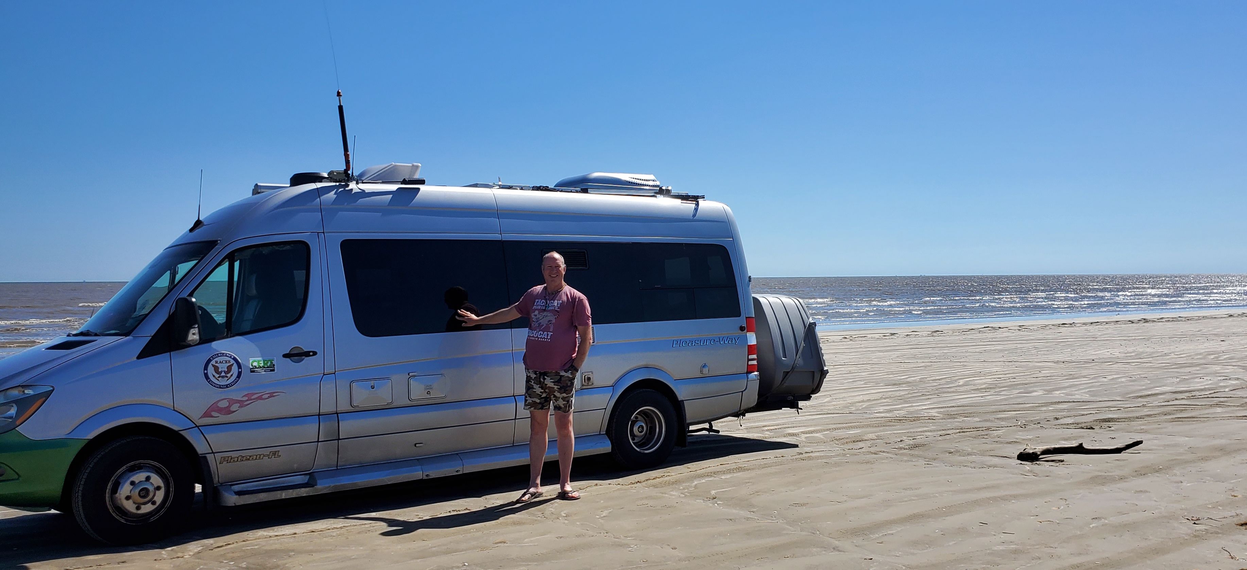
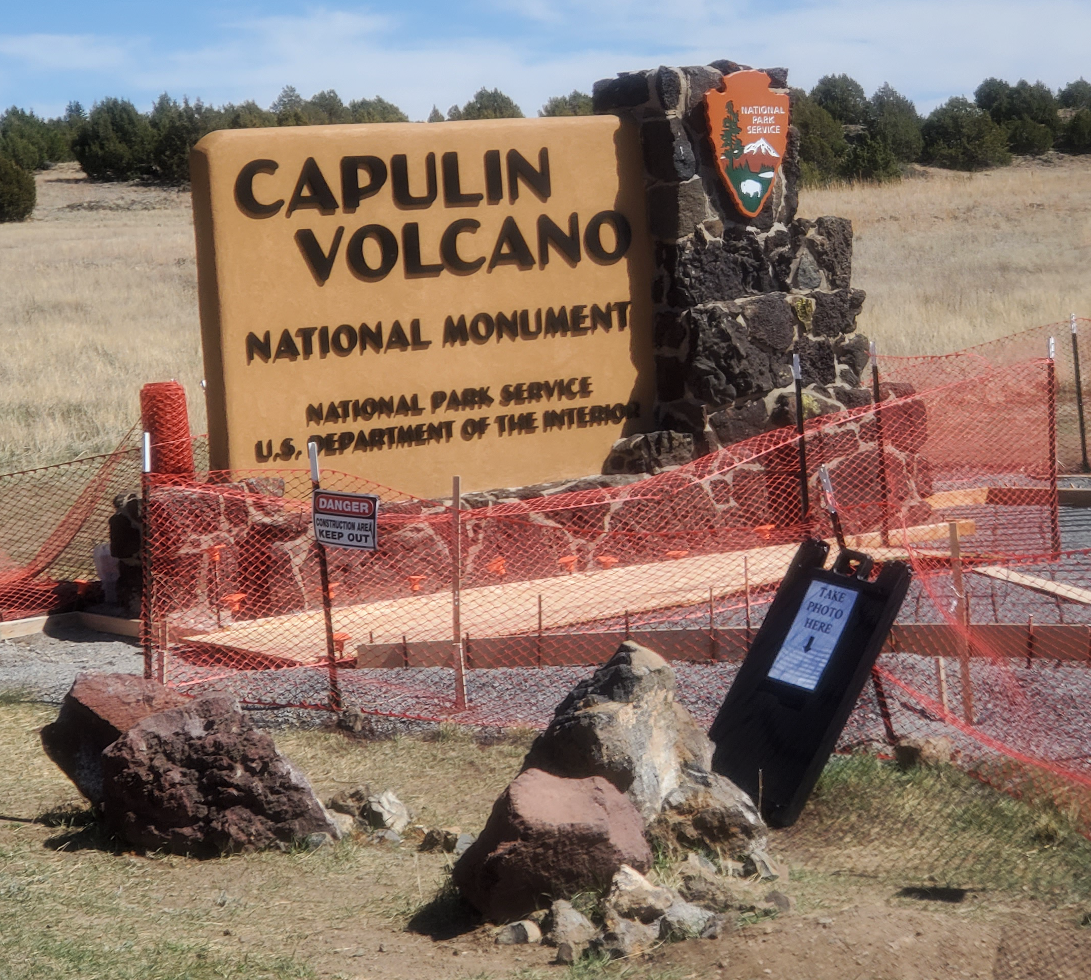
Parks on the Air
“Activate” a park by making contacts from within a State or National Park.
“Hunt” parks by contacting the people activating parks from your location.
Collect Awards at various milestones
Activating Cheyenne Mountain, Colorado

Slide 14
Making DX Connections
Collect QSO cards from contacts made around the world!

Slide 15
Operate Digital Modes
You don’t need Morse Code to talk around the world anymore!
Send data using your computer & radio

Slide 16
Summits on the Air
Go mobile! “Activate” a mountain top by setting up a station on top of a mountain and making at least 4 contacts.
Peaks are rated on difficulty. A peak you drive to is easy. If you need to carry all your gear to the top and set it up, it is worth more points.

Slide 17
Contesting
Goal
The goal of Amateur Radio contesting is to contact as many stations as possible during the contest period.
Every contest has Contest Rules:
Only certain bands may be used
The contest only takes places between certain times and on certain dates..
An exchange of information is necessary during each contact. You may be required to send and receive a serial number, location, name or even a person’s age.
Only certain operating configurations can be used. You may have to choose a “category” of operation such as a single operator using low power.
Photos from WVARA Field Day, 2017

Slide 18
ARRL Field Day
Field Day is ham radio's open house. Every June, more than 40,000 hams throughout North America set up temporary transmitting stations in public places to demonstrate ham radio's science, skill and service to our communities and our nation. It combines public service, emergency preparedness, community outreach, and technical skills all in a single event. Field Day has been an annual event since 1933, and remains the most popular event in ham radio. ARRL Field Day is always held on the 4th full weekend in June.
2024 ARRL Field Day is June 22-23. Many local clubs are participating!

Slide 19
Apocalypse Preparation
Nobody knows how the world will end
Alien Invasion
Armageddon
Meteor Strike
Plague
Zombie Uprising
With a ham radio, at least you can talk about it!

Slide 20
Join the MeetUp Group
The SPECS MeetUp group was created to showcase all the Ham Radio related events going on in the Bay Area. We are trying to get more events where people can go to learn about what they can do with their licences, and to facilitate making connections between Elmers (Mentors/Teachers) and Hams looking to learn. We are encouraging clubs to post their meetings and events here to make them more widely available.
We also hope to start promoting events to evangelize Ham Radio to attract a new generation of operators to carry Ham Radio into the future. Participating in the MeetUp will help encourage more people to become active.

Slide 21
The MasterHam Project
A single source for reference, programs, manuals, and Emcom resources.
Living document, updated as time permits and as new items found.
Sneakernet. Too large for interet distribution.
Free to share
Includes Stiv’s Guide to Ham Radio in the SF Bay Area, another living and growing document.

Slide 22
Join the Groups.IO site
Announce@SF-Bay-Ham-Radio.groups.io
Where the MeetUp group is intended to host events, the Groups.IO site is intended to facilitate cross-club communication and to connect all Hams in the area with topics they are interested in. In addition to club specific lists, there will be lists to support various collaborative projects, and to host discussion between Elmers, Volunteers and new hams.
We all know we have a generation cliff facing Ham Radio. This Groups.IO sites ultimate goal is to get people cooperating towards addressing this problem.

Slide 23
Community Outreach Site
Join the MeetUp Group
Sign up for Groups.IO and join the discussions
Tap into the MasterHam Project
New Ham Resources.
http://qsl.net/k9stv

Slide 24
Join a club!
SPECS | SVECS | South County (San Mateo) (SCARES)
Foothills Amateur Radio Club | Santa Clara County ARES®/RACES | West Valley Amateur Radio Association (WVARA)
Palo Alto Amateur Radio Association | Northern California DX Club | South Bay Amateur Radio Association
50 MHz and Up Group of NorCal | NorCal Contest Club | San Mateo Radio Club – W6UQ

