Slide 1
POTA and SOTA
Life outside the Shack

Slide 2
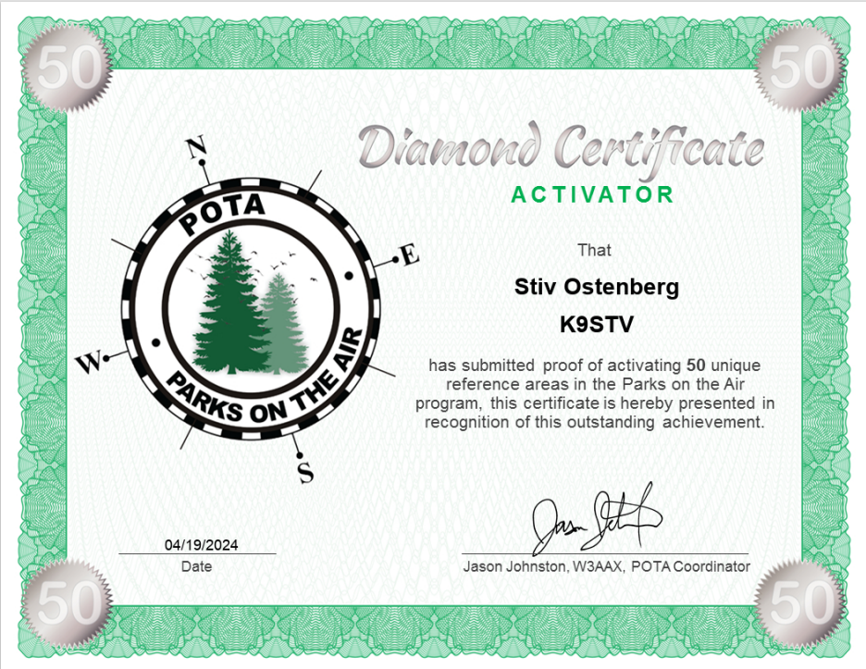
What are POTA and SOTA?
Parks on the Air and Summits on the Air are Ham Radio award programs each with specific rules
There are two roles for operators in each program
Hunters
Activators
Both encourage Hams to get outdoors to operate
POTA is more popular with better implemented services
SOTA is more challenging and requires a bit of learning
Southern Peninsula Emergency Communications System

Slide 3
Why participate?
Ham radio is a learning experience. New activities are new opportunities!
Using your skills develops them. Skills learned in one activity can aid your other activities.
POTA and SOTA encourage getting out of the shack and into the world!
Opportunity to share Ham Radio with the public.

Slide 4
What do you need to play?
A Ham radio license, and a radio.
VHF/UHF are shorter range and may require coordination to activate. Use of repeaters is not allowed for contacts, but you can solicit contacts off a repeater.
HF offers longer range communications so more potential contacts.
Hunters can use their home rig.
Activators must go mobile. Activators can also hunt.
Use voice, CW, or digital modes..

Slide 5
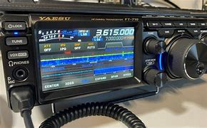
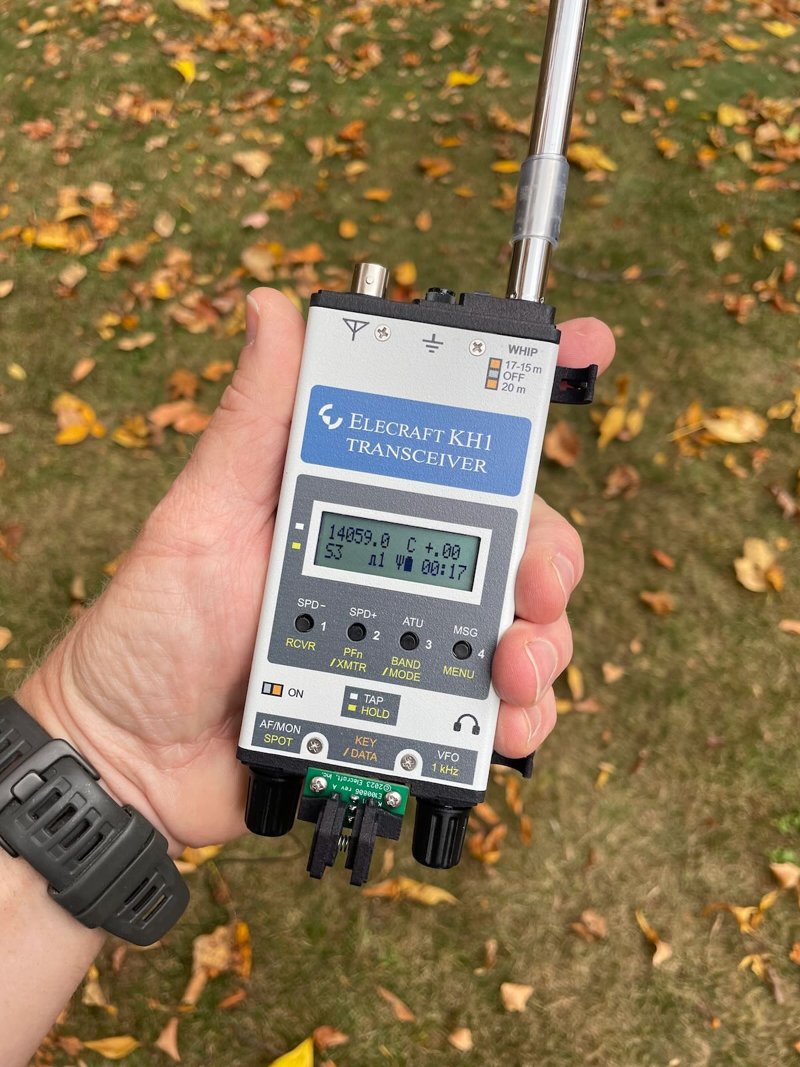
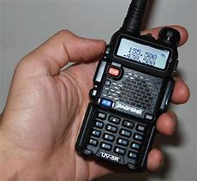
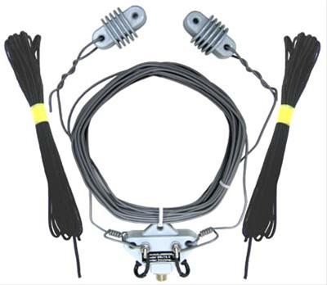
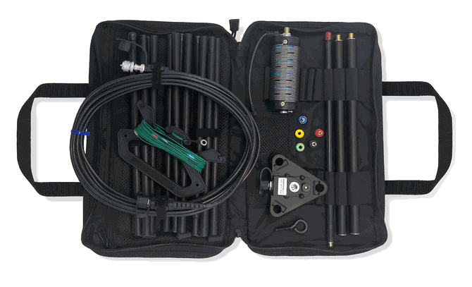
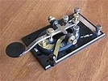
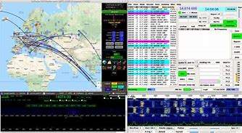
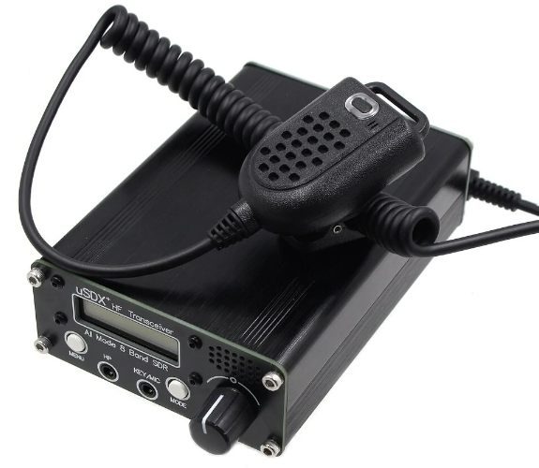
So many choices!
QRP, HT, or 100 watts?
Which Antenna?
CW, Voice, or Digital?
Cheap or Pricey?
SOTA or POTA?
Buy what you can afford and make it work.
Notes:
There is no right answer for what equipment to use for an activation. While a standard mobile HF station with 100 watts power is a great option, many hams prefer lower weight units that use less power (Called QRP) to make them easier to transport and operate longer. Different modes also have different characteristics. HF offers better chance of activating due to the greater range, but an VHF/UHF handheld can be made to work.
The challenge with VHF/UHF is finding contacts. Use of repeaters to activate is against the rules, however using a repeater to spot yourself and solicit contacts on a simplex frequency IS allowed. Spotting using the POTA website, or HAMRS can also help.
Bigger antennas are better, but smaller antennas are more portable. Dipoles are a great answer if you have a pole or trees to raise them up. Many hams like coil based antennas for the flexibility and size they offer, and they can be free standing.
Depending on whether you are doing POTA and operating from a car, or SOTA and carrying your rig up a mountain may influence your decision.

Slide 6
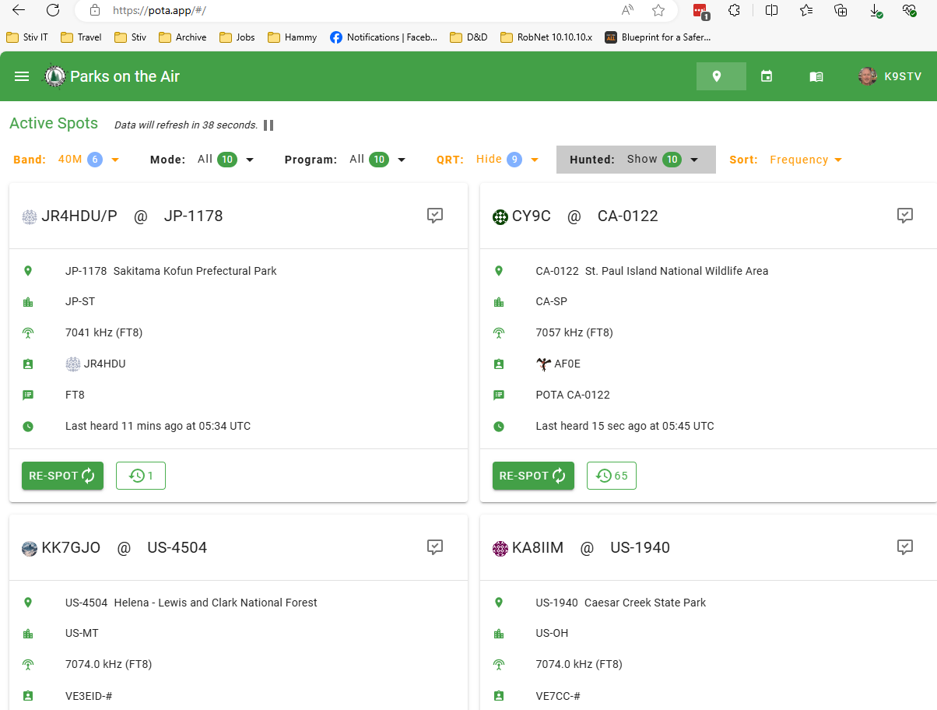
Getting started hunting with POTA
Sign up at POTA.app
Choose your filters
Hunt your prey….
Notes:
The POTA site will list activators, along with the location and frequency they are operating. This is a great way to get a list of frequencies to try. I usually sort by frequency on a band, then go down the list attempting a contact with each.
If you do not have Internet access, you can just scan through channels and listen for folks calling “CQ POTA”.

Slide 7
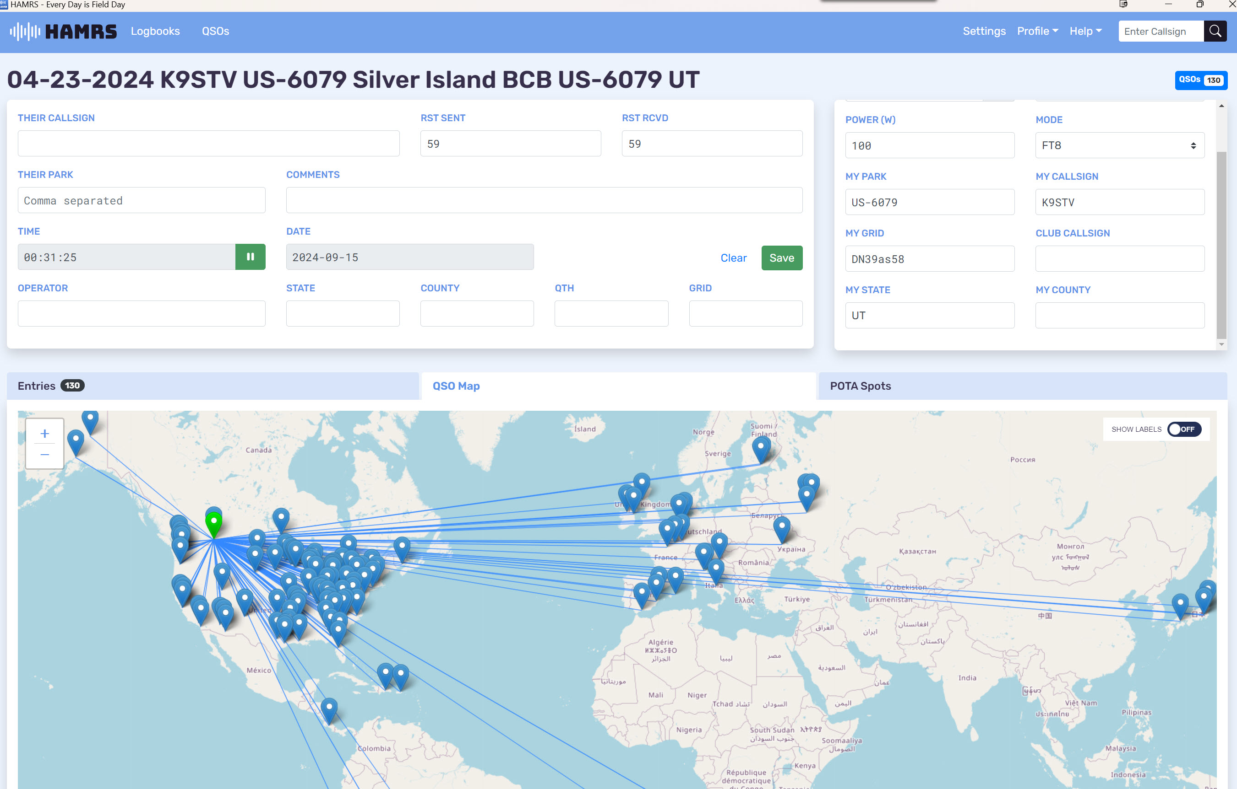
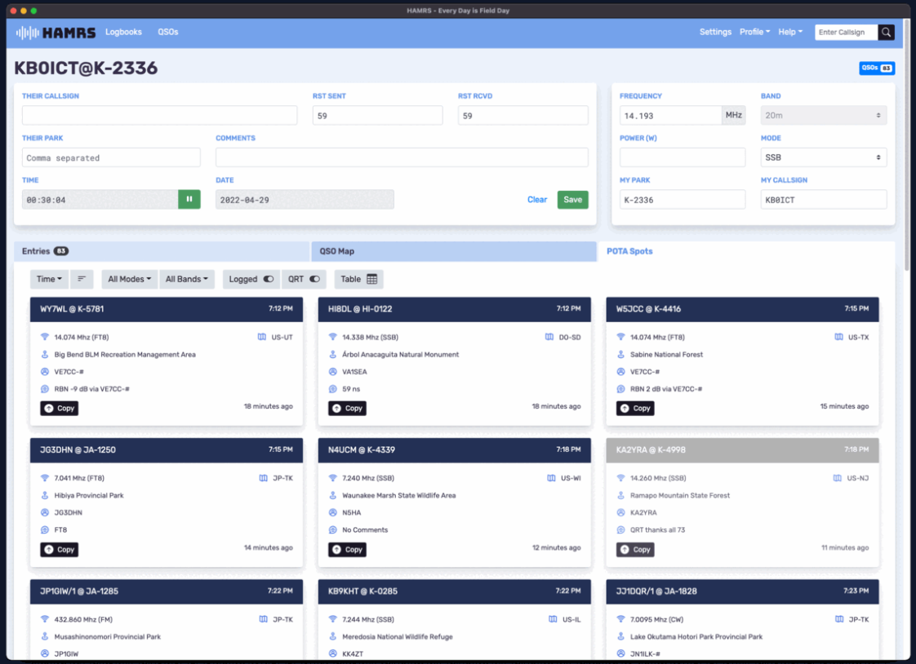
Log your contacts!
Only activators submit a log
HAMRS is stale, but popular
PC, iPhone, or Android
QSO Map
POTA Spots
Notes:
You can use any logging software, there are many options. HAMRS is stale (it has not been updated since park ids changed) but it is super easy to use and works on both PC and Android. It has features specific to doing a POTA run that make it popular.
While only activators submit a log, hunters get credit for logs they appear in.

Slide 8
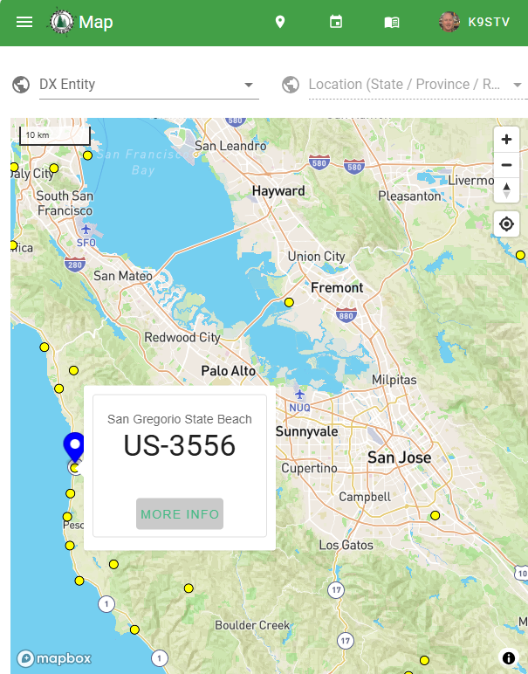
Activating with POTA
Open the Map on the POTA site.
Find a Park or Site to visit, note the number!
Go to that park with your radio.

Slide 9
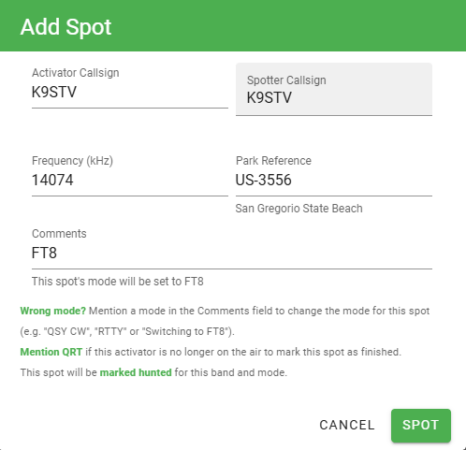
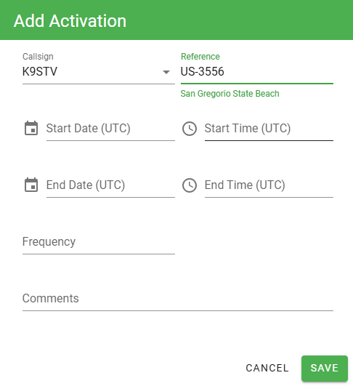
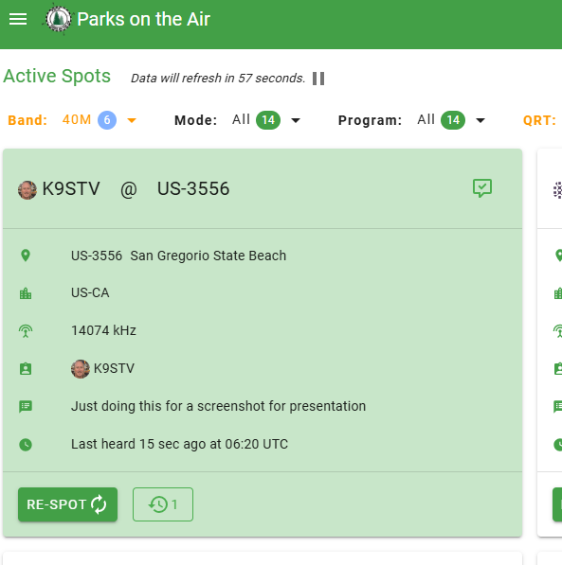
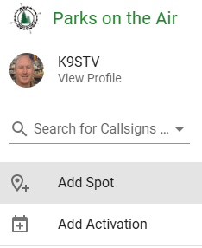
Spotting Yourself
Spotting yourself onsite
Spotting yourself in advance
Lets people know you are there so they can hunt you.
Notes:
Adding a spot is something done while operating.
Adding an activation is something you do if you will not be able to spot yourself onsite due to lack of connectivity. You simply let the app know when and where you will be operating.

Slide 10
Hunting from a Park
Each contact out counts towards activation.
Use the POTA Spots to make a Park to Park contact! Credit as both hunter and activator!
Record their park number in your log.

Slide 11
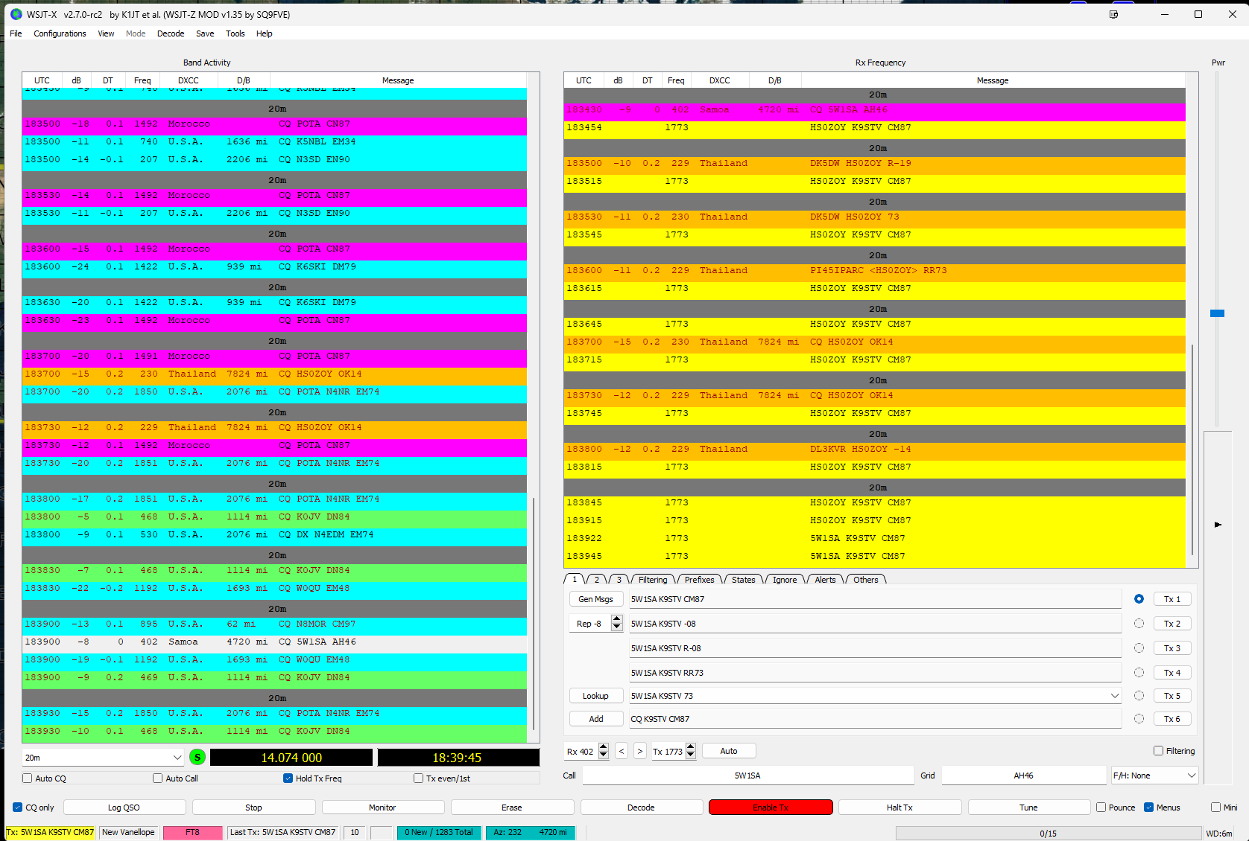
Using Digital Modes
Digital Modes increase your range, but take more time. FT8 is popular.
WSJT is used to transmit FT8
Cool visualization tools
Can be tricky getting everything lined up to work right.
Notes:
Digital modes offer distances comparable to CW (Morse Code) without the manual effort.
Setting up requires computer settings and radio settings align, and can be tricky to get working.

Slide 12
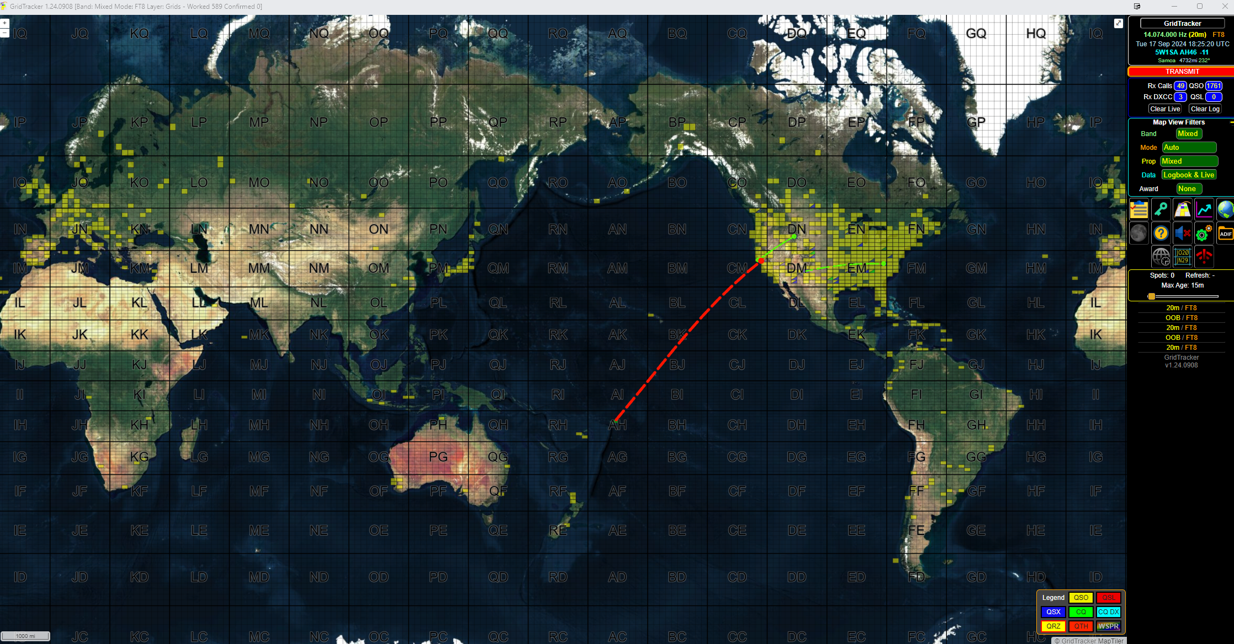
Gridtracker with WSJT & FT8
12
Notes:
Gridtracker is a program that can read network output from WSJT and display it on a map. It maintains a history of contacts, and shows other contacts being made making it useful for seeing where signals are going.
In the map above, yellow squares are squares I have made contacts with at some point. Green squares are calling CQ, and blue squares active. Green lines show stations having a conversation, and the red line is who I am talking to. If a square I have contacted is on the air, the square is shown as half yellow and half blue or green.

Slide 13
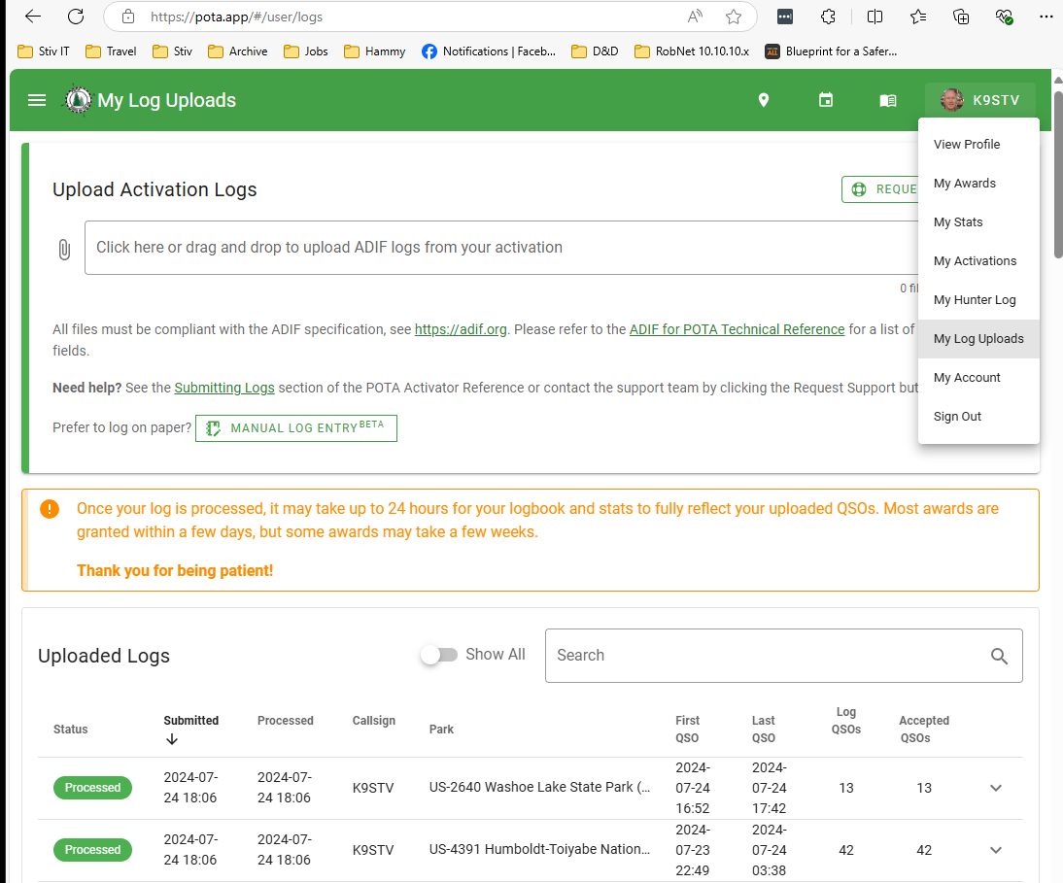
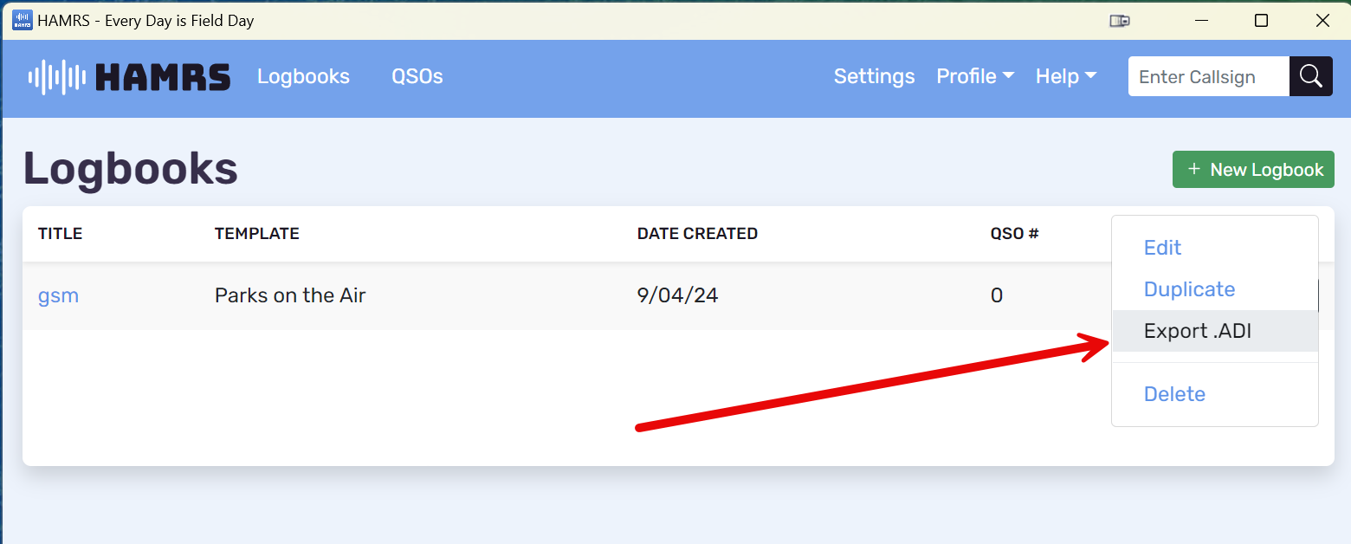
Submitting your logs
Only activators upload!
Export log to .ADI Format
Upload to POTA.app
Notes:
Submitting your logs is how you get credit for your work. You can use any logging program that will export to ADI, though HAMRS has no caveats and contains all information needed.
You can also upload logs to EQSL and Logbook of the World.

Slide 14
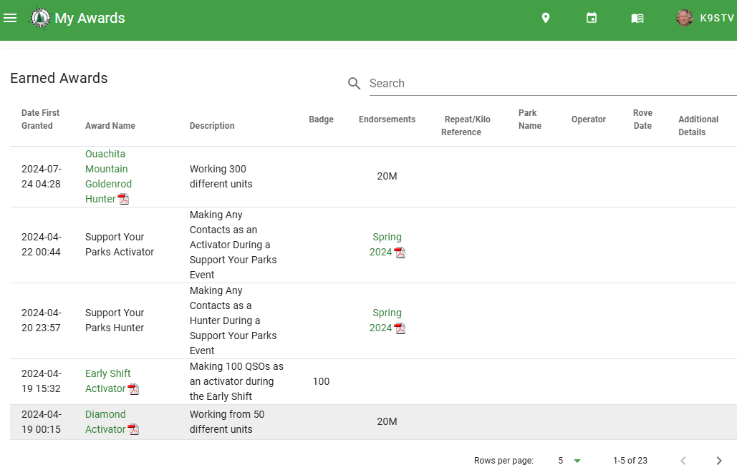
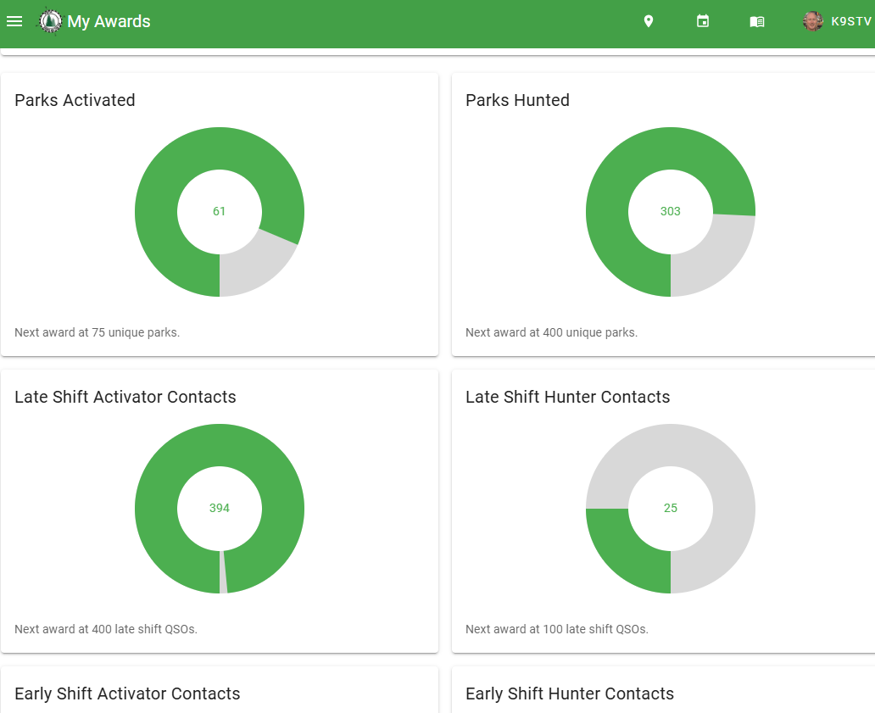
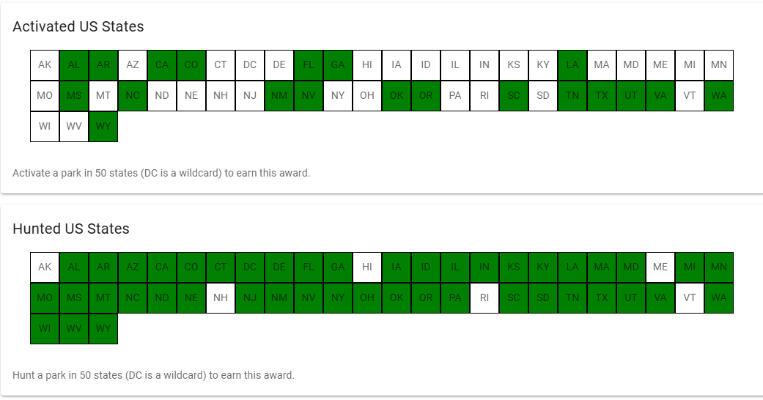
Collect Awards
Collect awards
Track Progress
Notes:
There are many awards for different accomplishments. Some are tracked, such as Parks Activated, and some just pop out and surprise you, such as the Warthog award for 5 parks in one day.

Slide 15
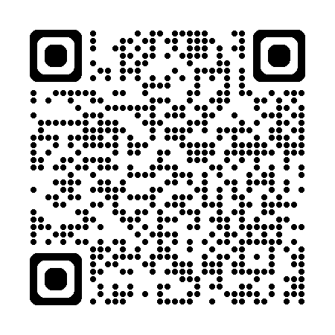
Summary
SOTA and POTA offer new opportunities to operate and learn.
Get out of the shack, and promote ham radio
We live in an amazing country, get out and explore.
Be an advocate for Ham Radio in the field.
Join the Community sites…
Notes:
There are many awards for different accomplishments. Some are tracked, such as Parks Activated, and some just pop out and surprise you, such as the Warthog award for 5 parks in one day.

Slide 16
THANK YOU!
Stiv Ostenberg, K9STV
Email
stiv@stiv.com

