Slide 1
Off-Grid Spotting with SOTAmāt
Stephan Schmid, HB9EAJ
HAM RADIO 2023
Notes:
Thanks to Sylvia for having me as your guest.
At first I was not convinced about giving a presentation, because I haven't tested it for at least 100 activations.

Slide 2
Presentation Overview
Purpose and overview of SOTAmāt
Existing spotting possibilities
Setup and configuration of SOTAmāt
Self-spotting example
How it works and caveats
Tips & tricks and outlook
Questions anytime, please!

Slide 3
SOTAmāt Overview
Website: sotamat.com
Developed in 2022 by Brian Mathews, AB6D
The system consists of a server application and a smartphone app (iOS and Android)
Allows self-spotting on HF, typically using FT8
The name is pronounced differently than you might think, but you'll get used to it ;-)

Slide 4
Sounds Familiar to You?
You've hiked for several hours to a summit and have no mobile network coverage
OK, let's try to spot with APRS, choose one:
No digipeater reachable
Handheld UI is tedious
I should've learned CW and posted an alert beforehand!
Notes:
Been there, done that

Slide 5
SOTA Spotting Possibilities 1/2
SOTAWatch, SOTA API (used by 3rd-party applications like SOTLAS)
SOTA SMS Gateway Service
Doing CW after posting a corresponding alert
APRS to SOTA on 144.800 MHz FM (Europe)
JS8Call on HF (needs a laptop or a single-board computer)

Slide 6
SOTA Spotting Possibilities 2/2
Ask another ham on the air to spot you (hopefully, there's no contest going on)
A satellite messenger, e.g. Garmin InReach, Zoleo or SPOT-X:
They use Iridium or Globalstar low-Earth-orbit satellites and need a clear view of the sky
Requires a subscription
New: Use SOTAmāt with your SSB transceiver!

Slide 7
Why is SOTAmāt so Cool?
It's free and you probably already have all the equipment!
Basically, works with any smartphone
FT8 audio is generated by the app itself
Works with any HF SSB transceiver with a microphone (audio cable is optional)
Once everything is set up, it's quick and easy to spot
Notes:
Android 5.0 or higher
IOS 14.5 or higher

Slide 8
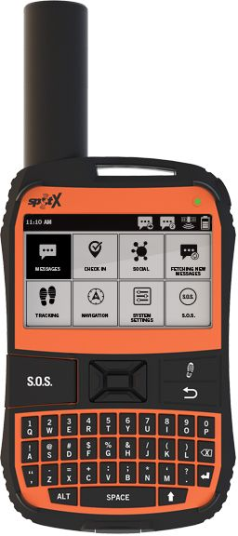
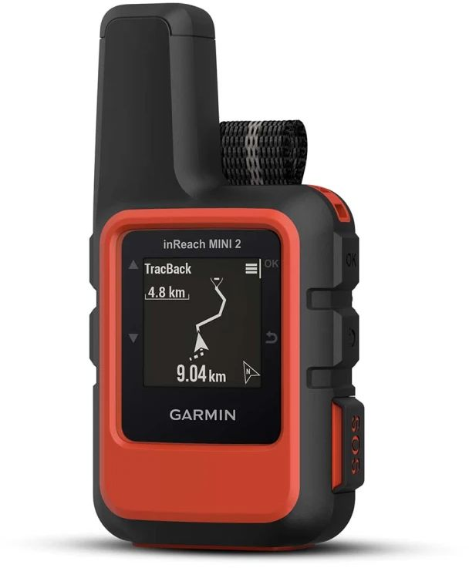
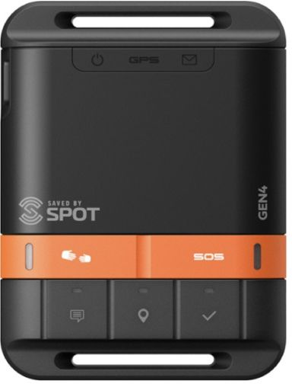
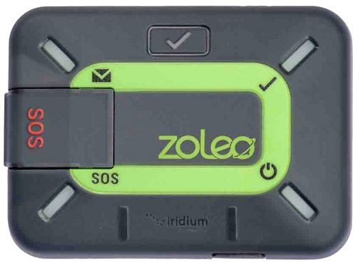
Further SOTAmāt Features
POTA self-spotting
Self-alerting, mainly useful for CW operators
Send a predefined email or SMS message
Several two-way commands, by SMS, email or satellite communicators

Slide 9
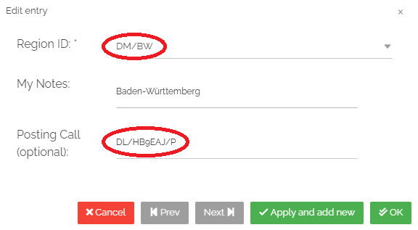
SOTAmāt Setup – Server 1/4
Register on sotamat.com
Go to menu HF PREPARATION:
Add SOTA REGIONS (including association) with your call sign, e.g. DM/BW with DL/HB9EAJ/P
Notes:
Use your call sign as username.

Slide 10
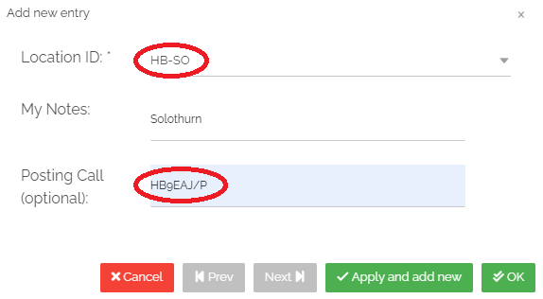
SOTAmāt Setup – Server 2/4
Optional: Add POTA LOCATIONS e.g. HB/SO with call sign HB9EAJ/P used:

Slide 11
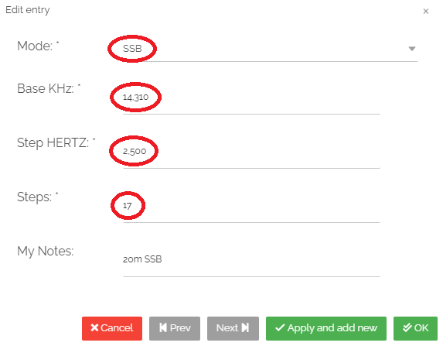
SOTAmāt Setup – Server 3/4
Add FREQUENCIES & MODES e.g. SSB, 14.310 MHz base frequency with 2'500Hz step increment and 17 steps (14.310 MHz to 14.350 MHz*): * Do you see the mistake?

Slide 12
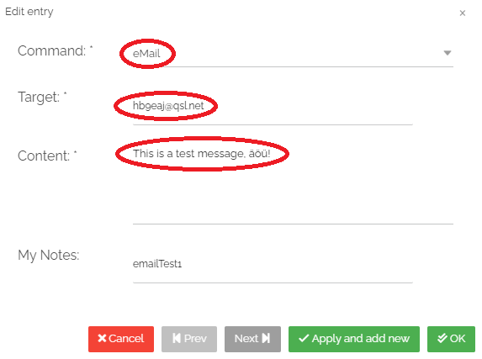
SOTAmāt Setup – Server 4/4
Optional: MESSAGING COMMANDS e.g. email, SMS or REST, with predefined content

Slide 13
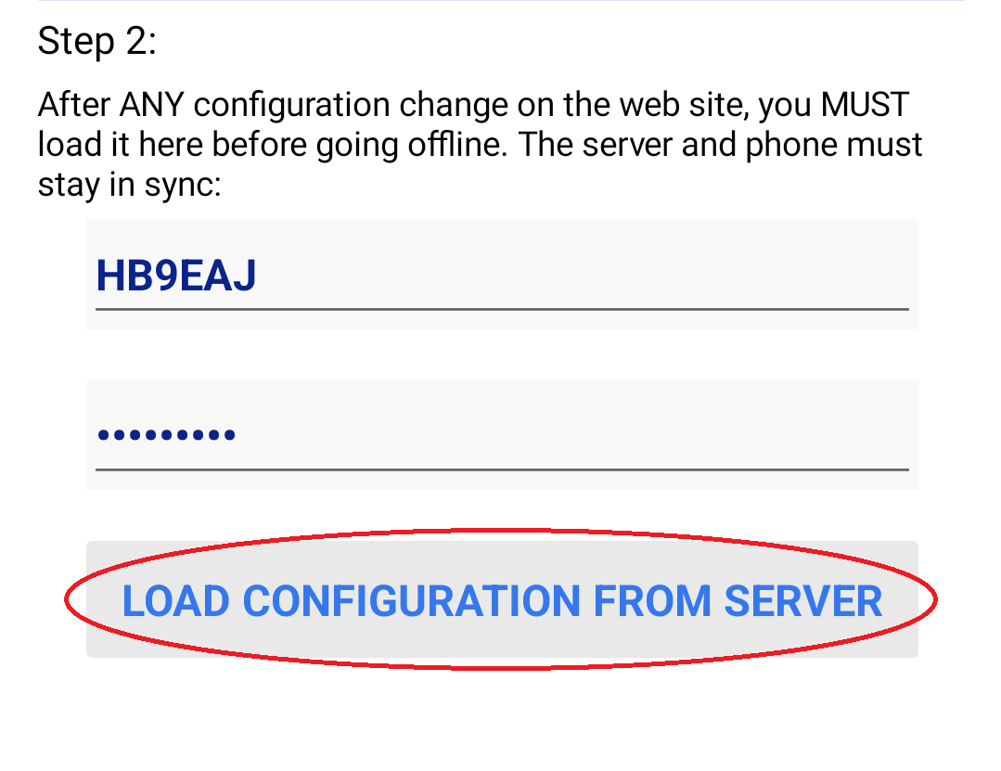
SOTAmāt Setup – App 1/3
Install the SOTAmāt app:
Android ≥ 5.0: or as APK file
iOS/iPadOS ≥ 14.5:
Go to menu Setup:
Enter login credentials and press [LOAD CONFIGURATION FROM SERVER] button:

Slide 14
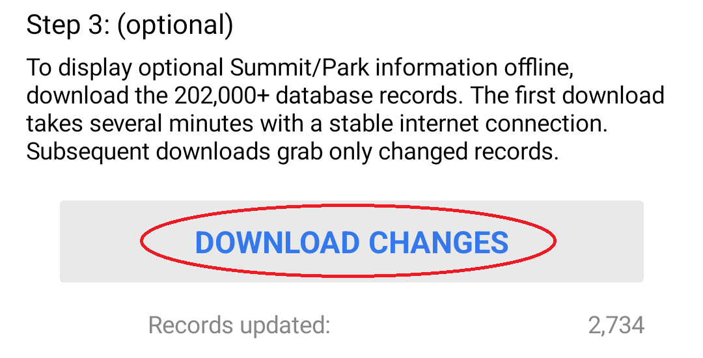
SOTAmāt Setup – App 2/3
Optional: Press button [DOWNLOAD CHANGES] (SOTA and POTA offline data):

Slide 15
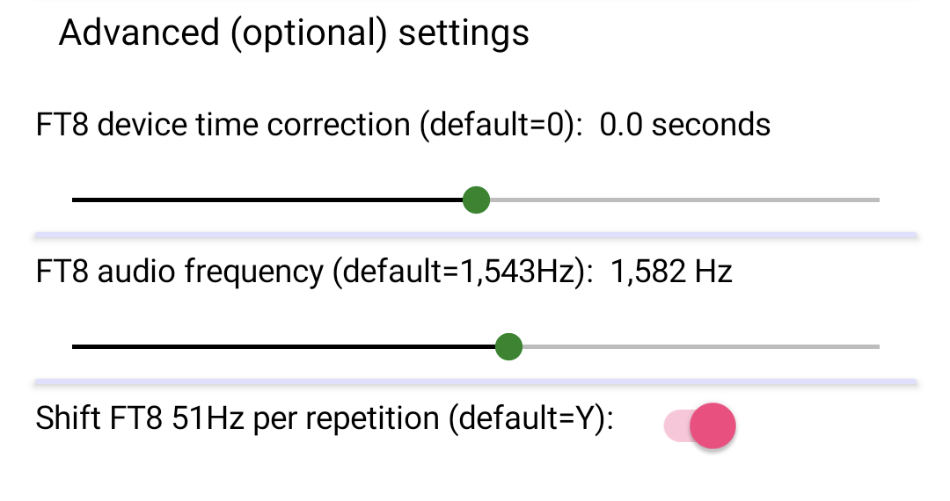
SOTAmāt Setup – App 3/3
Advanced settings:

Slide 16
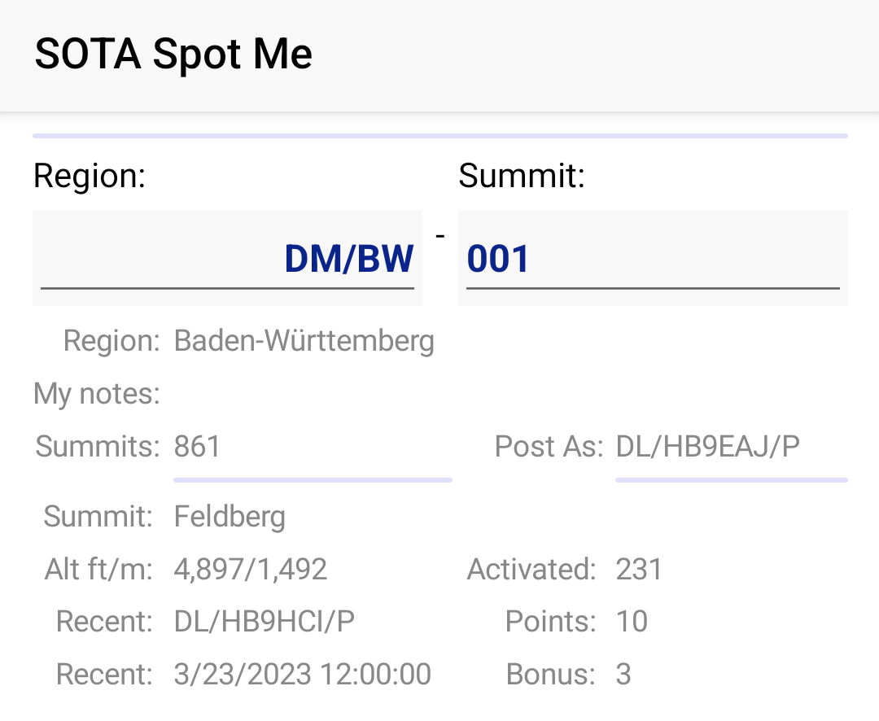
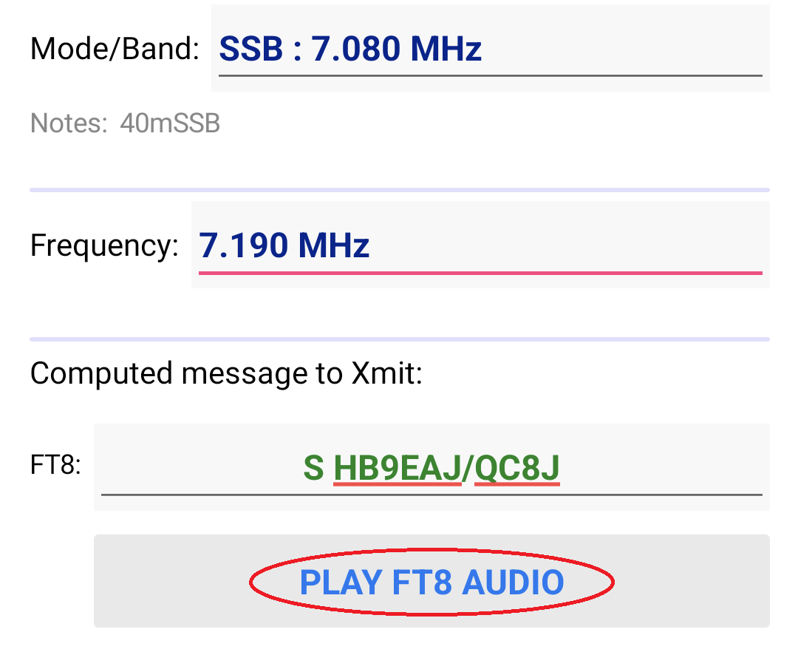
SOTA Spotting Example – Setup
Spotting on DM/BW-001 for 7.190 MHz SSB:

Slide 17
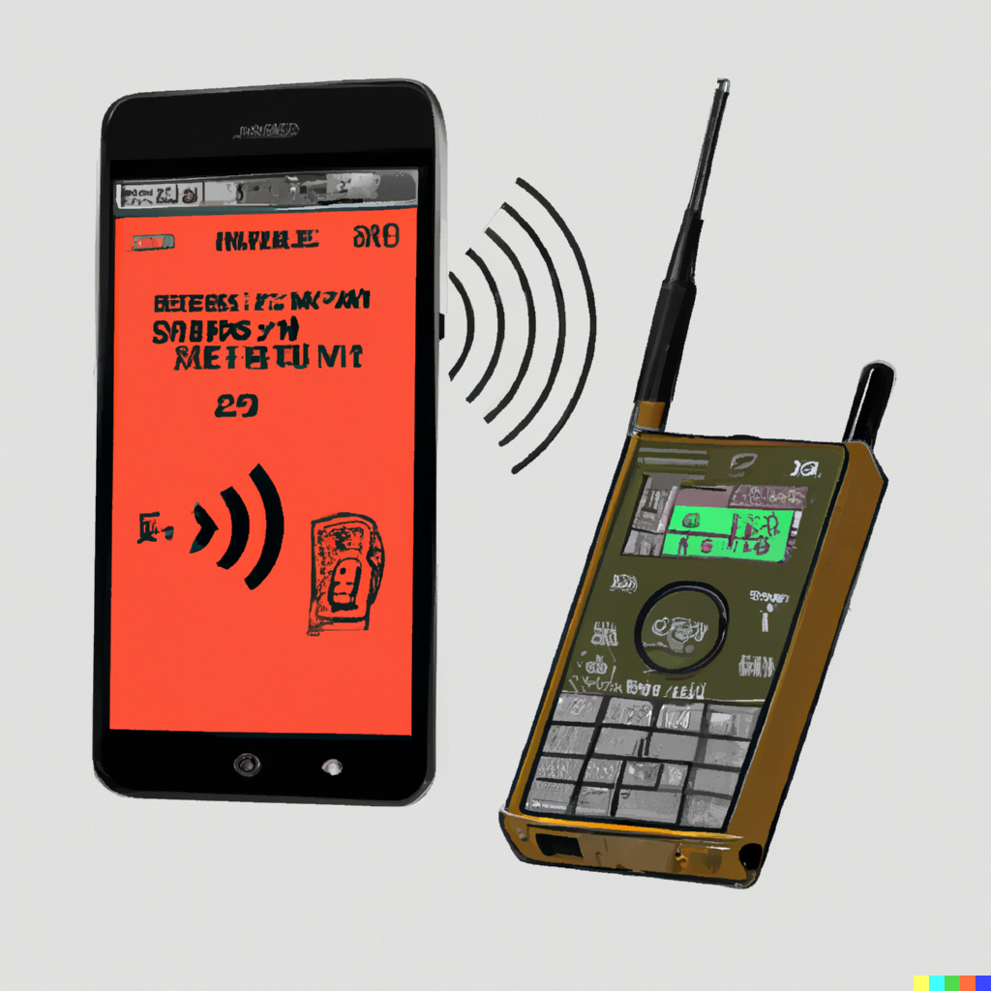
FT8 Audio is Played - Notes
FT8 band and spotting band may be different
FT8 on 20m is best
FT8 runs on USB
Send it redundantly, duplicates are OK
AI-generated image by DALL·E
Notes:
Duplicate messages will be avoided for 15 minutes.

Slide 18
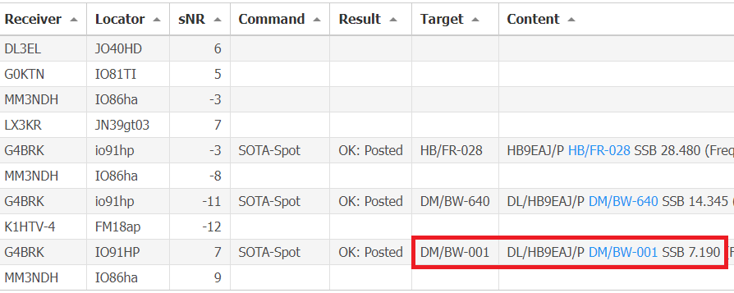
SOTA Spotting Example – Result
G4BRK received and spotted me! (can be seen under sotamat.com/activity)

Slide 19
SOTAmāt Workflow
FT8 TX → skimmer RX →PSK Reporter → SOTAmāt → SOTAwatch, email, SMS, ...

Slide 20
Notes about Spotting
Only about 0.2% FT8 skimmers can decode FT8 free text and send it to PSK Reporter:
Currently only SparkSDR and WSJT-X plugin
Spotting can take up to 6 minutes:
Skimmers cache for 5 minutes before sending to PSK Reporter
Remaining minute is spread over the systems
On average a spot needs 2-3 minutes

Slide 21
Encoding the Message 1/2
Data is encoded in an FT8 free text message (max. 13 alphanumeric characters)
Format example: S HB9EAJ/WXYZ
S: Free text start character(s), followed by a space
HB9EAJ: Call sign (max. 6 characters)
/WXYZ: Call sign suffix (max. 4 characters)
Suffix with max. 4 alphanumeric characters (A..Z + 0..9) = Total 1'727'604 combinations

Slide 22
Encoding the Message 2/2
Many of these 1.7M suffix combinations have a conflict or special meaning (e.g. /P, /W4, /HELP, …) and can't be used
1 Mio possible combinations remain:
Only a limited combination of regions, modes and frequencies can be defined

Slide 23
Caveats 1/2
One-person project (with the help of others)
Currently closed source, but will be opened
No guarantee that it works when needed
Few skimmers handle our FT8 format, even fewer support PSK31 (e.g. for KX2/3 owners)
May need up to 6 minutes to be spotted
Strong wind and other sound may affect FT8 audio when using a microphone

Slide 24
Caveats 2/2
Only previously defined data can be spotted, e.g. you can't spot a reference if you're on the "wrong" side of a border summit
You can't change the spot comment
Only one-way communication possible
Only self-spotting/alerting possible
System time should be within +/- 1 second
Server and app configuration must be in sync

Slide 25
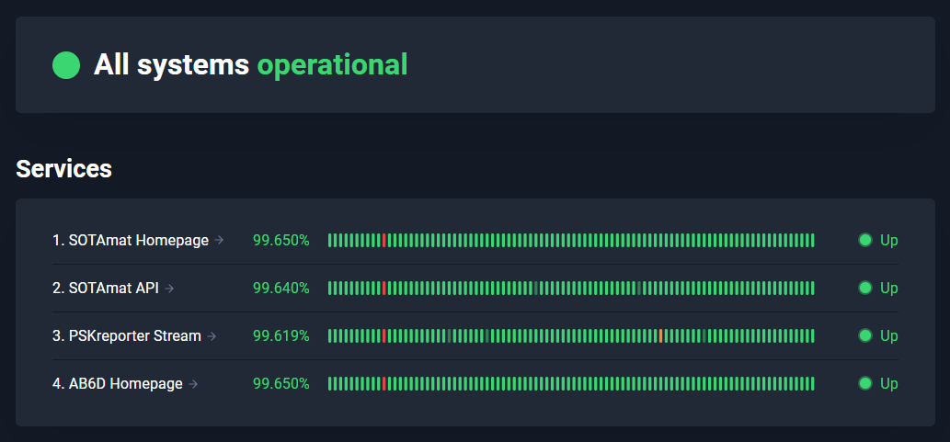
Tips & Tricks 1/2
No spot after 6 minutes. What to do?
Check your settings (e.g. FT8 mode)
Check your system time and corresponding correction in SOTAmāt
Send it again, for redundancy, several times, maybe on another band
Once you have internet access, check the SOTAmāt status page

Slide 26
Tips & Tricks 2/2
Quickly switch between FT8 and spotting frequency/mode:
Toggle between VFO A/B
Toggle between VFO and FT8 memory
Adjust FT8 audio level:
Stay below the max. power output or watch ALC
You can use a special call sign, by adding it temporarily to the corresponding region
Dedicated test mode available

Slide 27
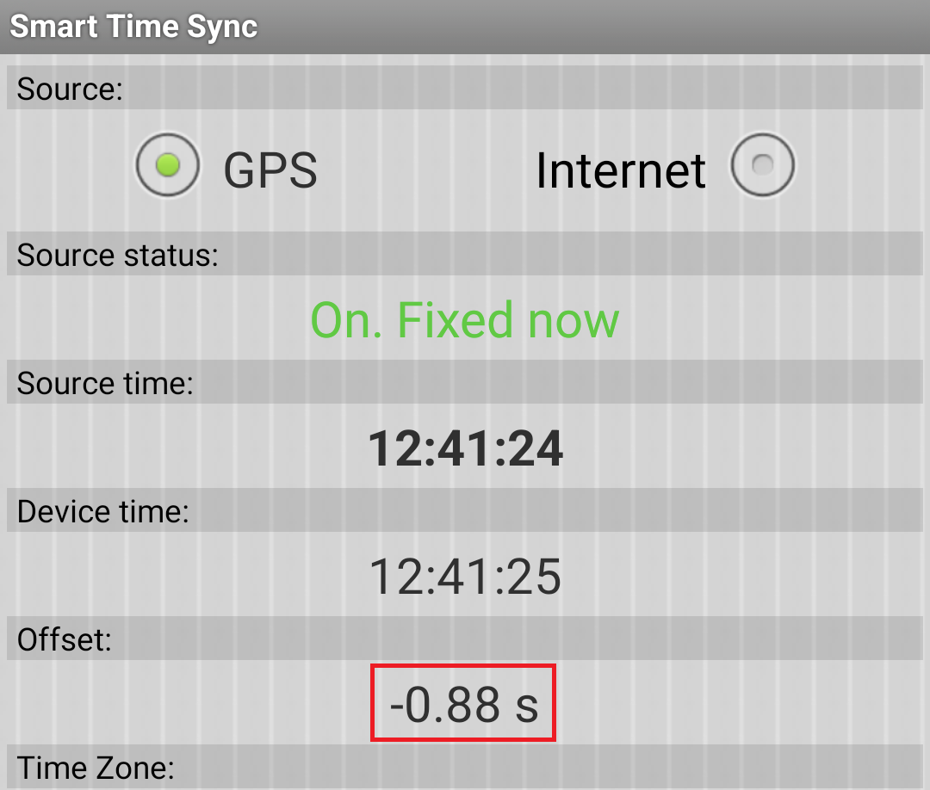
Tips & Tricks 3/3
Correct system time difference:
Do it "by ear" or with an app like Smart Time Sync (Android) supporting GPS time
Correct app time in the opposite direction

Slide 28
SOTAmāt Outlook
The app code will be made open source
The server code will be donated (in escrow) to the SOTA and POTA organizations
More skimmers will support SOTAmāt and you can be one of them (e.g. by running the WSJT-X plugin)!
More features are planned to be implemented, like custom comments, WWFF, ...

Slide 29
Questions?

Slide 30
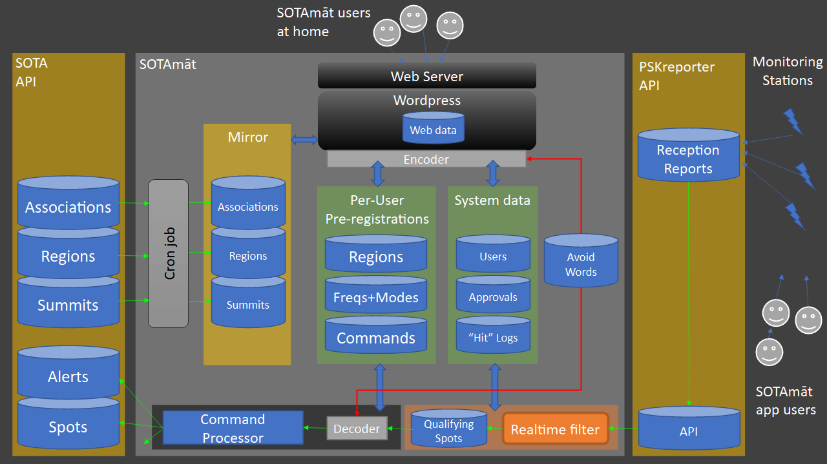
System Overview

