Slide 1

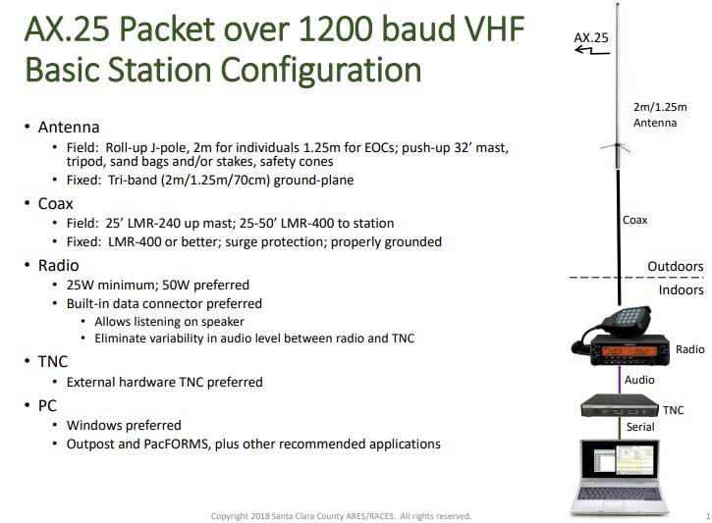
VARA-FM Station Similarity to SCC Packet:
VARA-FM over 25 Kbaud UHF
Tune to 433.33 MHz
USB Sound Card
VARA-FM,
VARA Chat
JCN. 12/27/23

Slide 2
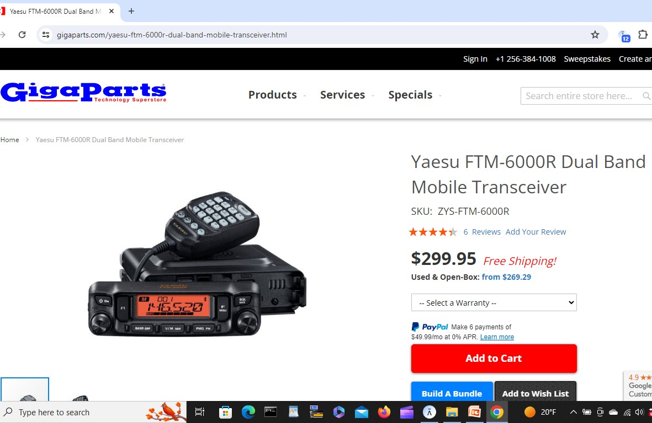
SJ EOC VARA-FM Station Recommendations:
USE A DEDICATED RADIO AND ANTENNA, 50W RF POWER OUTPUT, SUPERHET RECEIVER, WITH OUT-OF BAND FILTERING (NOT CHEAP CLONE RADIO). RECOMMEND YAESU FTM 6000R RADIO:
JCN. 1/5/24

Slide 3
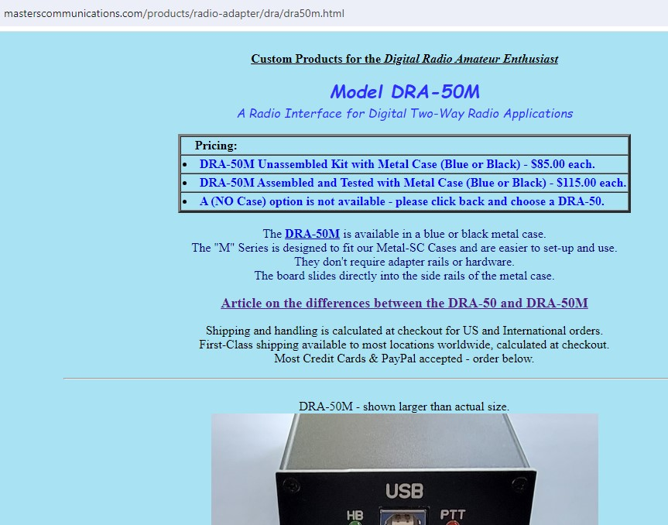
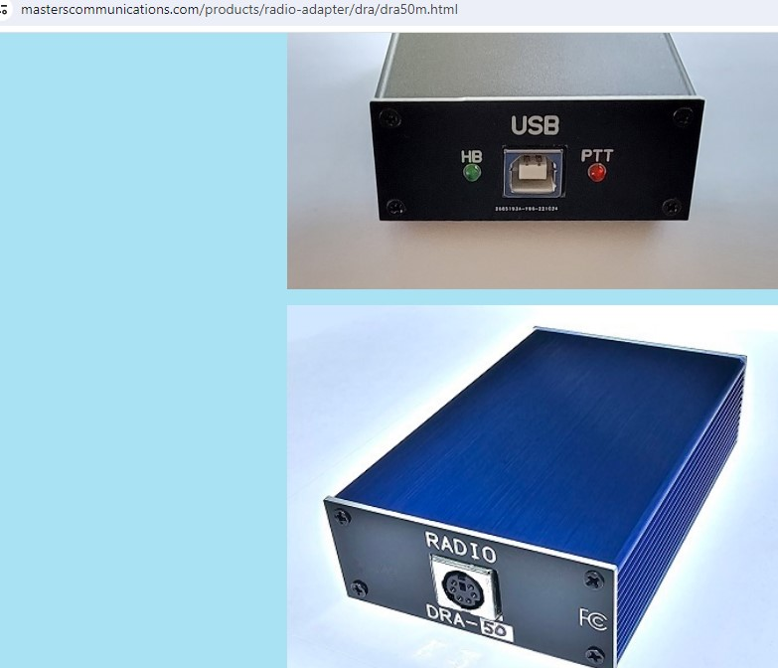
Recommended VARA-FM Station
USB Sound Card (“Digital Radio Adapter”):
JCN. 1/5/24

Slide 4
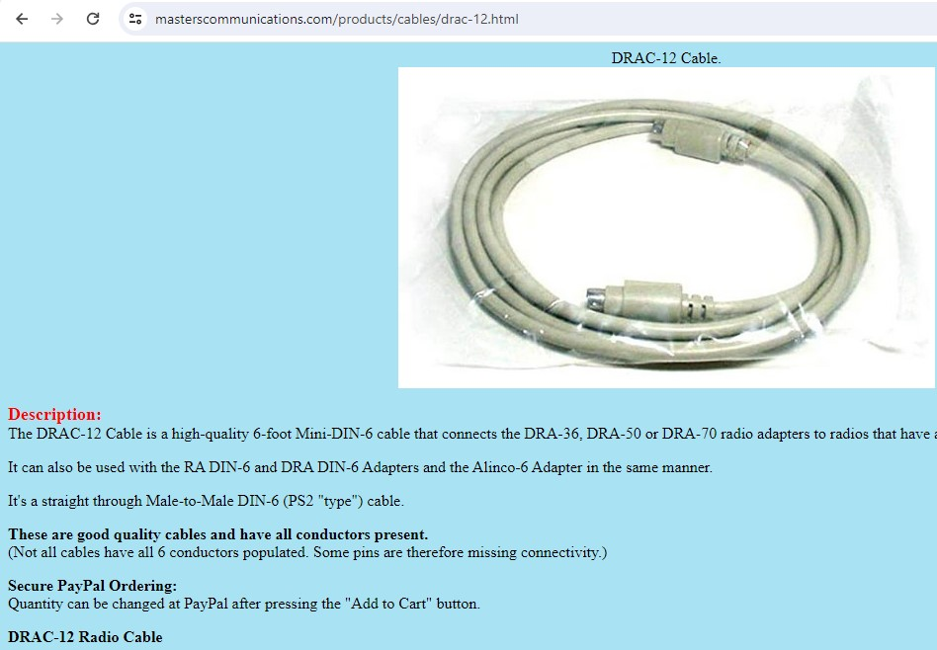
VARA-FM Station USB Sound Card
Kenwood D-710 Radio Interface Cable:
JCN. 1/5/24

Slide 5
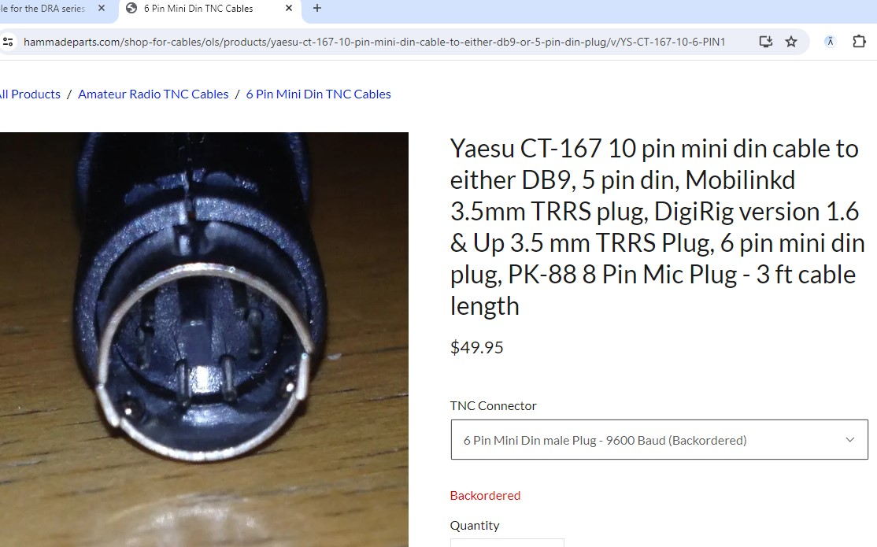
VARA-FM Station USB Sound Card
Yaesu FTM 6000R Radio Interface Cable:
JCN. 1/5/24

Slide 6
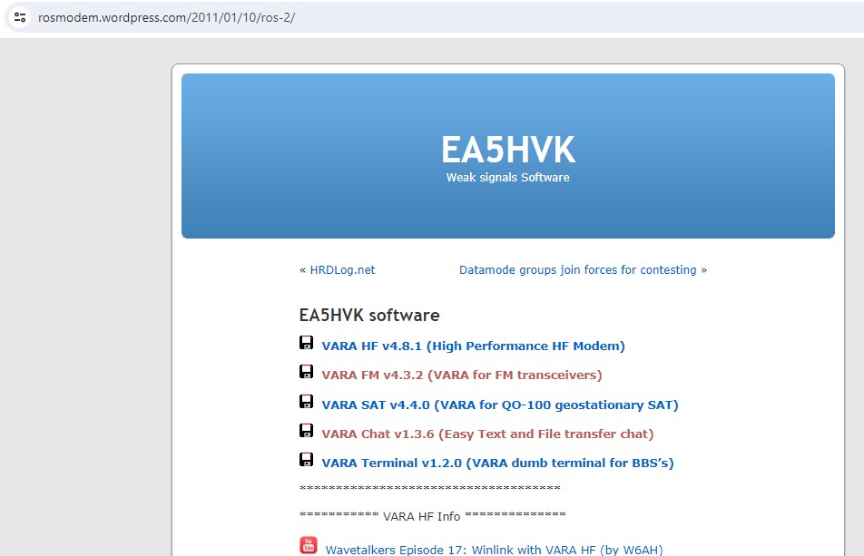
EA5HVK VARA Software (Windows Only) Download:
This is the “MODEM” Application
This is the “Operator Interface” Application
JCN. 1/7/24

Slide 7
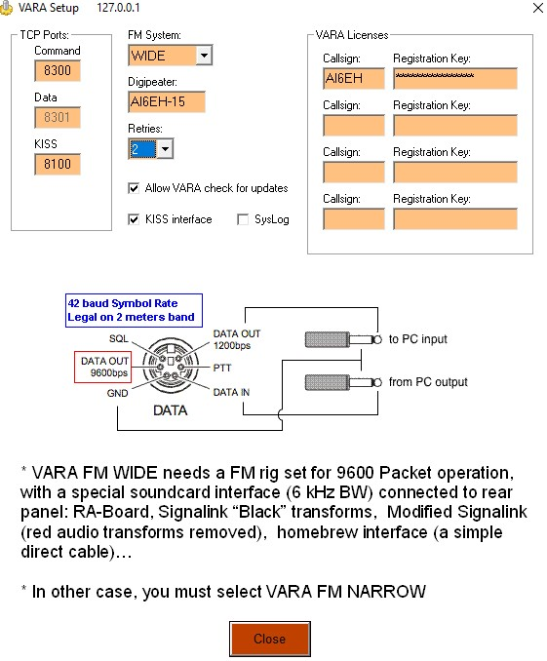
VARA-FM Software Configuration Example:
JCN. 1/5/24

Slide 8
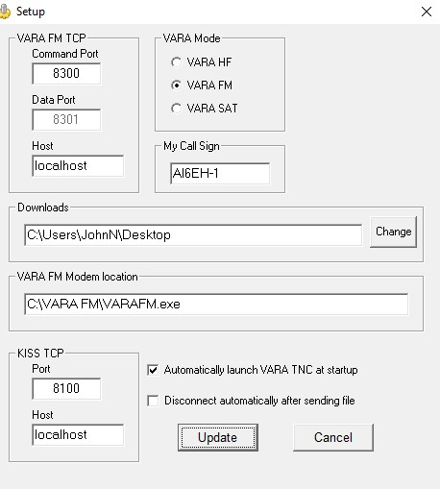
VARA-Chat Software Configuration Example:
This is Where Files Sent to You are Stored
JCN. 1/5/24

Slide 9
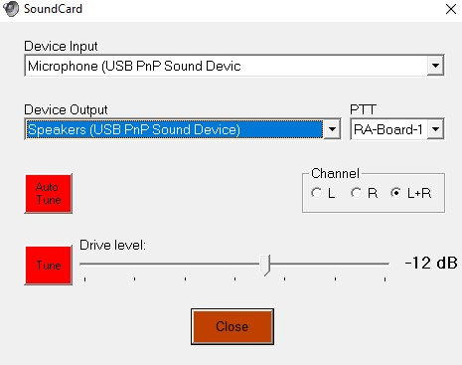
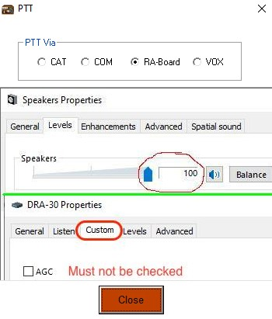
VARA-FM Software Configuration Soundcard & PTT Examples:
Since the Radio Interface is a USB “Soundcard” make sure both these say “USB”
Radio “Push-To-Talk” is keyed by the Digital Radio Adapter (“Soundcard”)
You Can Let the VARA-FM Software Set your Transmit Audio Level by Connecting with Another Station. (This is Very Slick!)
JCN. 1/5/24

Slide 10
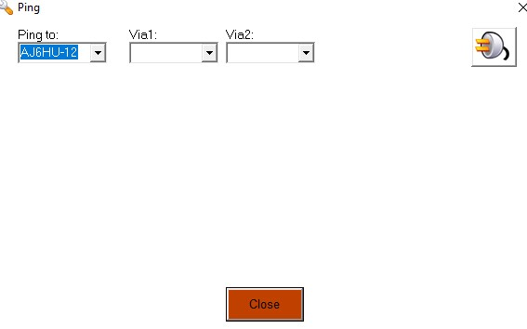
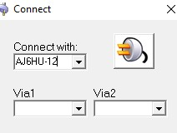
VARA-FM Software Ping & Connect Examples:
You Can Get a Signal Report by “Pinging” a Station before Connecting with them.
(This is the “EXECUTE” Button)
You Can “DIGIPEAT” thru one or two Intermediate Stations (at Lower Throughput)
JCN. 1/5/24

Slide 11
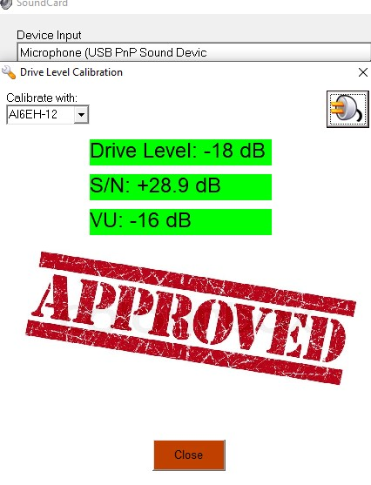
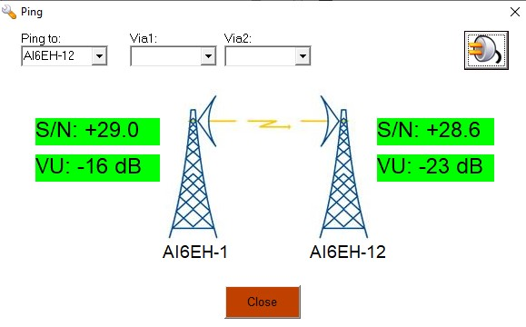
VARA-FM Software Ping & AutoTune Results:
JCN. 1/5/24

Slide 12
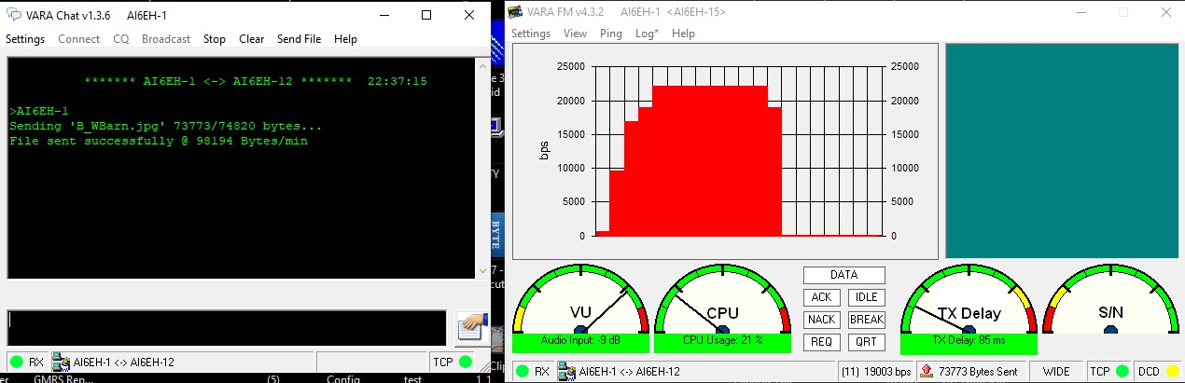
VARA Chat File Transfer Results:
JCN. 1/5/24

Slide 13
How to Use VARA:
Generally:
THINK OF SENDING A FAX, POINT-TO-POINT
LISTEN ON THE RADIO CHANNEL BEFORE TRANSMITTING
NEVER USE A RADIO CHANNEL USED FOR PACKET MESSAGING. (VARA TAKES UP THE WHOLE CHANNEL).
Operating:
USE VARA Chat “BROADCAST” FOR KEYBOARD-TO-KEYBOARD CHAT WITH OTHER STATIONS
USE VARA Chat “BROADCAST” TO ADVISE OTHER STATIONS THAT YOU WILL BE SENDING A FILE
“PING” THE DESTINATION STATION TO MAKE SURE THEY ARE ON-LINE
SELECT “FILE SEND” AND POINT TO THE FILE YOU WANT TO SEND
CLICK ON THE “POWER PLUG” ICON.
JCN. 12/30/23

