Slide 1
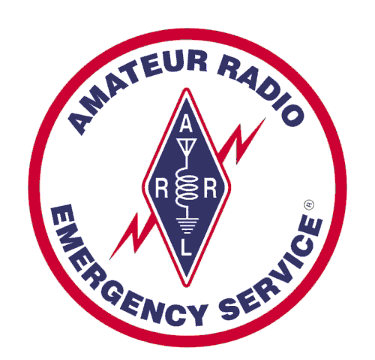


Amateur Radio for
Emergency Managers
Santa Clara County ARES/RACES
Michael Fox, N6MEF, RACES Chief Radio Officer
Revised: 11-Mar-2019

Slide 2
Amateur Radio in Santa Clara County
Santa Clara County
  ~1.8M people
  ~ 8,000 amateur radio licenses
  Many “eyes and ears”
  Most people know someone who
  is an amateur radio operator
SCCo ARES/RACES
  A group within amateur radio focused on emergency comms systems, procedures, equipment
  About 350 weekly check-ins
  Weekly nets, monthly classes, quarterly drills, public service

Slide 3

EOC Operations
#1 disaster response issue:
  Poor communications
A key role & responsibility of an Emergency Operations Center is:
  Information Collection, Evaluation, Dissemination

Slide 4
Amateur Radio in EOC Operations
Amateur Radio can help:
Communications
  Create the capability where it don’t normally exist
  Provide backup capability where existing systems have failed
Information collection and dissemination

Slide 5
The Standardized Emergency Management System (SEMS)
State EOC
State
Region
Regional EOC
County EOC
Operational Area
DOCs
City EOC
Local Government
DOCs
Field
Schools
Shelters
Unincorporated
Neighborhoods
Hospitals

Slide 6



How We Think of Communications
Follows the SEMS / NIMS model
Assumptions
  Connectivity will be there when needed
  Communications systems and services (voice, data, video, …) will be there when needed
Region/State EOC
OA EOC
Local EOC
DOC
Field

Slide 7
Reality Is More Complicated
Services:
Phone
E-mail
Files
WebEOC
Other
Connectivity (Land Lines, Mobile, Cable, WiFi, …)
Redundant
Broadband
Perhaps
little or no
connectivity
Possibly
limited
bandwidth
Broadband
Region/State EOC
OA EOC
Local EOC
DOC
Field

Slide 8
Possible Connectivity Problems
Connectivity may not be available at some locations
      Ex: Parks and other field locations
Connectivity can fail at any time, even without a local disaster
    Ex: Equipment, human error, hacking, terrorism, …
Services:
Phone
E-mail
Files
WebEOC
Other
Connectivity (Land Lines, Mobile, Cable, WiFi, …)
Redundant
Broadband
Perhaps
little or no
connectivity
Possibly
limited
bandwidth
Broadband
Region/State EOC
OA EOC
Local EOC
DOC
Field

Slide 9
Possible Service Problems
Services:
Phone
E-mail
Files
WebEOC
Other
Connectivity (Land Lines, Mobile, Cable, WiFi, …)
Redundant
Broadband
Perhaps
little or no
connectivity
Possibly
limited
bandwidth
Broadband
Connectivity at the service provider can fail
Systems that provide the services can fail
May have nothing to do with our own local situation
  Ex: Equipment, human error, hacking, terrorism, …
Region/State EOC
OA EOC
Local EOC
DOC
Field

Slide 10
Amateur Radio Can Help
When communications at a field site doesn’t normally exist …
Or, when existing systems are degraded or disabled …
Amateur radio doesn’t replace these systems
But it can help fill in some of the gaps
Region/State EOC
OA EOC
Local EOC
DOC
Field

Slide 11
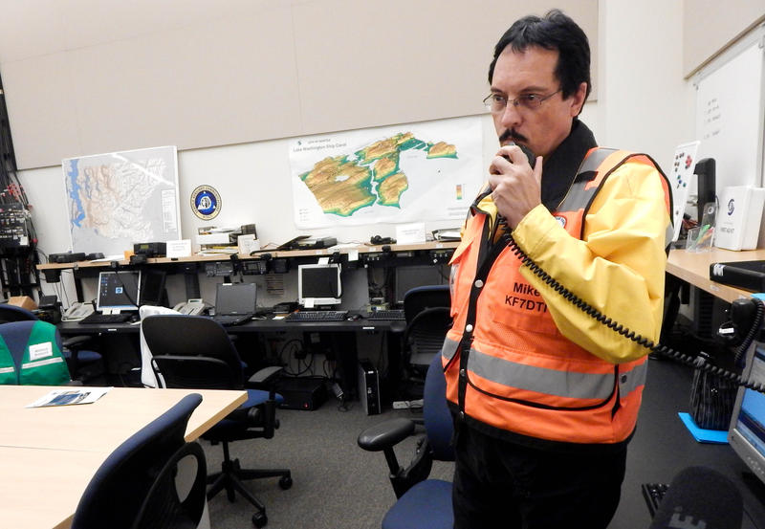
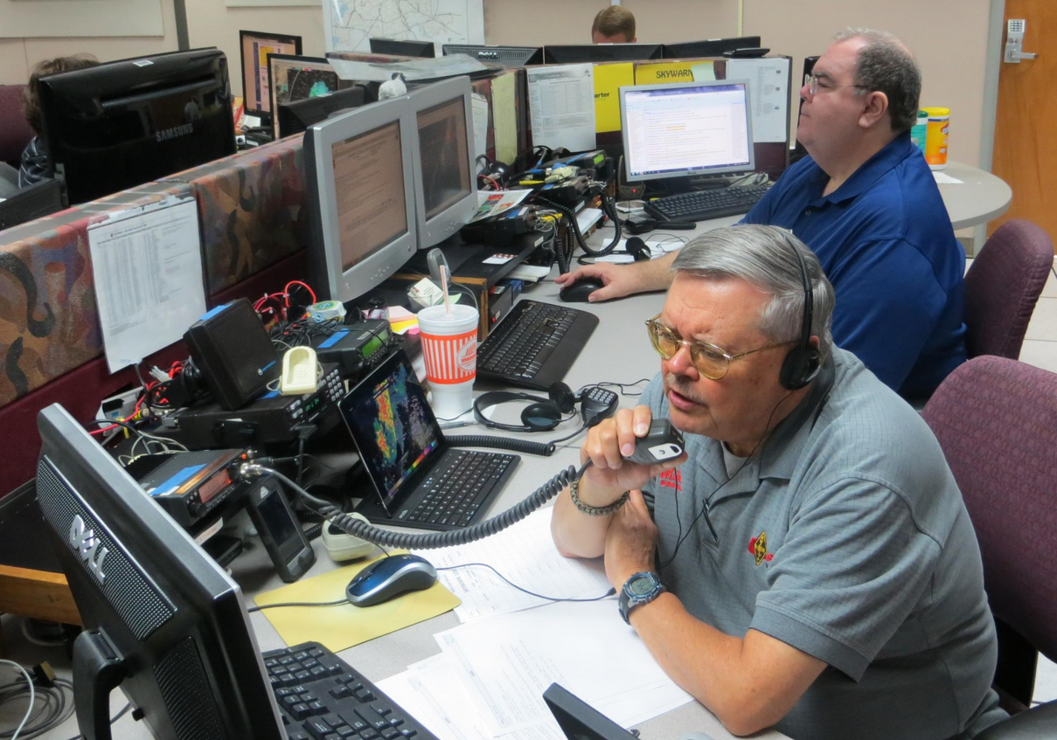
Amateur Radio Provides
Voice AND Data Communications
When most people think of “amateur radio”, they think of voice communications …
Today, we use a mixture of voice and data communications …
In Santa Clara County, we leverage data communications for increased speed, accuracy and alignment with served agency needs

Slide 12
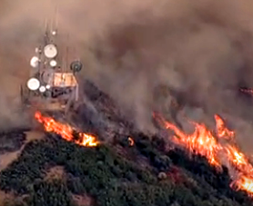
“When All Else Fails”
Crystal Peak – North Tower
2016 Loma Fire
  Commercial power failed
  Generator at radio site failed
  Roads closed; no access to bring backup generator
  Internet service provider networks failed
  Most private communications systems failed
Santa Clara County ARES/RACES network continued to run
  Provided temp, humidity, smoke sensor info to other site tenants
  Used to send/receive Internet email while ISP networks were down
Source: NBC

Slide 13
2017 Wine Country Fires
Mendocino:
Fire destroyed AT&T cable between Ukiah and Willits
Loss of E-911, cellular, landline, cable and most broadband services
Cash only; no ATM machines, credit card readers, …
Sheriff Allman: relying on amateur radio for hospital communications
In Napa and Sonoma:
Electrical service cut off during initial wind storm
Widespread loss of cell service and other communications
Loss of communications at hospitals, shelters, …
Amateur Radio Response:
Local radio amateurs deployed to EOCs, medical centers, nursing homes, Red Cross shelters, high schools, …
Coordinated delivery of food, bedding, shelter supplies, donations

Slide 14
Amateur Radio in EOC Operations
Amateur Radio can help:
Communications
  Create the capability where it don’t normally exist
  Provide backup capability where existing systems have failed
Information collection and dissemination

Slide 15
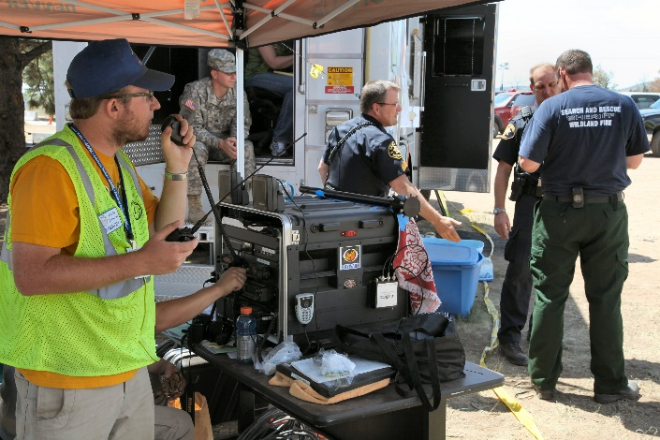
Information Collection
Information needs to be collected from places that lack communications
Field
DOC
EOC
Amateur Radio
Can provide communications at schools, shelters, hospitals, neighborhoods and for groups such as CERT, Red Cross, CADRE, and others.
Report on situation, collect status, make requests

Slide 16
Example:
Earthquake Damage Reports

Slide 17


Earthquake Damage Reports
DOC
EOC
Santa Clara County amateur radio operators are trained how to send in damage reports using the Modified Mercalli Scale
Quickly establishes a county-wide picture of where and how much damage has occurred

Slide 18
Example:
Schools / Local EOC

Slide 19
Example: Schools / Local EOC
Schools report to school district; school districts report to city EOC
  Status (damage, injuries, …), resource requests, H&W
Amateur Radio:
  School districts to city EOC (primary or backup)
  Schools to school districts (backup)
School District
Office(s)
Business
Radio
Amateur
Radio
EOC
Schools
School
District
Operator
Amateur
Radio
Operator
Amateur
Radio
Operator

Slide 20
Example:
Neighborhoods / Local EOC
Mountain View CERT and ARES/RACES (Amateur Radio)

Slide 21
Example: Neighborhoods / Local EOC
Community Emergency Response Teams report to neighborhood command posts; CP reports to city EOC
  Damage assessment
Amateur Radio: neighborhood CP to EOC
Neighborhood
Incident Command Posts
FRS or MURS
Radio
Amateur
Radio
EOC
CERT
Teams
CERT
Operator
Amateur
Radio
Operator
Amateur
Radio
Operator

Slide 22
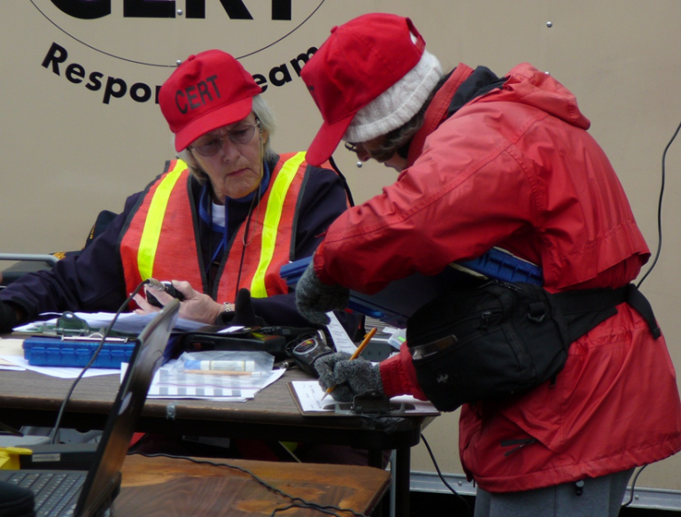
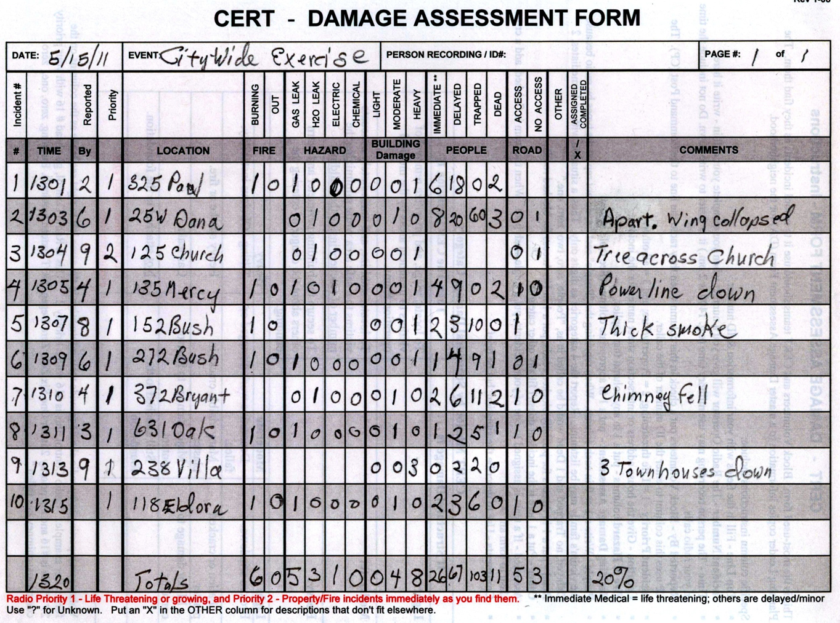
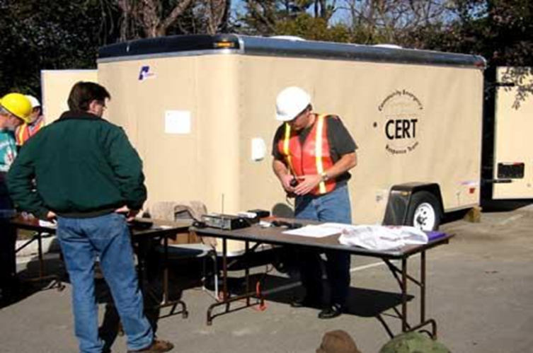
CERT Collects Neighborhood Data

Slide 23
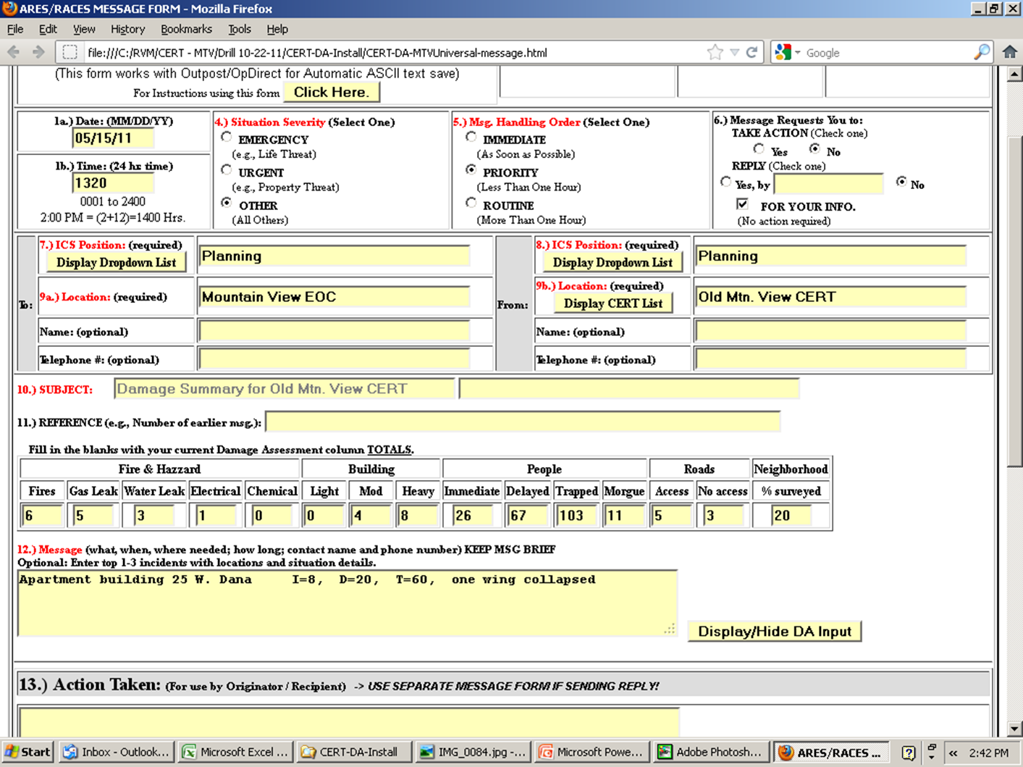
Summary Data Ready to Transmit

Slide 24
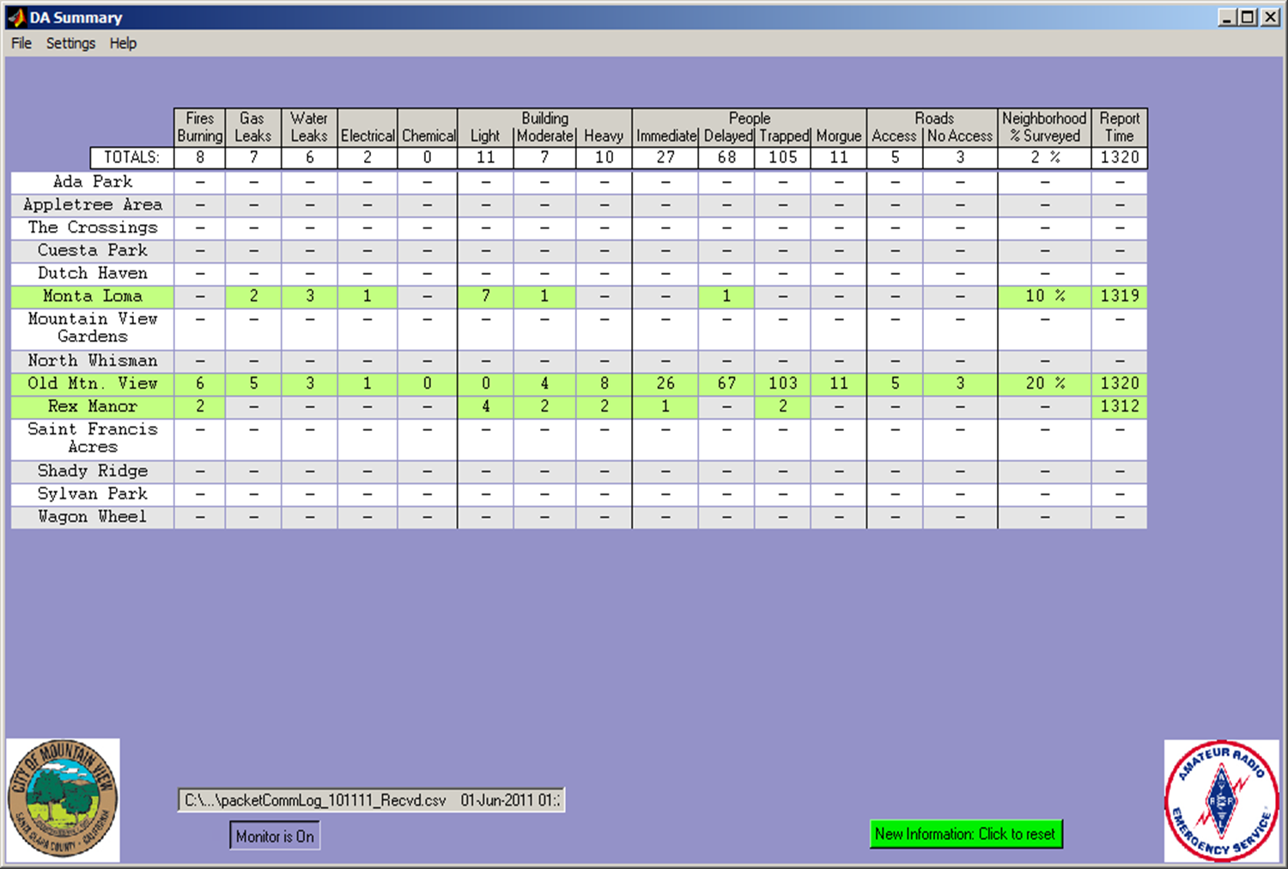
Summary Displayed in Mountain View EOC

Slide 25
Example:
Hospitals, Allied Health
Various health-specific forms or other messages

Slide 26
Example: Hospitals, Allied Health
Medical info is reported to MHJOC; municipal issues are reported to the city EOC; OA EOC supports both
  Bed status, facility status, resource requests, municipal issues
Amateur Radio:
  Hospital to (MHJOC or City EOC) to OA EOC
  Support for Allied Health facilities is new
Hospital
Medical Health
Joint Operation Center
Amateur Radio
OA EOC
Amateur Radio Operator
Amateur
Radio
Operator
Allied Health
City EOC
Amateur Radio
Amateur Radio Operator

Slide 27
Example:
City EOC / County EOC
EOC 213RR Resource Request or other messages

Slide 28
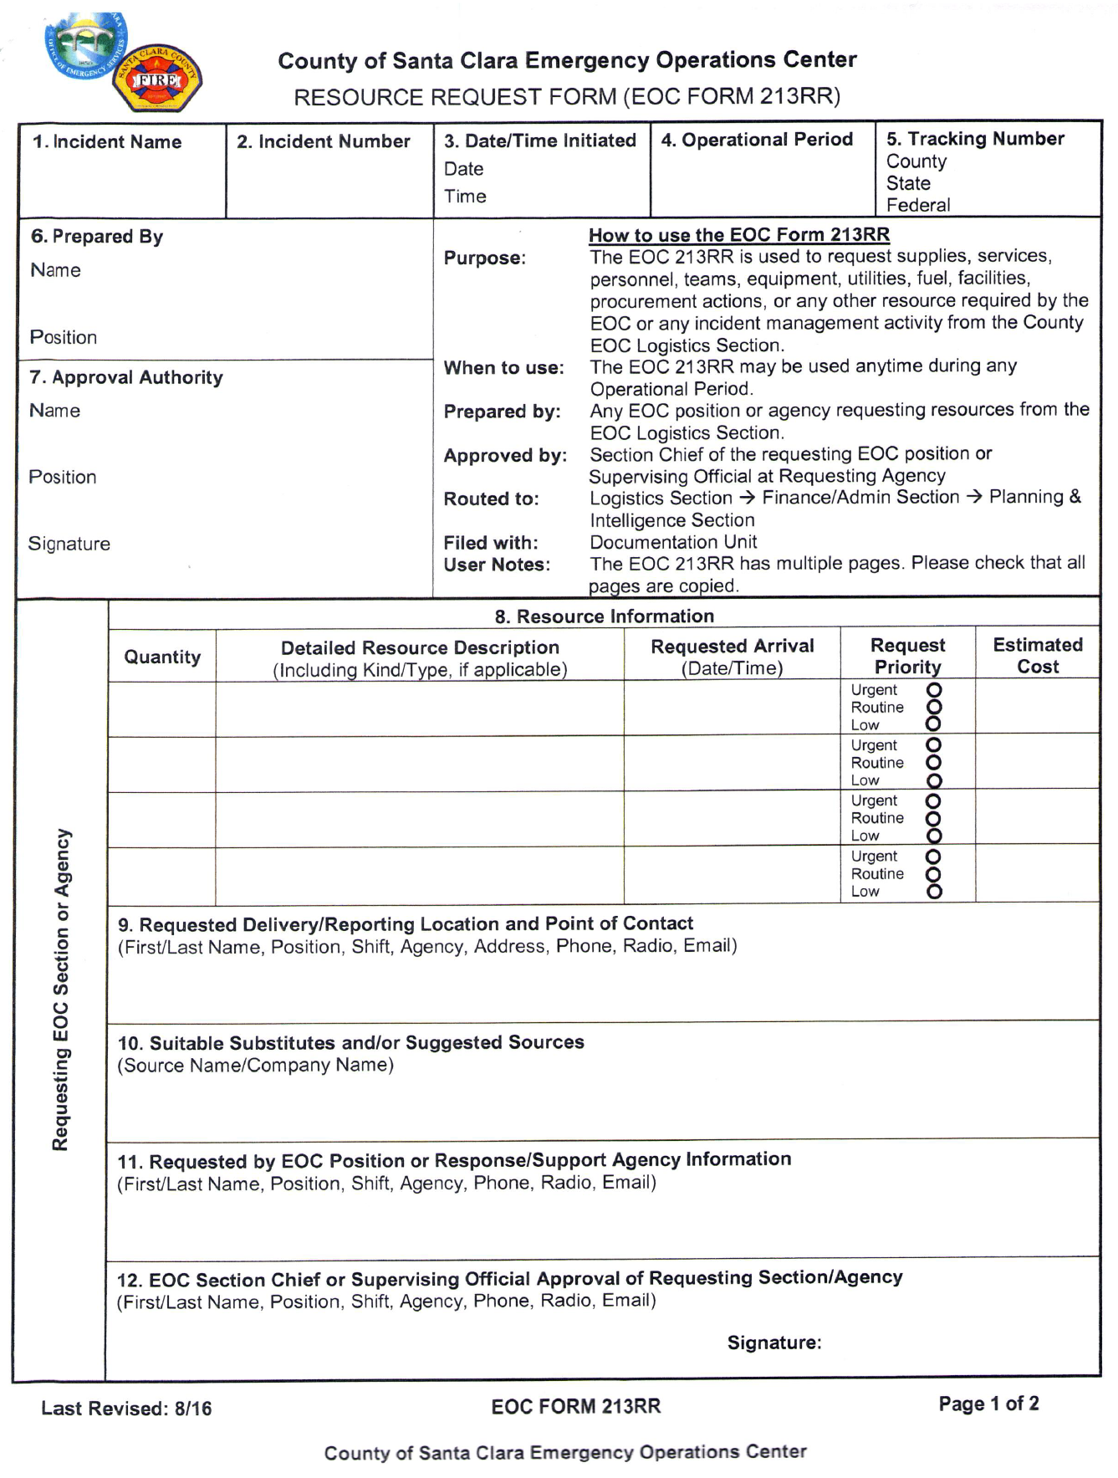
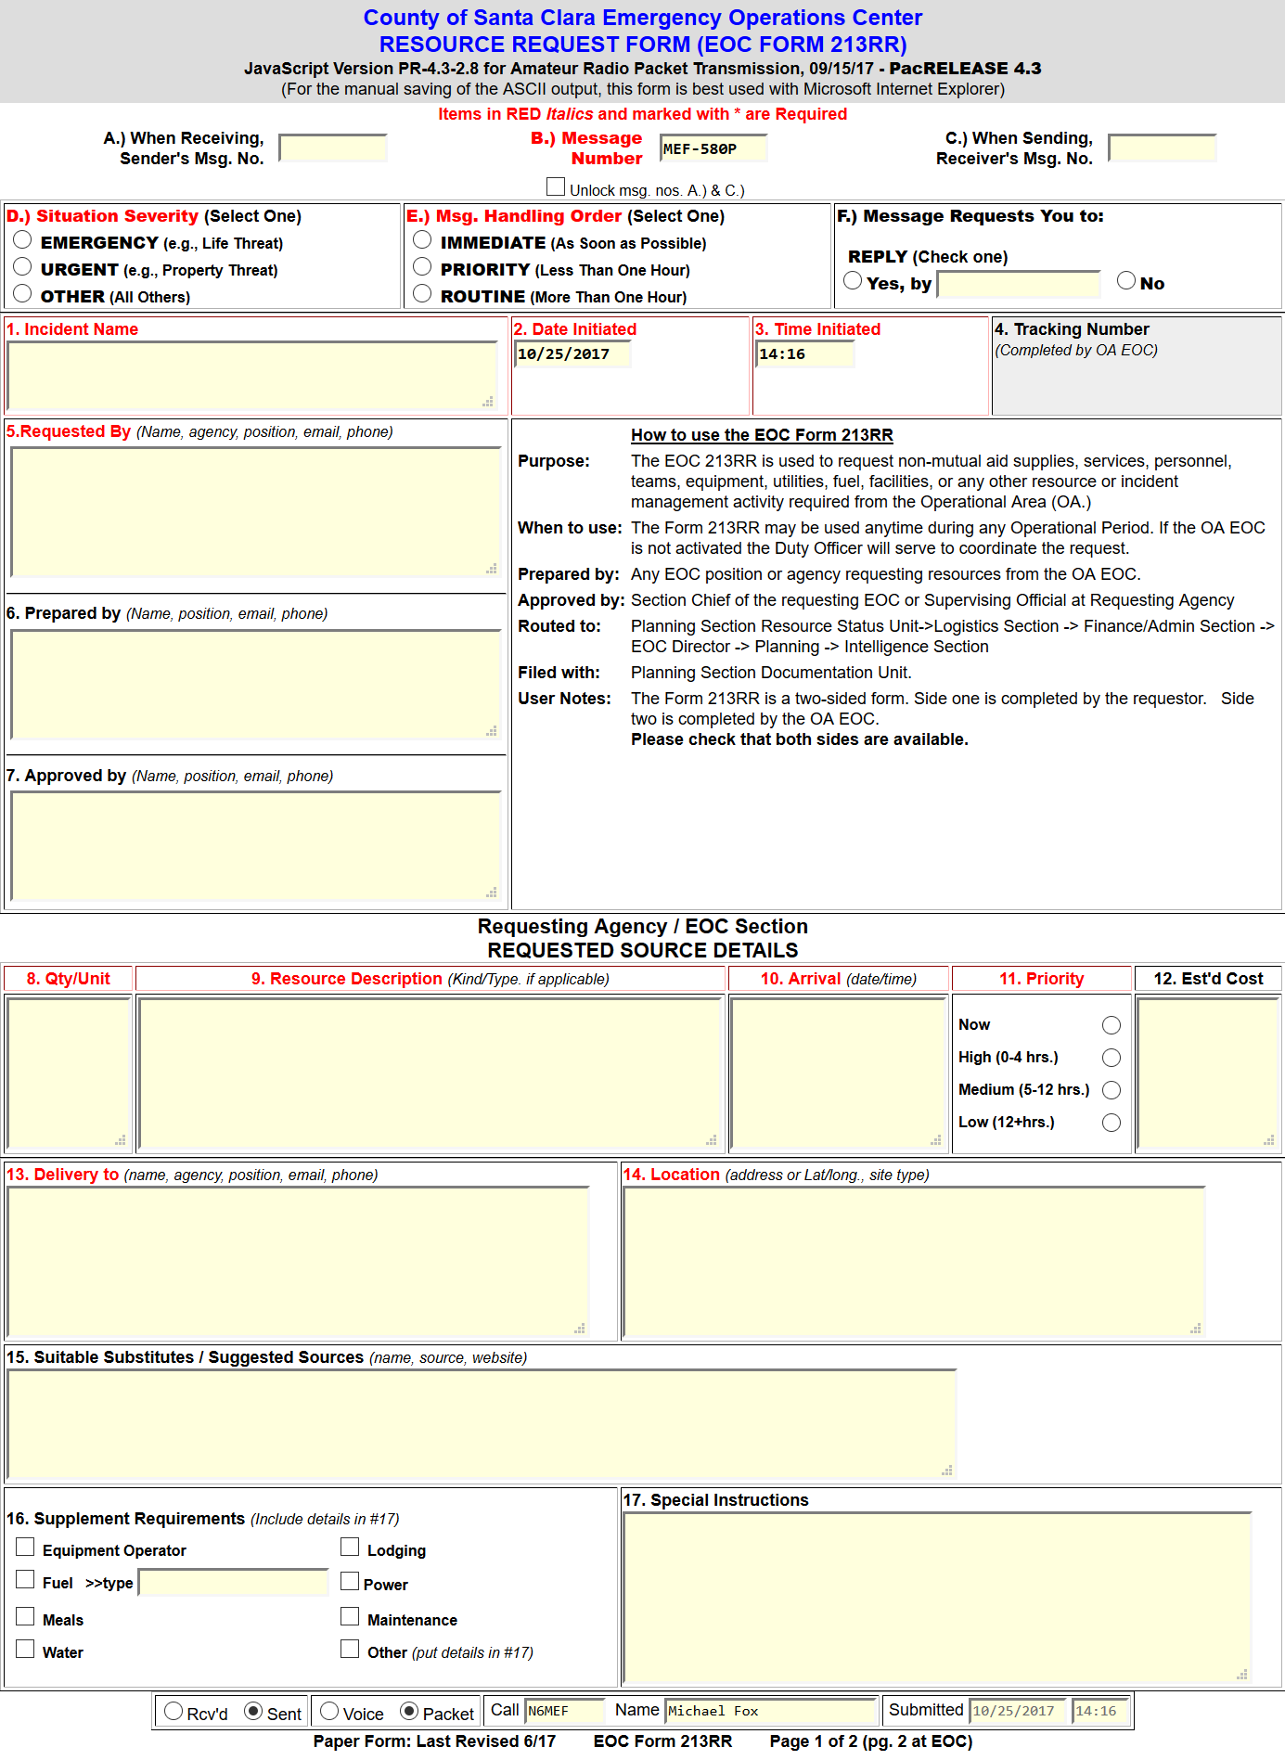

Example: City EOC / County EOC
Scenario:
City EOC needs to send a Resource Request form to the County EOC
Connectivity to WebEOC not available at one or both ends
City EOC
OA EOC
Fill Out Paper Form
Deliver
City EOC radio operator sends form
County EOC radio operator receives form
Give to
amateur
radio
operator
Transmit via radio from anywhere in the county
Print Form

Slide 29
Example:
Alternate 911
Under development for: Cupertino, Los Altos Hills, Saratoga

Slide 30
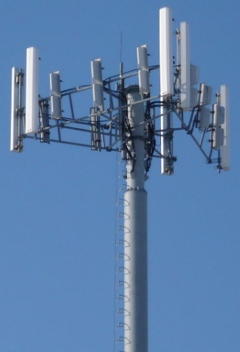


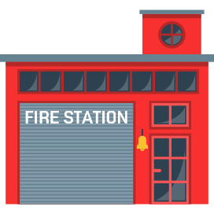


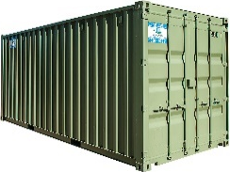
Alternate 911
Dispatch
DOC
EOC
Law,
Fire,
EMS
Issues
Local
Gov
Issues
Amateur
Radio
Equipped
and Staffed
Fire Station or Ark Location

Slide 31
Information Dissemination
After analysis, synthesis, information can be distributed to field resources and the public
EOC
DOC
Field
Amateur Radio
Can be used to distribute information to schools, shelters, hospitals and groups such as CERT, Red Cross, CADRE, and others.
Press releases and public service announcements can distributed to the general public

Slide 32
Example:
Disseminating info to field responders

Slide 33
Information Dissemination: Field
Situational awareness, common operating picture, resource status, prioritization, analysis, support, …
Amateur radio: each SEMS level
County EOC
City EOC
DOC
Field
Amateur radio operators are trained in message passing techniques (voice and data) which help deliver the message correctly and quickly

Slide 34
Example:
Distributing Information to the Public

Slide 35
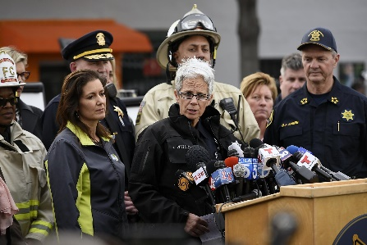

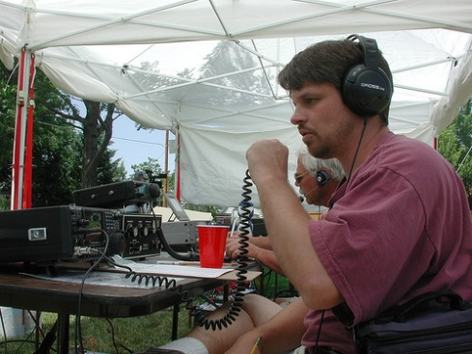
Distributing Public Info
Broadcast
Media
PIO
Social
Media
What about those who don’t have access or where communications systems are damaged?
Schools
Shelters
Neighborhoods
… wherever needed
Amateur
Radio

Slide 36
Example:
Beyond the Op Area

Slide 37
Example: Beyond the Op Area
Communications outside of our operational area is also important
  Who
    Other Operational Areas
    Region and State
    Elsewhere
  Why
    Situational awareness
    Common operating picture
    Resource sharing
    Coordination
    …
Amateur radio can compliment existing communications paths or act as backup during failures
Region/State EOC
Santa Clara Co EOC
Other OA EOC(s)

Slide 38

EOC Readiness: Amateur Radio
Two related but separate questions:
Is your EOC ready for Amateur Radio?
Is Amateur Radio ready at your EOC?

Slide 39

Readiness Assessment
Each city/OA has a Chief Radio Officer
  Manages amateur radio emergency comms efforts
  Best single point of contact for EOC staff
Equipment & facilities
  Do sufficient radios, antennas, computers, etc. exist for simultaneous operations on standard nets?
  Do you have sufficient space allocated? Accessible to/from EOC?
  We have standardized recommendations for city EOCs, hospitals, …
Personnel
  Do you have a sufficient number of amateur radio operators and are they sufficiently trained?
  Are you helping to recruit, encouraging participation, training?
  We have a comprehensive training and credentialing program
Procedures
  Do you have EOC procedures for utilizing amateur radio?
  Do your training, documentation, exercises include amateur radio?

Slide 40

Summary
Amateur radio can help at the EOC with
  Information collection and dissemination
  Communications
    Where it doesn’t normally exist
    Backup where existing systems are degraded or failed
Amateur radio in Santa Clara County
  Standards for people, procedures, equipment
  Robust and active training and exercise schedule
    Weekly nets, monthly classes, quarterly drills
    Public service events (races, parades, …)
  Each jurisdiction should assess readiness, encourage participation
For more information:
  https://www.scc-ares-races.org

